Slide 1
TASTY TREATS
(Spotlight 4)
Слепова К.И.

Slide 2
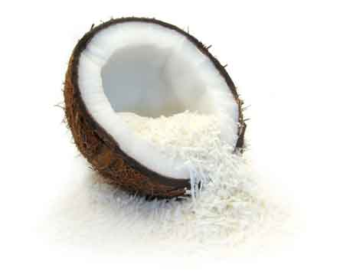
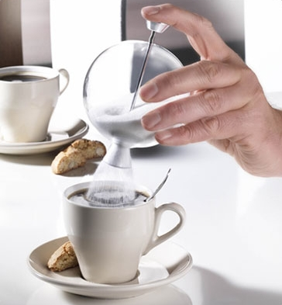
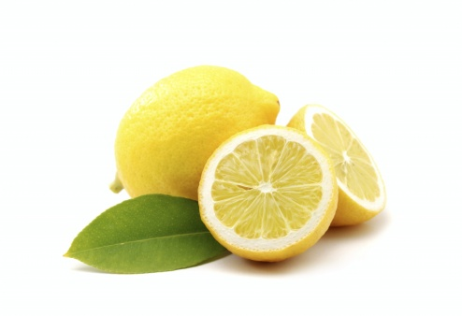
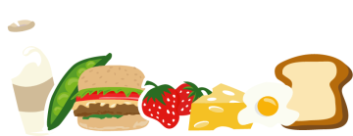
Fill in the missing
letters:
c_c_n_t
o
o
u
s_g_r
u
a
l_m_n
e
o

Slide 3
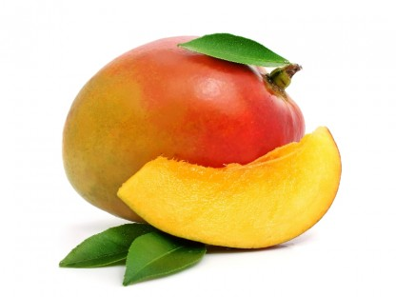
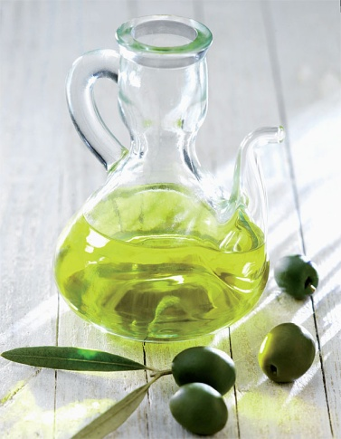
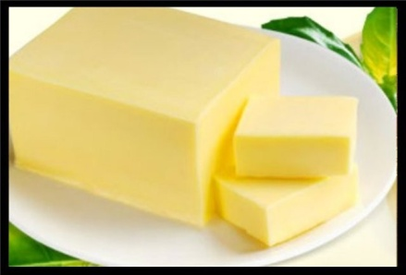
m_n_o
a
g
o_iv_ o_l
l
e
i
b_t_er
u
t

Slide 4
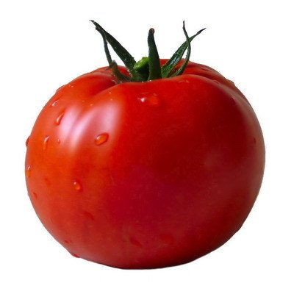
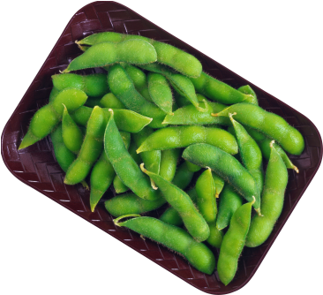
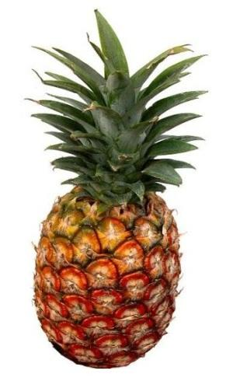
t_m_t_
o
a
o
b_a_s
e
n
p_n_ap_l_
i
e
p
e

Slide 5
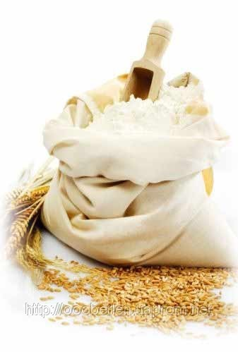
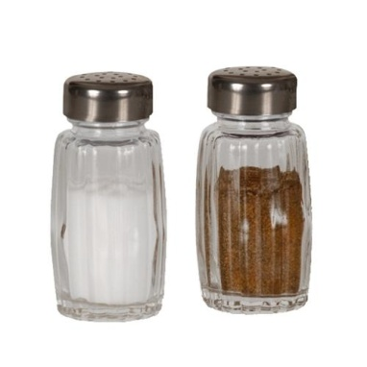
f_o_r
l
u
s_l_
a
t
p_p_e_
e
p
r

Slide 6

Many/much?
many
1.How ………. mangoes are there?
2. How ………. sugar is there in the cake?
3. How ………. eggs are there?
4. How ………. bananas are there on the table?
5. How ………. salt is
there on the shelf?
much
many
many
much

Slide 7
Many/much?
much
6. How ………. olive oil is there in the bottle?
7. How ………. pineapples are there in the box?
8. How ………. butter is there in the fridge?
9. How ………. lemons are there on the table?
many
much
many

Slide 8
lemon
beans
mango
butter
coconut
flour
pineapple
olive oil
sugar
salt
pepper
tomato
ананас
оливковое масло
сахар
бобы
лимон
сливочное масло
кокос
перец
помидор
мука
манго
соль

Slide 9
KEYS:
1 | 2 | 3 | 4 | 5 | 6 | 7 | 8 | 9 | 10 | 11 | 12
e | d | k | f | g | j | a | b | c | l | h | i

Slide 10
Is/Are?
is
There …... some olive oil in the salad.
There …… a lot of potatoes in the box.
There …… some sugar in the tea.
There …… a lot of butter in the fridge.
There …… a lot of tomatoes in the salad.
There …… some flour in the bag.
are
is
is
are
is

Slide 11


