Slide 1
Round the English
- speaking countries

Slide 2
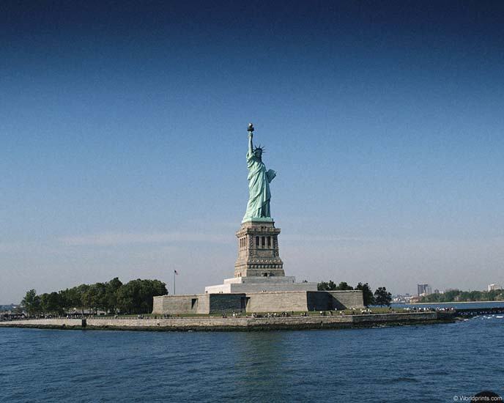
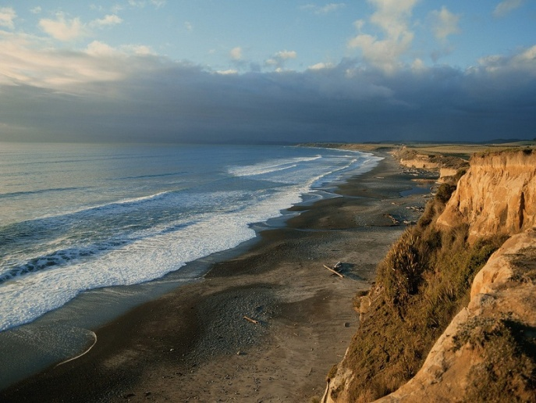

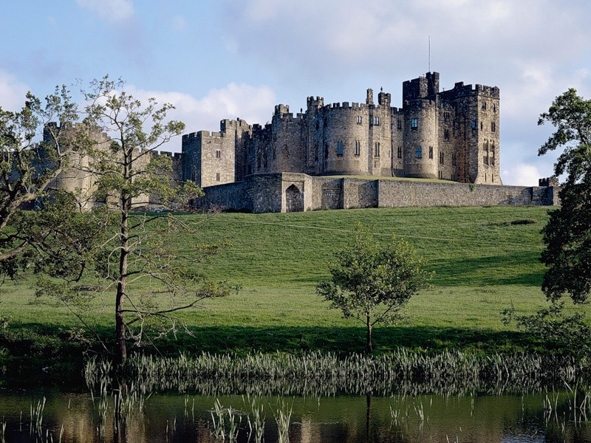




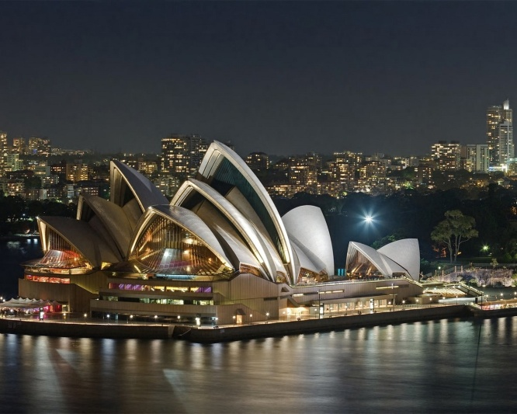
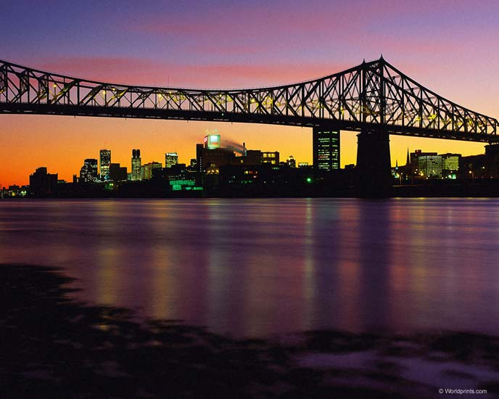
English is the native language in:

Slide 3
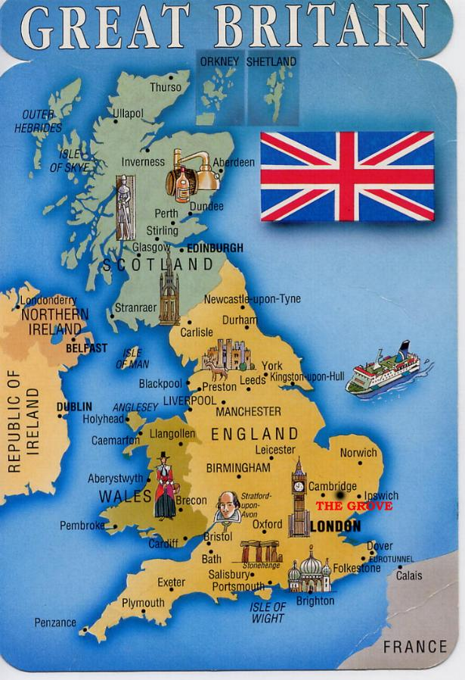
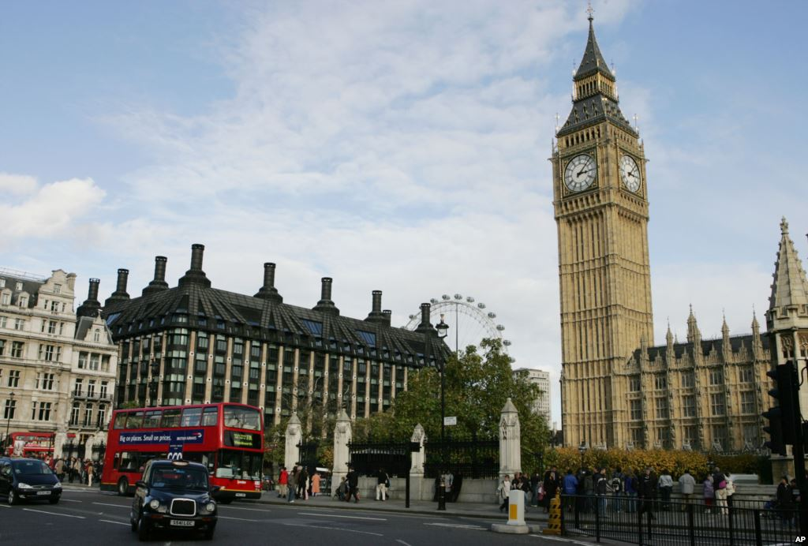
The United Kingdom of
Great Britain and Northern Ireland
The capital of Great Britain is London.
Peoples – the British

Slide 4
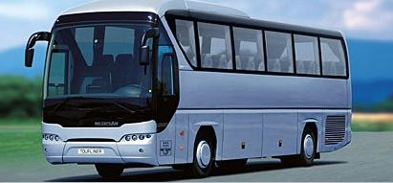
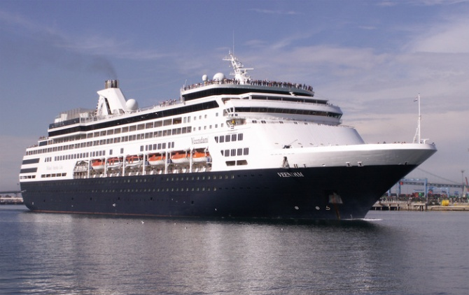
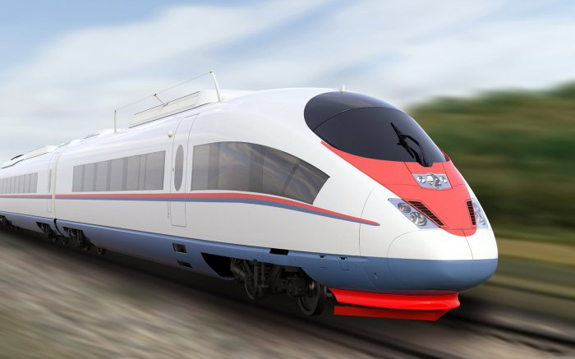
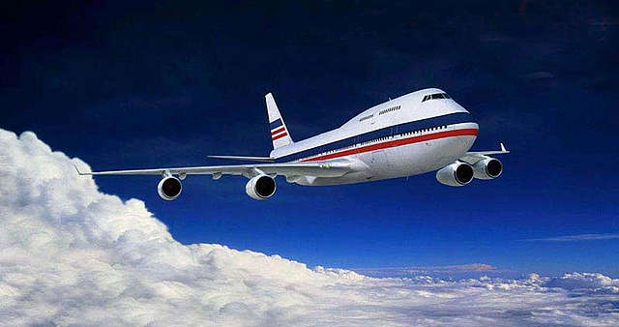
How can we travel?
BY BUS…
BY SHIP…
BY TRAIN …
BY PLANE…
OF COURSE, WE SHOULD CHOOSE PLANE!
QUICK! Comfortable! (expensive, dangerous)

Slide 5
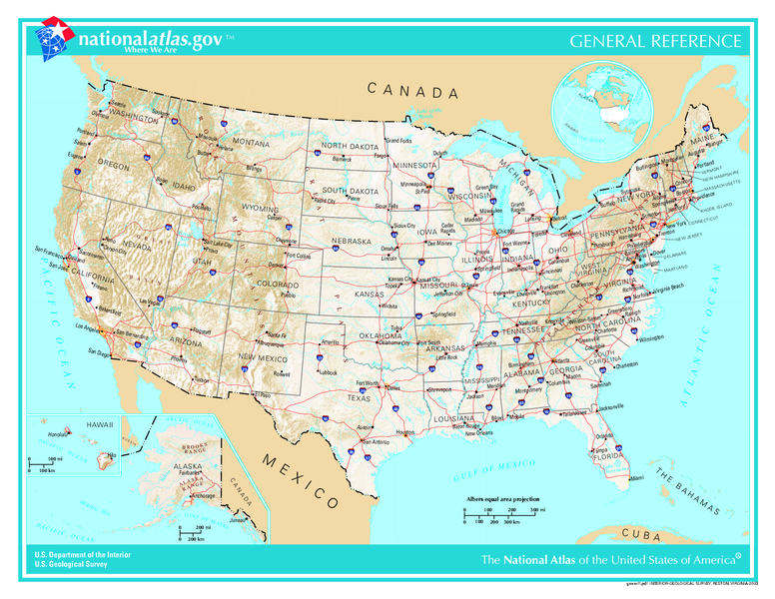

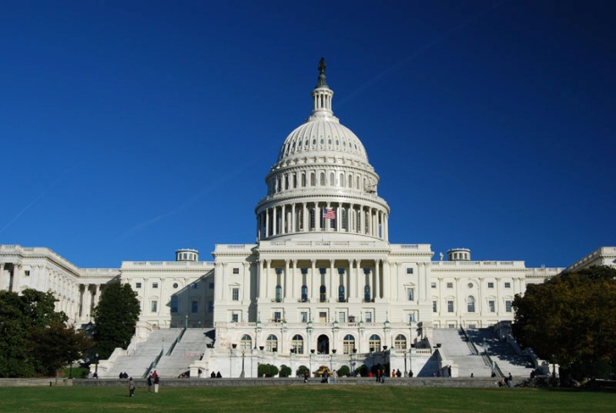
The United States of America
The capital of America is Washington.
Peoples –
the Americans

Slide 6

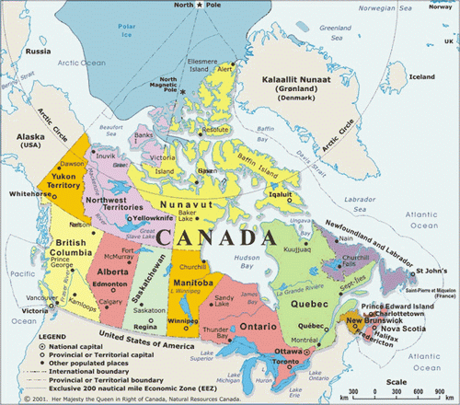
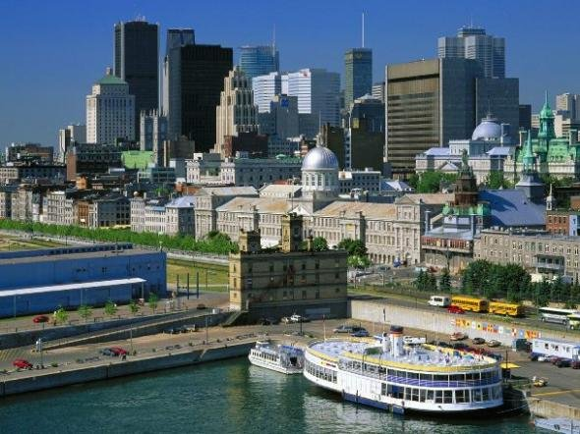
Canada
The capital of Canada is Ottawa
Peoples –
the Canadians

Slide 7

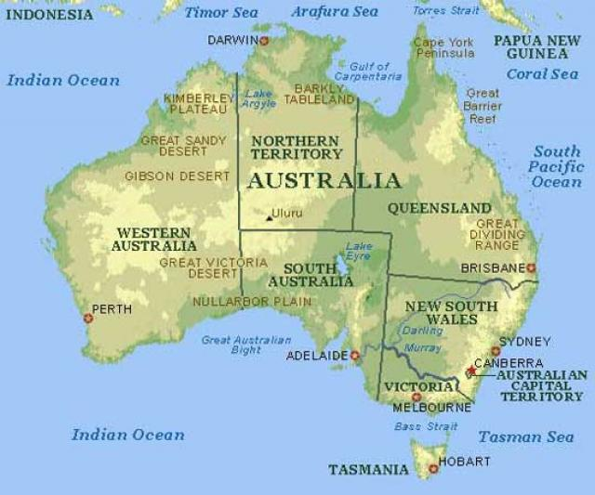
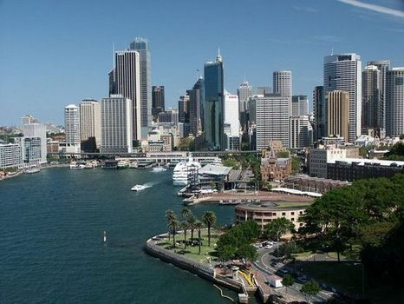
Australia
The capital of Australia is Canberra.
Peoples –
the Australians

Slide 8

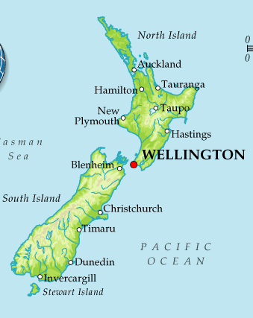
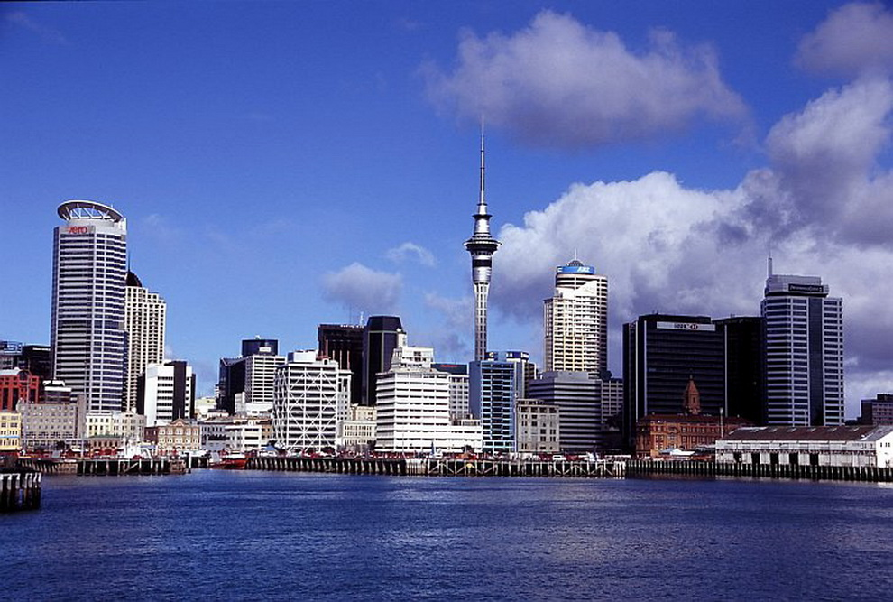
New Zealand
The capital of New Zealand is Wellington.
Peoples –
the New Zealanders

Slide 9
East or West – home is the best

Slide 10
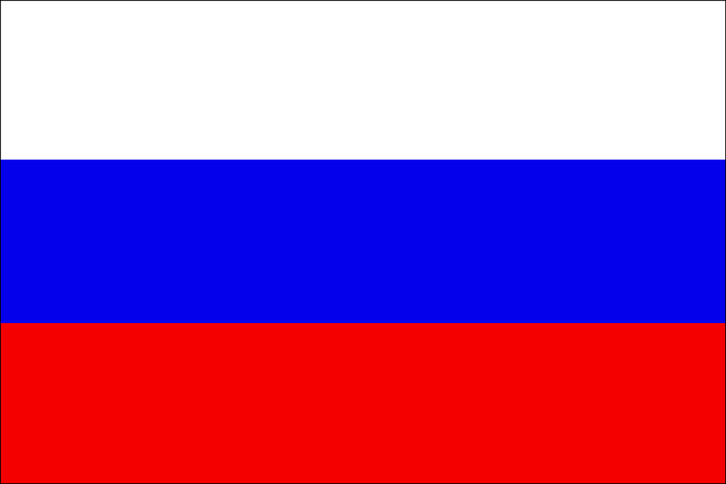
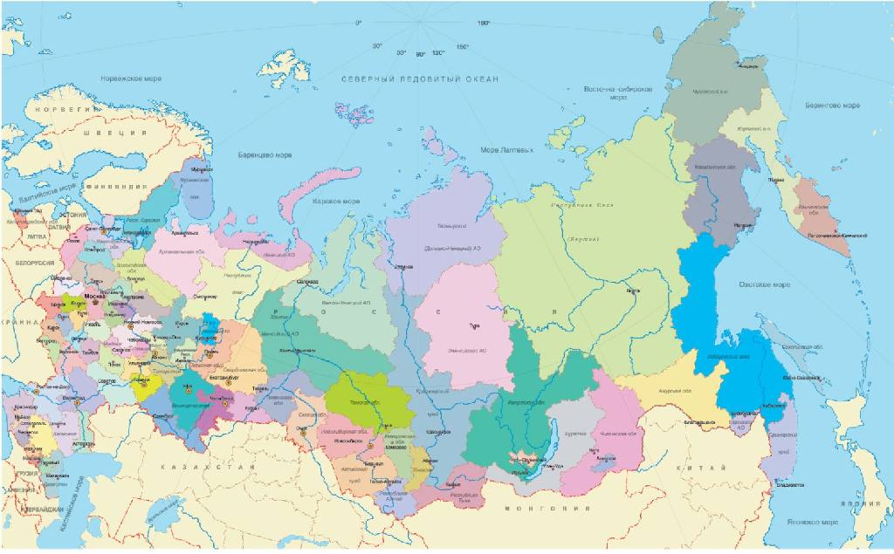
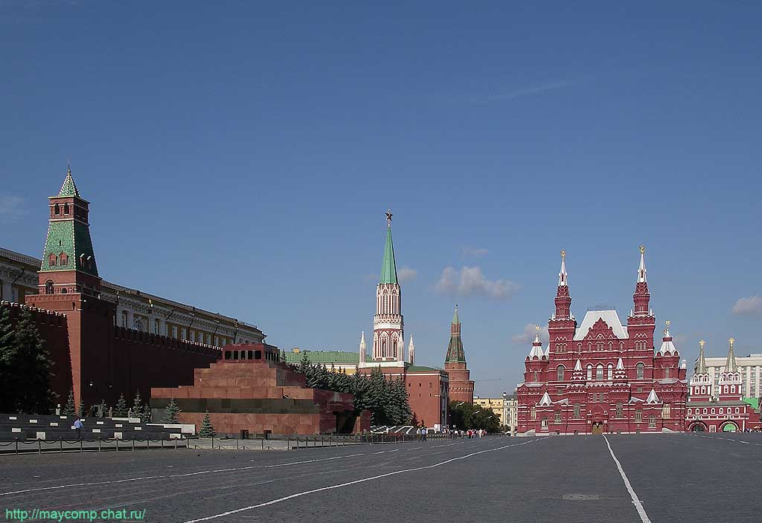
Russia
The capital of Russia is Moscow.
Peoples –
the Russians

Slide 11

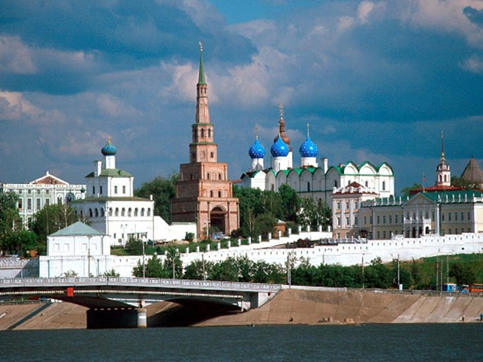
Tatarstan
The capital of Tatarstan is Kazan.

