Slide 1
eating a banana
washing your hair
riding a scooter
playing tennis
painting a picture
picking up rubbish
feeding the fish
washing the window

Slide 2
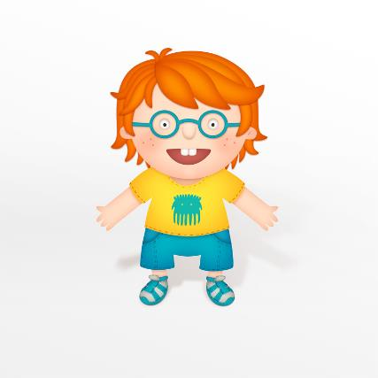
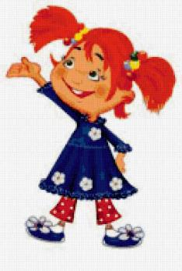
Guessing game
What am I doing?
Are you …?

Slide 3
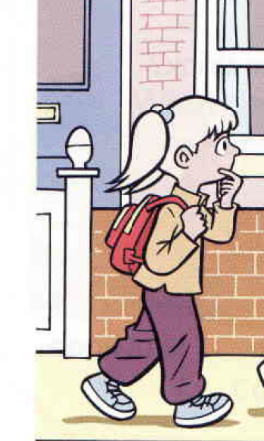
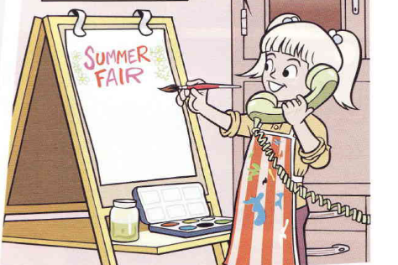
Every day
Megan goes to school.
Now
Megan is painting a poster.

Slide 4
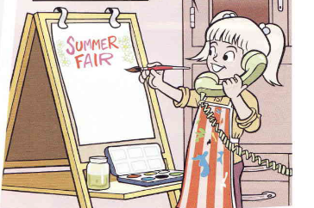
Every day
Megan goes to school.
Now
Megan is painting a poster.
Present Simple

Slide 5
Every day
Megan goes to school.
Now
Megan is painting a poster.
Present Simple
Present
Continuous

Slide 6
Мы используем Present Continuous для действий, которые происходят …
Мы используем Present Simple для … действий

Slide 7
Мы используем Present Continuous для действий, которые происходят …
Мы используем Present Simple для повторяющихся действий.

Slide 8
Мы используем Present Continuous для действий, которые происходят сейчас.
Мы используем Present Simple для повторяющихся действий.

Slide 10
is walking with the dog.

Slide 11
is walking with the dog.
Is feeding the cat.

Slide 12
is walking with the dog.
Is feeding the cat.
is cooking.

Slide 13
is walking with the dog.
Is feeding the cat.
is cooking.
is working in the garden.

Slide 14
is walking with the dog.
Is feeding the cat.
is cooking.
is working in the garden.
is washing the dishes.

Slide 15
usually
always
every day
every morning
every afternoon
now
every evening
every week

Slide 16
usually
always
every day
every morning
every afternoon
now
every evening
every week

Slide 17
usually
always
every day
every morning
every afternoon
now
every evening
every week

Slide 18
usually
always
every day
every morning
every afternoon
now
every evening
every week

Slide 19
usually
always
every day
every morning
every afternoon
now
every evening
every week

Slide 20
usually
always
every day
every morning
every afternoon
now
every evening
every week

Slide 21
usually
always
every day
every morning
every afternoon
now
every evening
every week

Slide 22
usually
always
every day
every morning
every afternoon
now
every evening
every week

Slide 23
usually
always
every day
every morning
every afternoon
now
every evening
every week

Slide 24
today
every month
on Mondays
at weekends
at the moment
at 10 o’clock

Slide 25
today
every month
on Mondays
at weekends
at the moment
at 10 o’clock

Slide 26
today
every month
on Mondays
at weekends
at the moment
at 10 o’clock

Slide 27
today
every month
on Mondays
at weekends
at the moment
at 10 o’clock

Slide 28
today
every month
on Mondays
at weekends
at the moment
at 10 o’clock

Slide 29
today
every month
on Mondays
at weekends
at the moment
at 10 o’clock

Slide 30
today
every month
on Mondays
at weekends
at the moment
at 10 o’clock

Slide 31
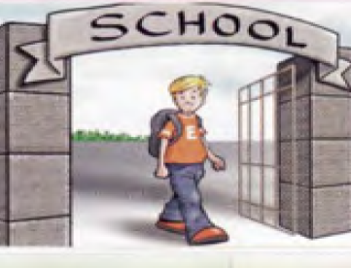
Usually \ Bob\ ride a bike
Today \ Bob\ walk

Slide 32
Usually \ Bob\ ride a bike
Today \ Bob\ walk
Usually Bob rides a bike.

Slide 33
Usually \ Bob\ ride a bike
Today \ Bob\ walk
Usually Bob rides a bike.
Today Bob is walking.

Slide 34
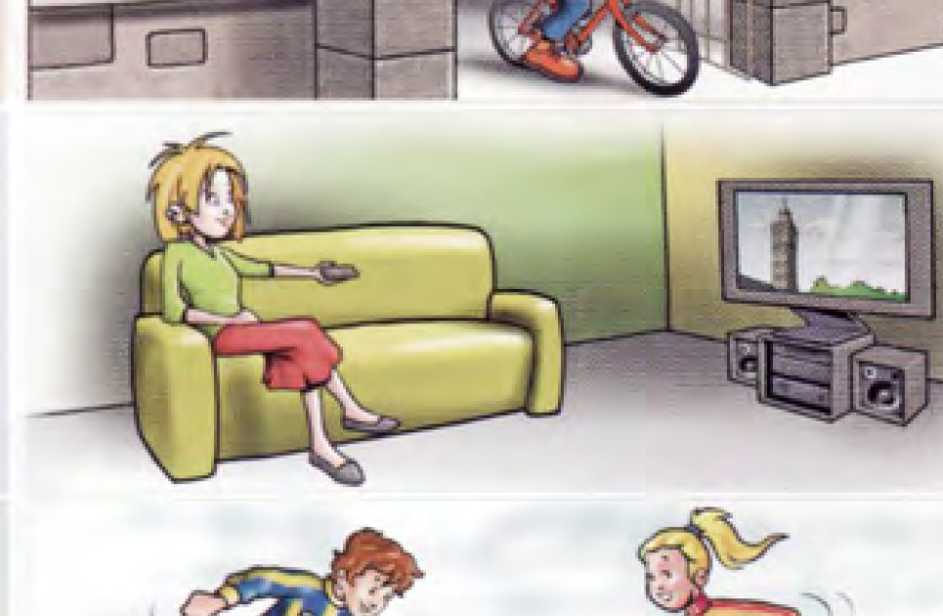
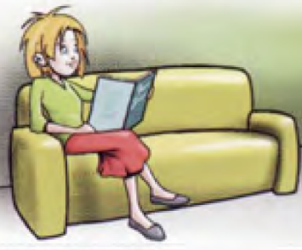
Usually \ Ann\ watch TV
Today \ Ann\ read a book

Slide 35
Usually \ Ann\ watch TV
Today \ Ann\ read a book
Usually Ann watches TV.

Slide 36
Usually \ Ann\ watch TV
Today \ Ann\ read a book
Today Ann is reading a book.
Usually Ann watches TV.

Slide 37
I can make sentences in Present Simple and Present Continuous.
2. I know new words ( usually, always …)
3. My work is good.

Slide 38
I can make sentences in Present Simple and Present Continuous. Yes.
2. I know new words ( usually, always …).
3. My work is good.

Slide 39
I can make sentences in Present Simple and Present Continuous. Yes.
2. I know new words ( usually, always …). Yes.
3. My work is good.

Slide 40
I can make sentences in Present Simple and Present Continuous. Yes.
2. I know new words ( usually, always …) Yes.
3. My work is good. Yes.

Slide 41
Well done!

