Slide 1
Do you know Britain?
Учитель английского языка
МБОУ СОШ №3 ст. Фастовецкая
Бражникова Татьяна Размиковна

Slide 2
What people lived on the british Isles in the early days of history?

Slide 3
What country isn’t situated in great Britain?

Slide 4
Big Ben is …

Slide 5
Where did english people come from?

Slide 6
Where does English language come from?

Slide 7
The british flag is often called…

Slide 8
Oliver Cromwell was…

Slide 9
The capital of Northern Ireland is…

Slide 10
Where is the Poet’s Corner situated?

Slide 11
Madam tussaud’s is a museum of ….

Slide 12
Sir Christopher wren was …

Slide 13
How many countries does the UK consist of?

Slide 14
British children take GCSR exams at the age of …

Slide 15
British teenagers take A-level exams at the age of…

Slide 16
How old is London?

Slide 17
Nelson’s column is situated in

Slide 18
What’s a traditional british food?

Slide 19
The first invaders of the british isles were…

Slide 20
The Tower of London now is ….

Slide 21
What is a symbol of england?

Slide 22
Who stands at the head of the Uk?

Slide 23
What currency is used in britain?

Slide 24
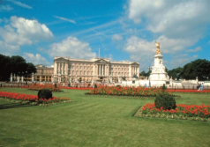
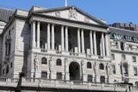
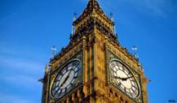
What is the oldest building in London?

Slide 25
Downing Street, 10 - is the address of …

Slide 26
Covent garden is …

Slide 27
Speakers corner is in…

Slide 28
Which football club is English?

Slide 29
Sir christopher wren built…

Slide 30
How long has Elizabeth been on the throne?

Slide 31
What is the City?

