Slide 1
Решение систем уравнений
второй степени

Slide 2
Способы решения
систем уравнений второй степени:
графический
подстановки
алгебраического сложения
введения новой переменной

Slide 3
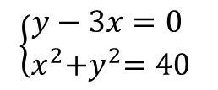
Способом подстановки решить систему $\left\{\begin{aligned}y−3x=0 \\ {x^{2}+y}^{2}=40\end{aligned}\right.$.
$y−3x=0$
$$y=3x$$
$$3x$$
$$\left\{\begin{aligned}y−3x=0 \\ x^{2}{+y}^{2}=40\end{aligned}\right.$$
$$⇔ \left\{\begin{aligned}y=3x \\ x^{2}{+y}^{2}=40\end{aligned} \right.$$
$$⇔ \left\{\begin{aligned}y=3x \\ x^{2}{+(3x)}^{2}=40\end{aligned} \right.$$
$$⇔ \left\{\begin{aligned}y=3x \\ x^{2}{+9x}^{2}=40\end{aligned}\right.$$
$$y$$
$$3x$$
$$x^{2}{+9x}^{2}=40$$
$$⇔\left\{\begin{aligned}y=3x \\ {10x}^{2}=40\end{aligned}\right.$$
$$⇔ \left\{\begin{aligned}y=3x \\ x^{2}=4 \end{aligned}\right.⇔\left\{\begin{aligned}y=3x \\ x=±2 \end{aligned}\right.$$
$${10x}^{2}=40$$
$$\left\{\begin{aligned}x=−2 \\ y=3∙(−2)\end{aligned}\right.$$
$$\left\{\begin{aligned}x=2 \\ y=6\end{aligned}\right.$$
$$\left\{\begin{aligned}x=−2 \\ y=−6\end{aligned}\right.$$
$$\left\{\begin{aligned}x=2 \\ y=3∙2\end{aligned}\right.$$
Ответ: $\left(2;6\right), (−2;−6)$.

Slide 4
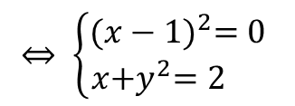
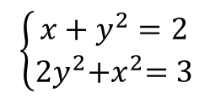
Способом сложения решить систему $\left\{\begin{aligned}x+y^{2}=2 \\ {2y}^{2}+x^{2}=3\end{aligned}\right.$.
$$\left\{\begin{aligned}x+y^{2}=2 \\ {2y}^{2}{+x}^{2}=3\end{aligned}\right.$$
$$\left\{\begin{aligned}−2y^{2}−2x=−4 \\ {2y}^{2}+x^{2}=3 \end{aligned}\right.$$
$$−2y^{2}$$
$$|∙(−2)$$
$${2y}^{2}$$
$$⇔ \left\{\begin{aligned}x^{2}−2x=−1 \\ x{+y}^{2}=2 \end{aligned}\right.$$
$$⇔ \left\{\begin{aligned}x^{2}−2x+1=0 \\ x{+y}^{2}=2 \end{aligned}\right.$$
$$⇔ \left\{\begin{aligned}{(x−1)}^{2}=0 \\ x{+y}^{2}=2 \end{aligned}\right.$$
$$⇔ \left\{\begin{aligned}x=1 \\ x{+y}^{2}=2\end{aligned}\right.$$
$$⇔ \left\{\begin{aligned}x=1 \\ 1{+y}^{2}=2\end{aligned} ⟺\left\{\begin{aligned}x=1 \\ y^{2}=1\end{aligned} ⟺\left\{\begin{aligned}x=1 \\ y=±1\end{aligned}\right.\right.\right.$$
$$1$$
$$1$$
$$1$$
$$y^{2}=1$$
$$1$$
$$1$$
$$1$$
$$y=±1$$
$$−$$
Ответ: $\left(1;1\right), (1;−1)$.

Slide 5
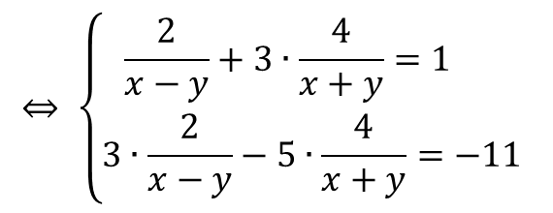
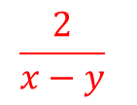

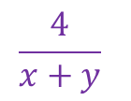

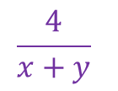
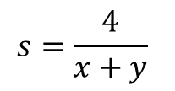

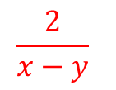

Способом введения новой переменной решить систему.
$$\left\{\begin{aligned}\frac{2}{x−y}+\frac{12}{x+y}=1 \\ \frac{6}{x−y}−\frac{20}{x+y}=−11\end{aligned}\right.$$
$$⇔ \left\{\begin{aligned}\frac{2}{x−y}+3∙\frac{4}{x+y}=1 \\ 3∙\frac{2}{x−y}−5∙\frac{4}{x+y}=−11\end{aligned}\right.$$
$$t=\frac{2}{x−y}$$
$$\frac{2}{x−y}$$
$$\frac{4}{x+y}$$
$$t$$
$$x−y$$
$$x+y$$
$$\frac{2}{x−y}$$
$$\frac{4}{x+y}$$
$$s=\frac{4}{x+y}$$
$$s$$
$$x−y$$
$$x+y$$
$$\left\{\begin{aligned}t+3s=1 \\ 3t−5s=−11\end{aligned}\right.$$
$$1−3s$$
$$⇔ \left\{\begin{aligned}t=1−3s \\ 3(1−3s)−5s=−11\end{aligned}\right.$$
$$⇔ \left\{\begin{aligned}t+3s=1 \\ −14s=−14\end{aligned}\right.$$
$$⇔ \left\{\begin{aligned}t=−2 \\ s=1 \end{aligned}\right.$$
$$3(1−3s)−5s=−11$$
$$\left\{\begin{aligned}\frac{2}{x−y}=−2 \\ \frac{4}{x+y}=1 \end{aligned}\right.$$
$$⇔ \left\{\begin{aligned}x−y=−1 \\ x+y=4 \end{aligned}\right.$$
$$⇔ \left\{\begin{aligned}2x=3 \\ x+y=4\end{aligned}\right.$$
$$⇔ \left\{\begin{aligned}x=1,5 \\ y=2,5\end{aligned}\right.$$
Ответ: $\left(1,5;2,5\right)$.

Slide 6
Способы решения
систем уравнений второй степени:
графический
подстановки
алгебраического сложения
введения новой переменной

