Slide 1
Презентация к учебнику английского языка О.В.Афанасьевой, И.В.Михеевой VI уровень.
Country and People
Учитель английского языка
ГБОУ СОШ № 180 г.Санкт-Петербург
Белоброва Е.Д.

Slide 2
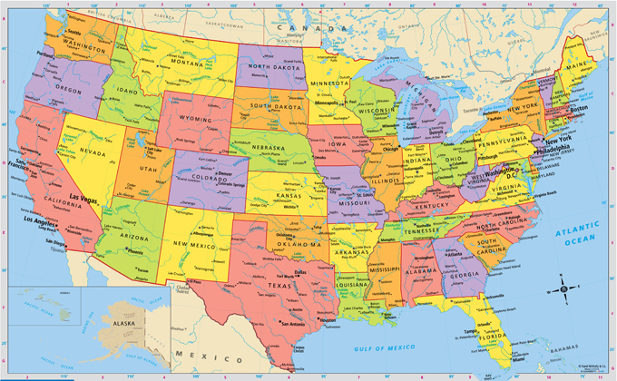

Slide 3
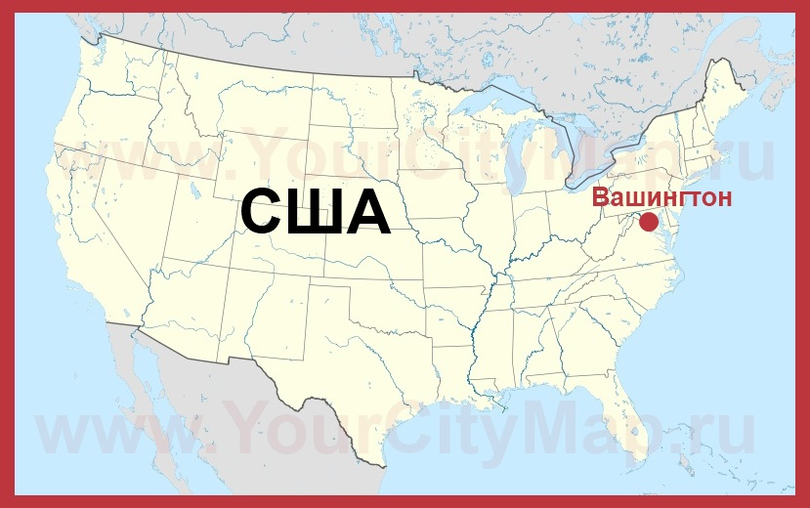

Slide 4
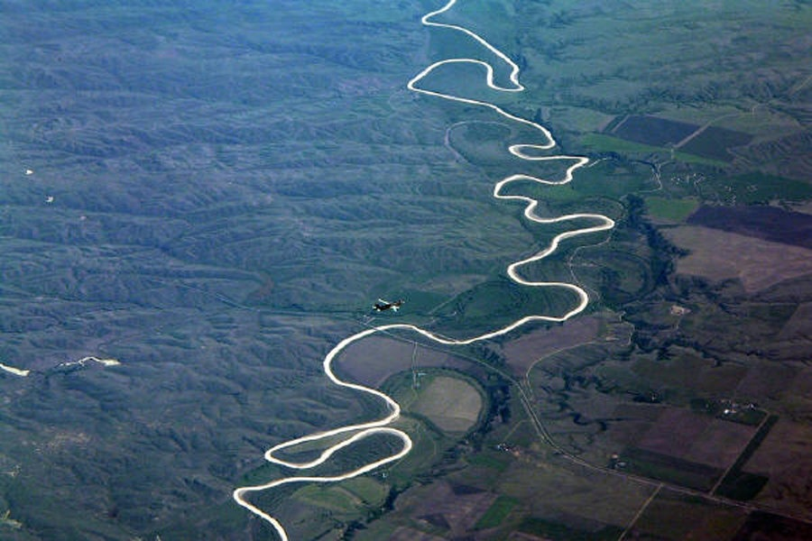
The mighty Mississippi River is nearly 6400 km.

Slide 5
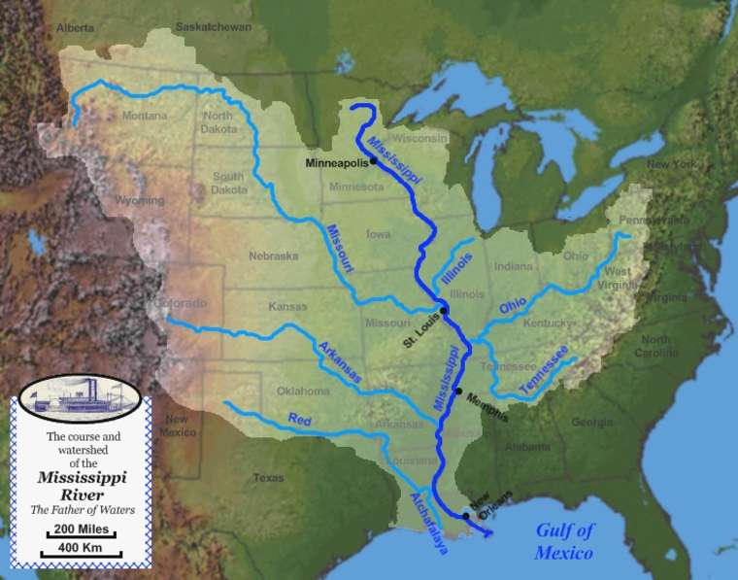
The Mississippi river begins in the north of the country
and ends in the Gulf of Mexico

Slide 6
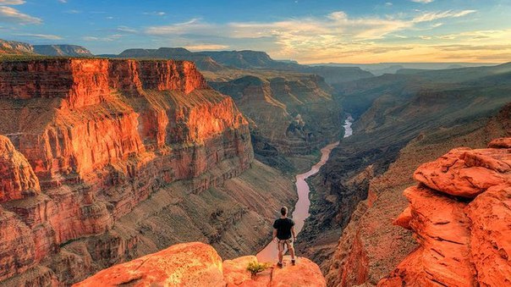
The Colorado river formed The Grand Canyon over millions of years.
It is one mile deep and 200 miles (320 km) long.
The Canyon looks different at different times of day and in different seasons.

Slide 7
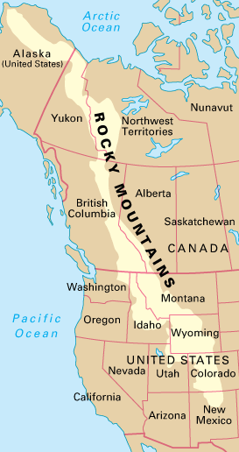
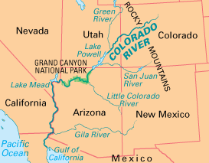
The Colorado river rises in the
Rocky Mountains that stretch from Alaska
down to the south of the country.

Slide 8
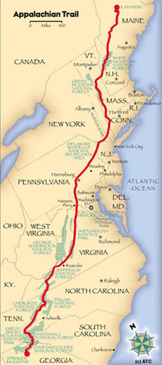
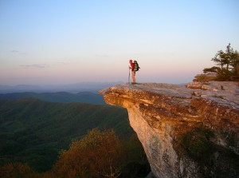
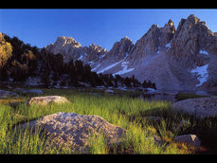
The Appalachians in the east run from north to south.

Slide 9
The U.S. is often called "the Great melting pot"
in which different cultures, languages and religions
combined to provide a single people - Americans.

Slide 10
Использованные интернет-ресурсы
http://tour.travelkey.vn/images/hanhtrinhdenmy/usamap.jpg
http://yourcitymap.ru/ssha/karta-vashingtona/gorod-vashington-na-kartessha.jpg
http://file2.answcdn.com/answcld/image/upload/w_760,c_fill,g_faces:center,q_60/v1401071988/zgvd4gzpyv79o0v8zoaf.jpg
http://svoipravila.ru/data/_uploads/2013/Отдых/Интересно%20отдыхаем/25%20самых%20на%20земле/Гранд-Каньон%20в%20США/7_Гранд-К
http://cs608927.vk.me/v608927065/cf6a/QwelzmqCzYc.jpg
http://4.bp.blogspot.com/ihRUA6VEwyE/TwJtZ7N4WcI/AAAAAAAAAEc/bxV9icHLYZc/s1600/appalachian-trail-map_lrg2.jpg
http://www.ratc.org/wp-content/uploads/2015/07/McAfee-iconic-300x223.jpg
http://fce-study.netdna-ssl.com/2/images/upload-flashcards/54/80/33/6548033_m.gif
http://1-news.net/uploads/posts/2014-12/medium/1418389274_los-angeles.jpg
http://www.ibc.org.ua/images/blog/tipy_predpriyatiy_v_ssha.jpg
https://s-media-cache-ak0.pinimg.com/originals/8a/52/68/8a5268f85149a7ca0ea26704186fbf20.jpg

