Slide 1
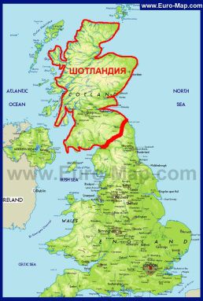
Презентация к учебнику английского языка О.В.Афанасьевой, И.В.Михеевой VI уровень.
Scotland
Учитель английского языка
ГБОУ СОШ № 180 г.Санкт-Петербург
Белоброва Е.Д.

Slide 2
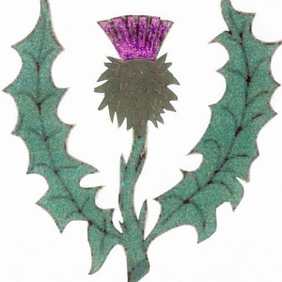
Scotland is a country in the UK
to the north of England.
It’s symbol is a thistle.
It’s patron saint is St. Andrew

Slide 3
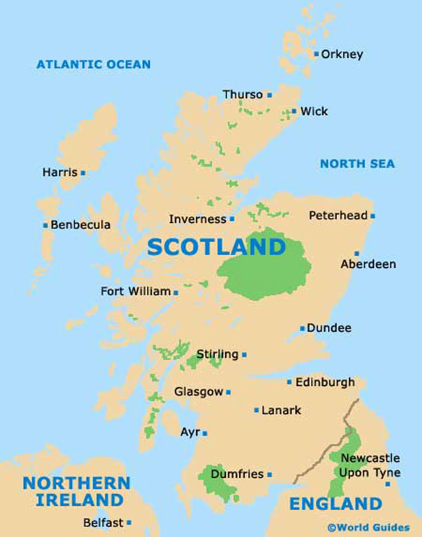
Glasgow is its largest
and busiest town.
Edinburgh is its capital

Slide 4
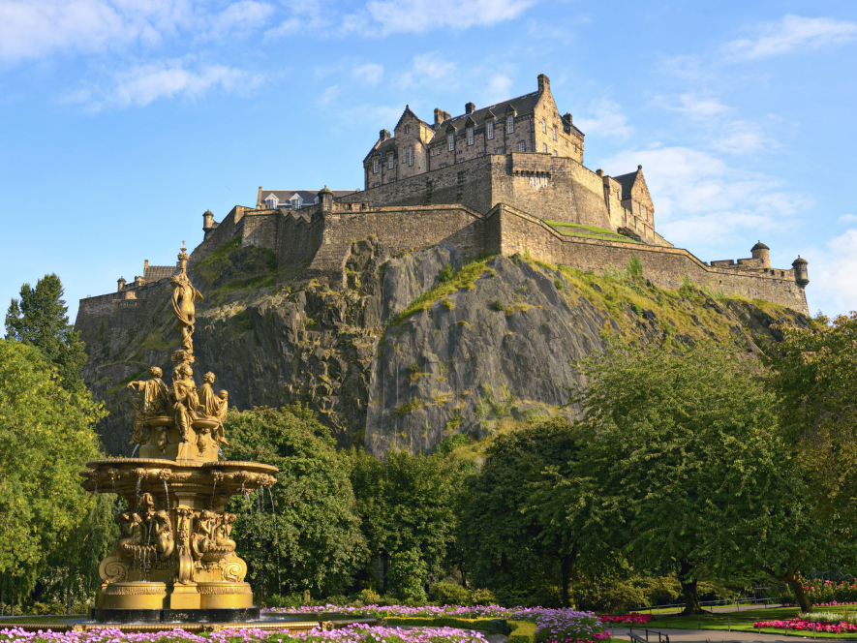
The Castle in Edinburgh

Slide 5
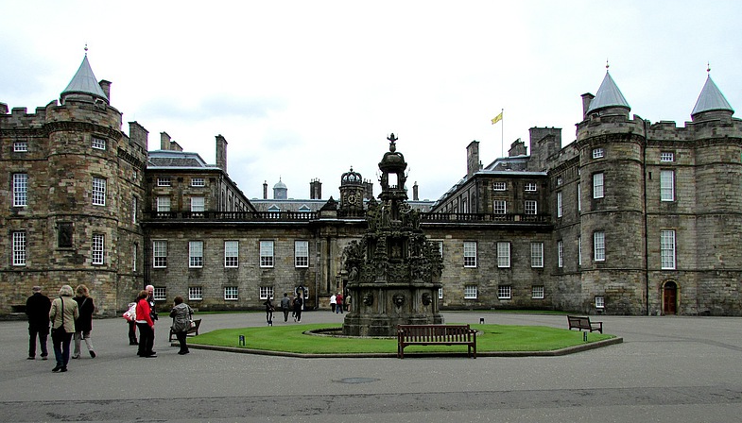
Holyrood Palace
It is the official residence of the Royal family in Scotland.
The palace is associated with the name of the queen Mary Stuart who lived here for 6 years.

Slide 6
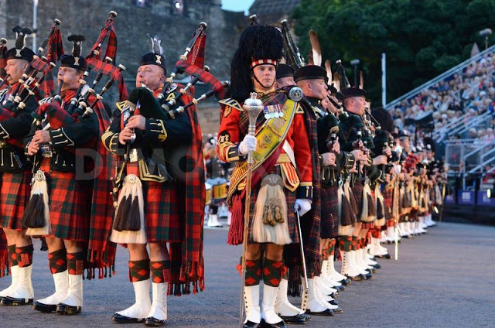
The Edinburgh military tattoo
Takes place every August and September.
For 90 minutes 600 people perform in the square in front of the Castle.
The performers play military music and march to it.

Slide 7
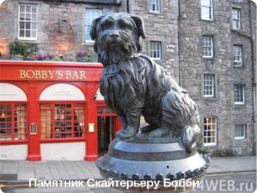
The monument to a dog Bobby

Slide 8
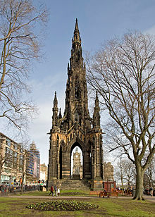
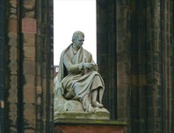
The monument to Walter Scott
It is 200 feet high (about 60 metres)

Slide 9
Использованные интернет-ресурсы
http://vocationblog.com/wp-content/uploads/2013/11/saltire.jpg
http://rack.1.mshcdn.com/media/ZgkyMDEyLzEyLzA4L2Y1L3RoaXN0bGV0aDk3LmJGdC5qcGcKcAl0aHVtYgkzMDB4MzAwIw/fcfe873f/b30/thistleth-97895c940d.j
http://topwar.ru/uploads/posts/2015-07/1436690117_shotlandiya-na-karte-velikobritanii.jpg
http://cdn.kingston.ac.uk/includes/img/cms/press/orig/kingston-university-2aec4db-kingston-academic-calls-for-rob.jpg
http://mediad.publicbroadcasting.net/p/shared/npr/201311/145411118.jpg
http://jumal115.users.photofile.ru/photo/jumal115/151220624/xlarge/178333708.jpg
http://3.bp.blogspot.com/-m0m0_pZWne0/UUnFoBJVoVI/AAAAAAAADB0/ByvH3Bcq10k/s640/tattoo-edinburgh-3004.jpg
http://www.gpsmycity.com/img/gd_cover/2784.jpg
http://snypiki.ru/upload/iblock/586/samye_znamenitye_pamyatniki_posvyashchyennye_sobakam.jpg

