Slide 1
Counting from 1 to 10

Slide 2
Numbers
1 2 3 4 5
6 7 8 9 10

Slide 3
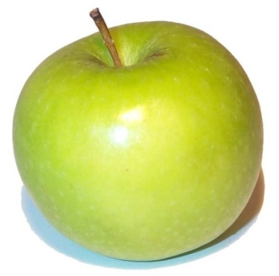
How many apples do you see?

Slide 4
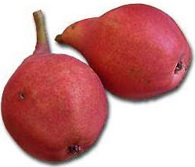
How many pears do you see?

Slide 5
How many plums do you see?

Slide 6
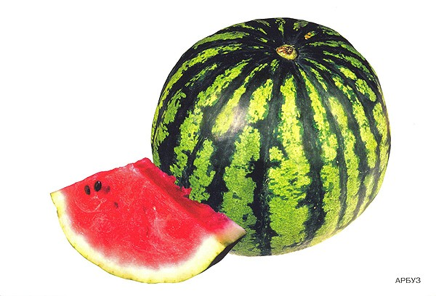
How many water-melons do you see?

Slide 7
How many raspberries do you see?

Slide 8
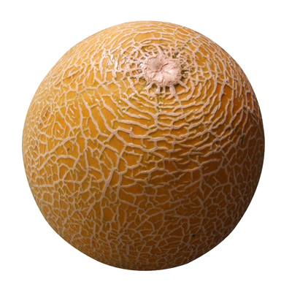
How many melons do you see?

Slide 9
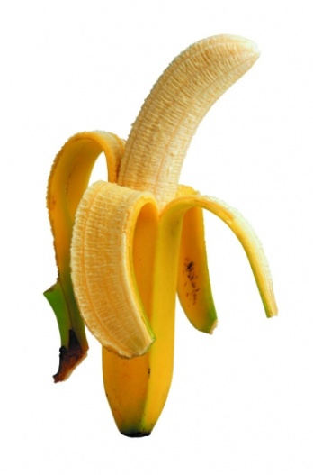
How many banans do you see?

Slide 10
How many lemons do you see?

Slide 11
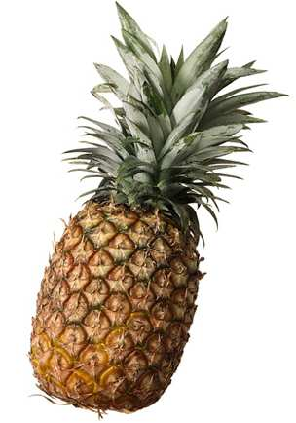
How many pine-apples do you see?

Slide 12
How many cherries do you see?

