Slide 1
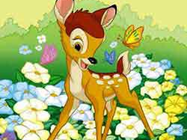
Presentation by Neverova Julia Gymnasium №528 Saint-Petersburg
2015

Slide 2
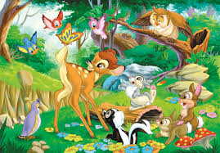
BAMBI
WALT DISNEY 1942

Slide 3
Match the words with their definitions
Cute a special ceremony, celebration
Wobbly I think
An occasion It’s really great!
I guess very nice and pretty
Gee whiz! (of a person) weak, moving from side to side

Slide 4
New words
Cute
Wobbly
An occasion
I guess
Gee whiz!
very nice and pretty
(of a person) weak, moving from side to side
a special ceremony, celebration
I think
It’s really great!

Slide 5
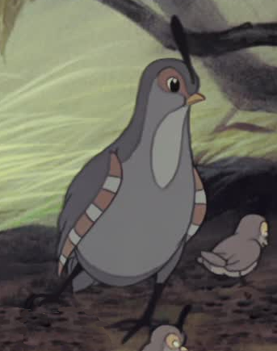
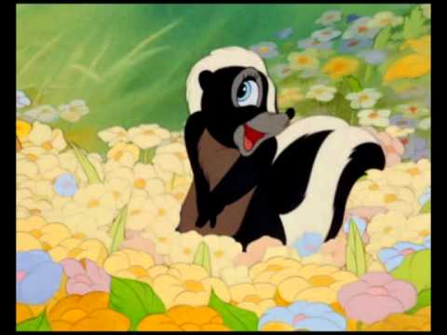
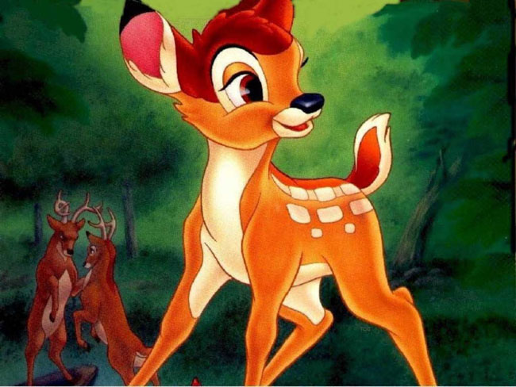
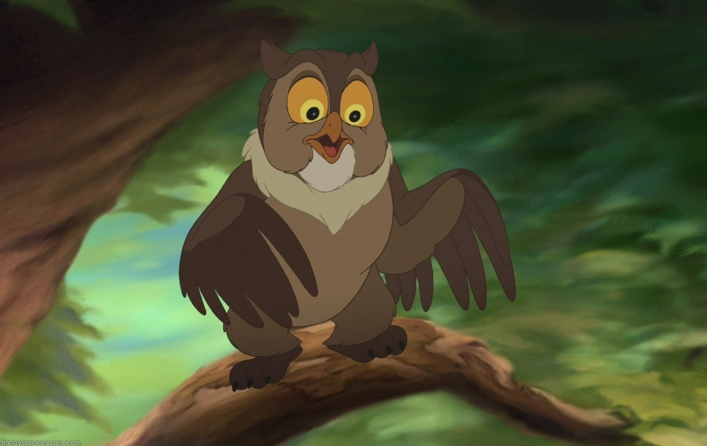
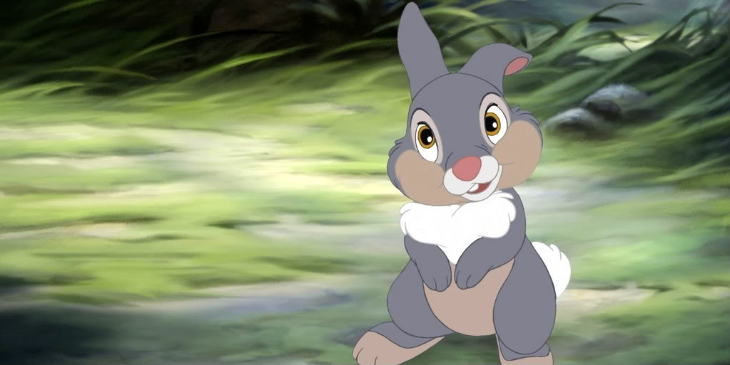
Name the characters of the cartoon.
Mrs Quail
Flower
Bambi
Friend Owl
Thumper

Slide 6
Put in the correct order and act.
-to fall down
- to talk
- to walk
-to get up
- to hop over
-to get up
-to walk
-to fall down
-to hop over
- to talk

Slide 7
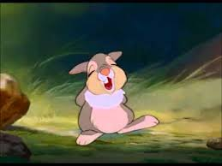
Make up the sentence. It is a wisdom. Explain how you understand it.
You if say say can’t nice nothing at all something don’t
If you can’t say something nice don’t say nothing at all

Slide 8
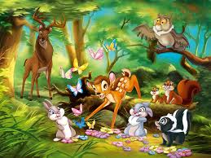
To be continued.

