Slide 1
Mother’s DAY
13 15 20 8 5 18 19 4 1 25

Slide 2
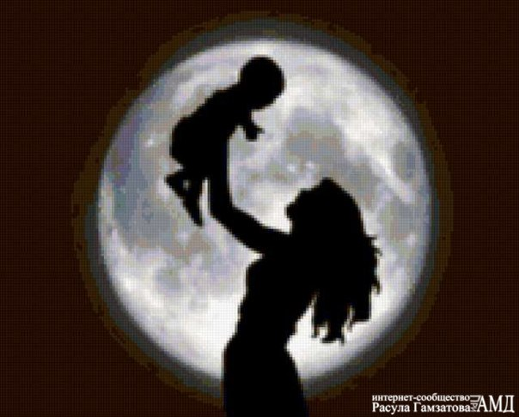
In Russia this holiday was established in 1998.
It is celebrated last Sunday of November.

Slide 3
Mother`s Day is a celebration that honors mothers.

Slide 4
A popular saying is that God cannot be present everywhere and so he created mothers.

Slide 5
Let’s have a quiz

Slide 6
Guess the words
c
o
u
s
i
n
grandmother
mother
sister
aunt
ardahnegft
hrafet
rebhrot
lneuc
nmghatoredr
tromeh
esrits
tuna
i
c
u
n
o
s
grandfather
father
brother
uncle

Slide 7
Характер:
special особенная
Kind добрая
Reliable надежная
pretty милая
beautiful красивая

Slide 8
Внешность:
eyes nose ears fair hair dark hair mouth | глаза нос уши светлые волосы темные волосы рот

Slide 9
Рассказ о маме
My mom’s name is…
She is … (age).
She is tall/short.
She has got dark/fair hair.
She has got … (colour) eyes.
My mom is pretty.
She сan.....
She can't....
I love my mom very much.

Slide 10
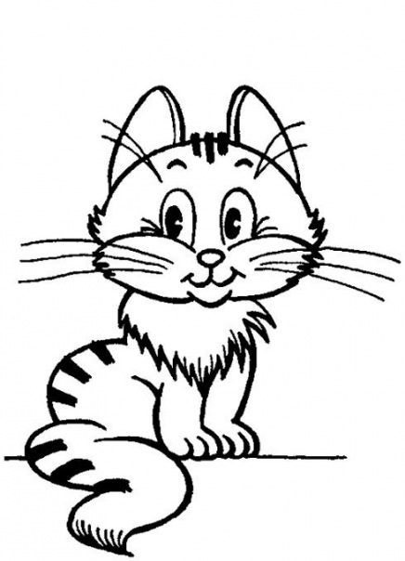
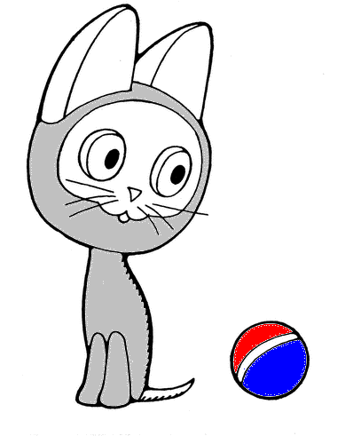
Little KITTENS

Slide 11
Translate the words and find out what will we cook for mummy
 |  |  |  |  |  |  |  |  |  |  |  |  | 8
 |  |  |  |  |  | 4
 | 2 |  |  |  | 3 |  |  |  |  |  | 7
1 |  |  |  |  |  |  |  | 5 |  | 6
B
U
T
T
E
R
S
U
G
A
R
C
H
O
C
O
L
A
T
E
F
L
O
U
R
J
A
M
C
H
E
R
R
Y
O
C
O
T
E
G
G
S
C
R
E
A
M
K

Slide 12
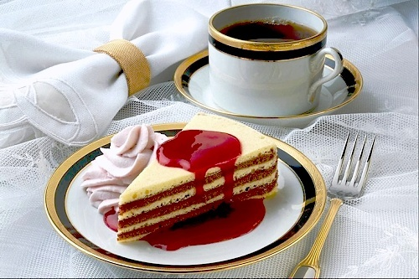
chocolate cake

Slide 13
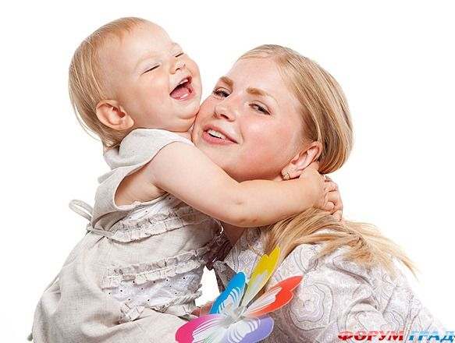
This holiday gives you the opportunity to tell your mother how much she means to you.
Let her know how special her love for you is.

Slide 14
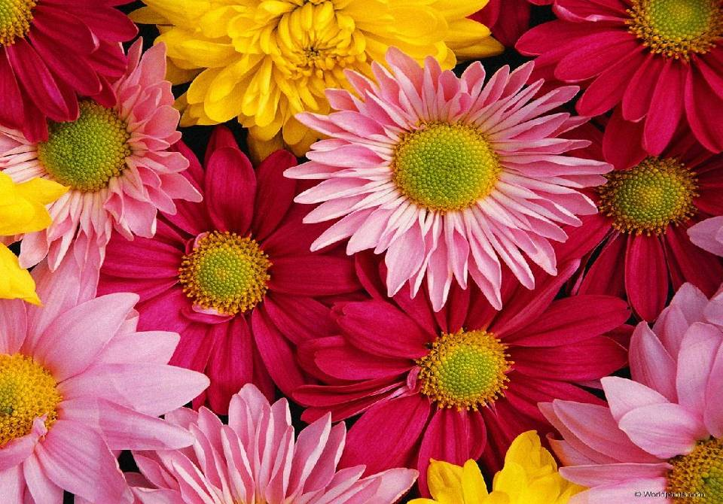
My dear mummy, I love you very much ! Thank you for your love!

Slide 15
Home Task :
Practice writing of words on the topic family.

