Slide 1
Sport equipment. Lesson 28.
Автор: Жданова Елена Константиновна
Учитель английского языка
Г. Санкт-Петербург
2014 г.

Slide 2
A check of home task.
ex. 3 p. 48

Slide 3
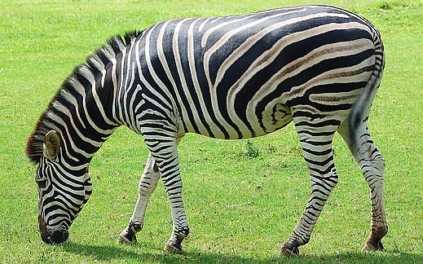
Буква Zz (зэд) читается как звук [z] (з)
We go, we go, we go to the zoo!
We can see a tiger and a zebra, too.

Slide 4
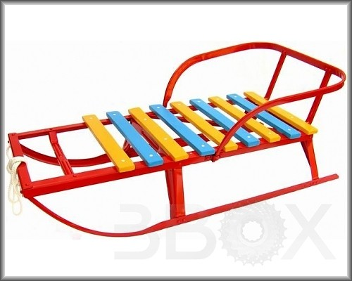
Sleigh [SLEI]

Slide 5
SKIING [ski:]

Slide 6
Ski

Slide 7
Ski poles

Slide 8
Hockey stick

Slide 9
Basket

Slide 10
Skates

Slide 11
shuttlecock

Slide 12
tennis racket

Slide 13
chess

Slide 14
Chess-board

Slide 15
Chess-men

Slide 16
bicycle, cycle, bike

Slide 17
wheels

Slide 18
Ex. 1 p.49
I can play football. –Я могу играть в футбол.
I can …

Slide 19
Clap, clap, clap your hands,
Clap your hands together!
Stamp, stamp, stamp your feet, Stamp your feet together!
Touch, touch, touch your ears, Touch your ears together!
Touch, touch, touch your cheeks,
Touch your cheeks together!
Shake, shake, shake your hands,
Shake your hands together!
Smile, smile at your friends,
Let us smile together!

Slide 20
Let`s make a dialogue!
Yes, .
?
No, not.

Slide 21
Offer to play!
Let`s play … - Давай поиграем в …
P. 50 ex.4

Slide 22
Home task:
P. 50 ex.4 - письменно в тетради.

Slide 23
Good-bye!

