Slide 2
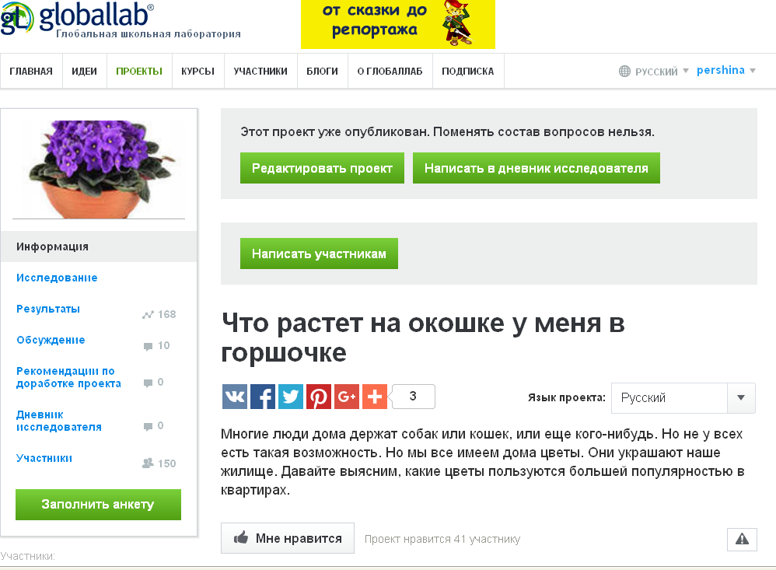

Slide 3
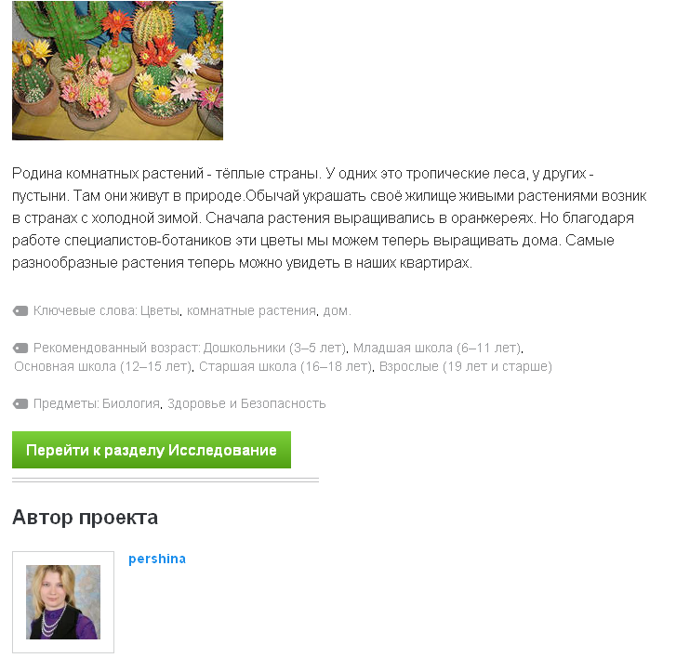
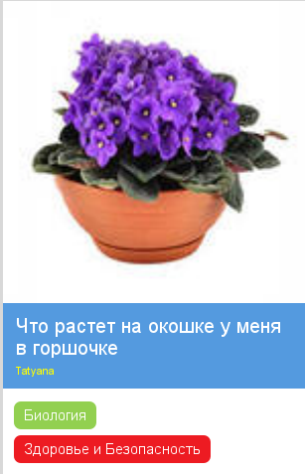

Slide 4
https://globallab.org/ru/project/catalog/#.VlScMnbhDIU

