Slide 2
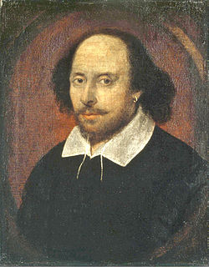

Slide 3
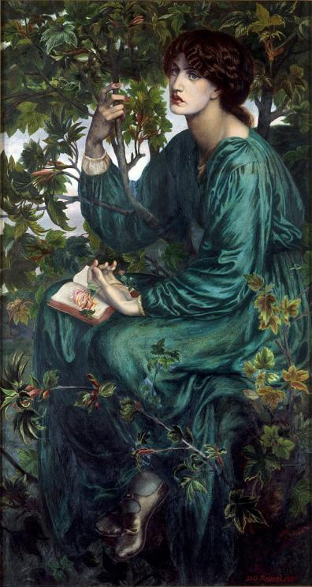
SONNET 73
That time of year thou may'st in me behold When yellow leaves, or none, or few, do hang Upon those boughs which shake against the cold, Bare ruin'd choirs, where late the sweet birds sang.
In me thou see'st the twilight of such day, As after sunset fadeth in the west, Which by-and-by black night doth take away, Death's second self, that seals up all in rest.
In me thou see'st the glowing of such fire That on the ashes of his youth doth lie, As the death-bed whereon it must expire Consum'd with that which it was nourish'd by.
This thou perceivest, which makes thy love more strong,
To love that well which thou must leave ere long.

Slide 4
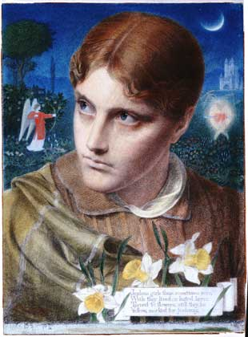
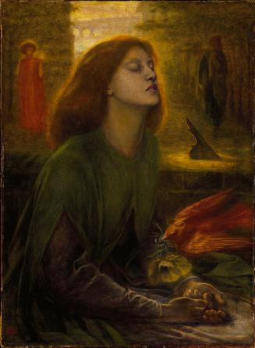
Sonnet 90
Then hate me when thou wilt, if ever, now
Now while the world is bent my deeds to cross,
Join with the spite of Fortune, make me bow,
And do not drop in for an after-loss.
Ah do not, when my heart has scaped this sorrow,
Come in the rearward of a conquered woe;
Give not a windy night a rainy morrow,
To linger out a purposed overthrow.
If thou wilt leave me, do not leave me last,
When other petty griefs have done their spite,
But in the onset come; so shall I taste
At first the very worst of Fortune's might;
And other strains of woe, which now seem woe,
Compared with loss of thee, will not seem so.

Slide 5
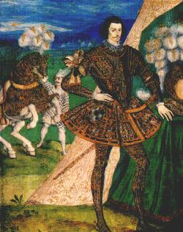
Sonnet 91
Some glory in their birth, some in their skill, Some in their wealth, some in their body's force, Some in their garments though new-fangled ill; Some in their hawks and hounds, some in their horse; And every humour hath his adjunct pleasure, Wherein it finds a joy above the rest: But these particulars are not my measure, All these I better in one general best.
Thy love is better than high birth to me, Richer than wealth, prouder than garments' cost, Of more delight than hawks and horses be; And having thee, of all men's pride I boast: Wretched in this alone, that thou mayst take All this away, and me most wretched make.

Slide 6
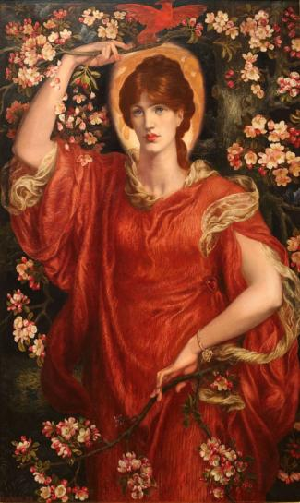
Sonnet 18
Shall I compare thee to a summer's day? Thou art more lovely and more temperate: Rough winds do shake the darling buds of May, And summer's lease hath all too short a date: Sometime too hot the eye of heaven shines, And often is his gold complexion dimm'd; And every fair from fair sometime declines, By chance or nature's changing course untrimm'd; But thy eternal summer shall not fade Nor lose possession of that fair thou owest; Nor shall Death brag thou wander'st in his shade, When in eternal lines to time thou growest: So long as men can breathe or eyes can see, So long lives this and this gives life to thee.

