Slide 1
Yes\ No
Do you know the prepositions of place?
Can you ask and answer the question “where”?
Can you describe the pictures?

Slide 2
Where is the mouse?

Slide 3
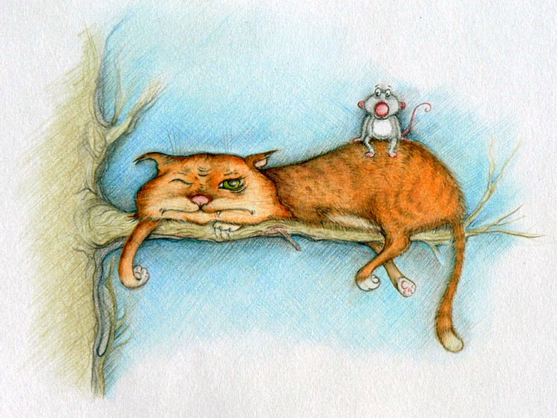
Where is the mouse?

Slide 4
Where is the mouse?
It’s on the cat.

Slide 5
Read and fill in the missing words

Slide 6
Where … the mouse?
… on the cat.

Slide 7
Where is the mouse?
… on the cat.

Slide 8
Where is the mouse?
It’s on the cat.

Slide 9
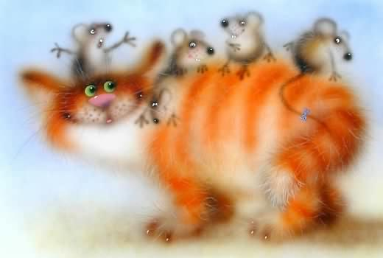
Where is the mouse?
Where … the mice?
It’s on the cat.
… on the cat.

Slide 10
Where is the mouse?
Where are the mice?
It’s on the cat.
… on the cat.

Slide 11
Where is the mouse?
Where are the mice?
It’s on the cat.
They’re on the cat.

Slide 12
Where is the vase?

Slide 13
Where is the vase?
It’s on the big table.

Slide 14
Where is the vase?
Where are the pictures?
It’s on the big table.

Slide 15
Where is the vase?
Where are the pictures?
It’s on the big table.
They’re on the wall.

Slide 16
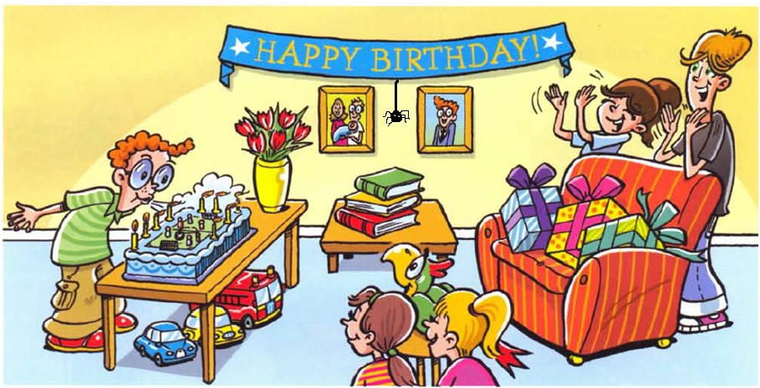

Slide 17
AB p. 67 - B

Slide 18
Yes\ No
Do you know the prepositions of place?
Can you ask and answer the question “where”?
Can you describe the pictures?

Slide 19

Well done!

