Slide 1
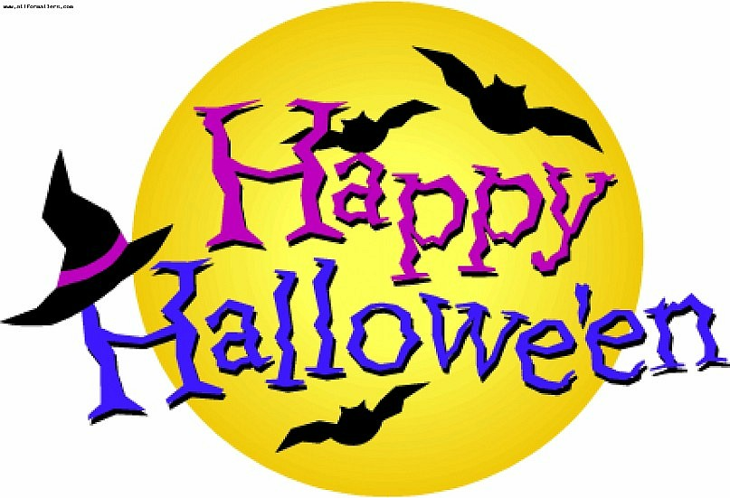

Slide 2
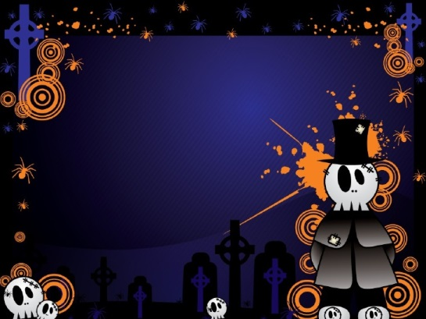
О праздник ведьм и приведений И страшных призрачных видений. Он наступает раз в году, Когда все кажется в аду.

Slide 3
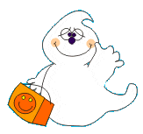
One of the national festivals of English-speaking countries is Halloween. It takes place on October 31 on Allhallow’s Eve.

Slide 4
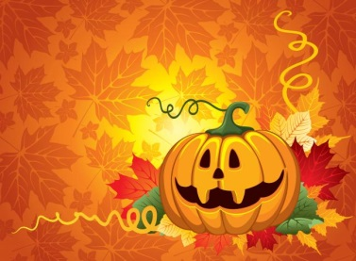
The pumpkin is a symbol of this festival in which offensive (неприятный, противный) face is cut out. A lighted candle is put into the pumpkin.

Slide 5
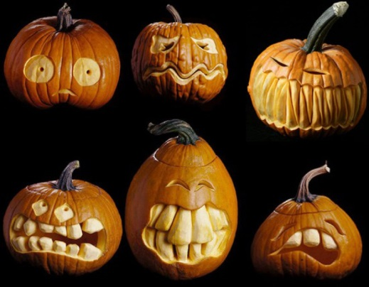

Slide 6
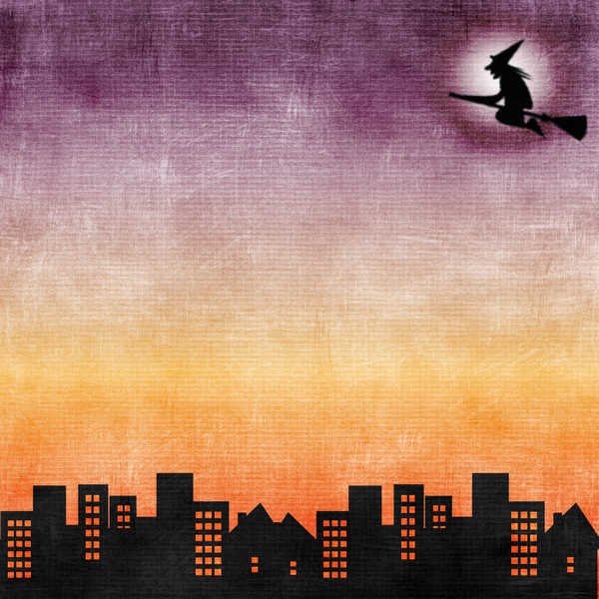
Traditional Halloween symbols are bats, black cats (and white ones in England), spiders, ghosts and images of Jack O'Lantern.

Slide 7
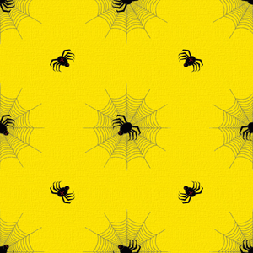
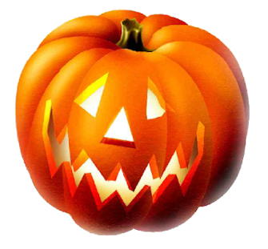
Traditionally on Halloween Night people wear scary or funny costumes of witches, vampires, pirates, fairies and ghosts. The most popular children's amusement ( развлечение, забава) on Halloween is "trick-or-treating".

Slide 8
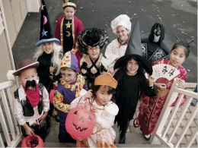
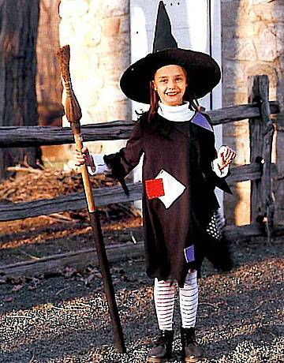

Slide 9
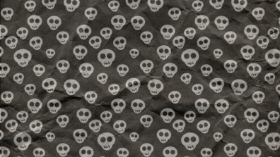
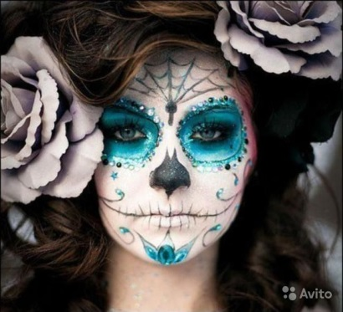
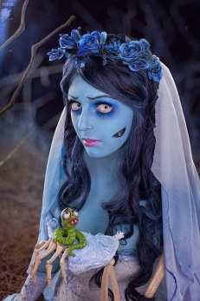
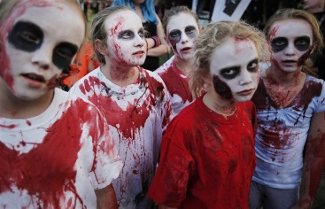
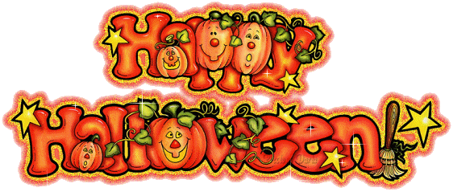

Slide 10
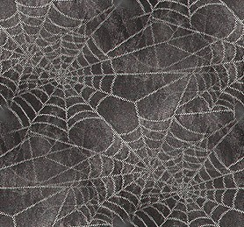
Children visit houses in their neighbourhood knocking on every door yelling the phrase: "Trick or treat!" Usually people give them sweets, fruit and candies, but if they don't, the children can play a low-down trick (злая шутка) on them.

Slide 11
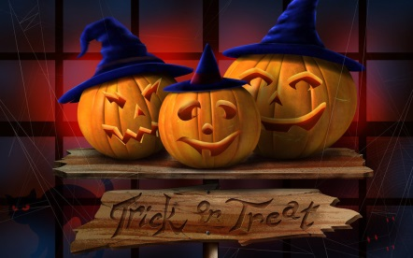

Slide 12
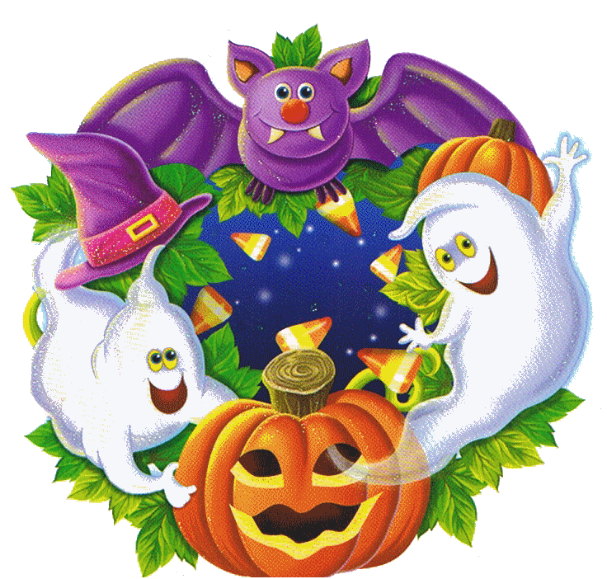
Trick or treat
Trick or treat, trick or treat, Give us something good to eat. Give us candy, give us cake, Give us something sweet to take. Give us cookies, fruit and gum, Hurry up and give us some. You had better do it quick Or we’ll surely play a trick. Trick or treat, trick or treat, Give us something good to eat.

Slide 13
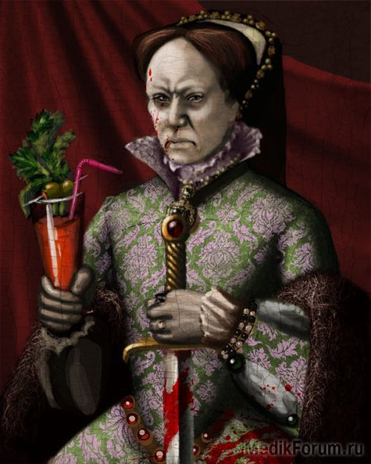
Besides that games and fortune-telling are widely spread on Halloween. At night children and teenagers tell each other horror stories and legends and the most popular legend is about Bloody Mary. She is said to appear in a mirror when her name is called three times.

Slide 14
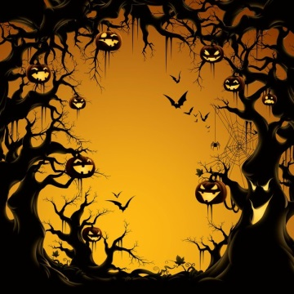
Halloween, Halloween, magic night. We are glad and very bright. We all dance and sing and recite, “Welcome! Welcome! Halloween night!”

Slide 15
Halloween is celebrated in many countries all over the world. In some of them (China, Mexico, Austria) the dead are honored and welcomed: people leave food and gifts for the souls of their deceased loved ones and keep lights in their houses burning all night.
In other countries, like Germany, people are afraid of ghosts and spirits. They even hide knives and other sharp objects in order not to be hurt (больно)by these visitors on Halloween night.

Slide 16
