Slide 1
My village Kavalersky
Презентация подготовлена
учителем английского языка
МБОУ Кавалерской СОШ №3
имени А.П. Дубинца
Кумпан Н.В.

Slide 2
There is place like home.

Slide 4
Content
The history of the village
The legend
Kavalersky nowadays

Slide 5
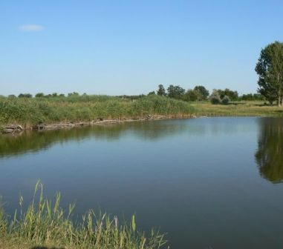
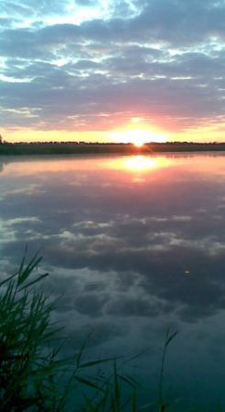
The river Kavalerka

Slide 6
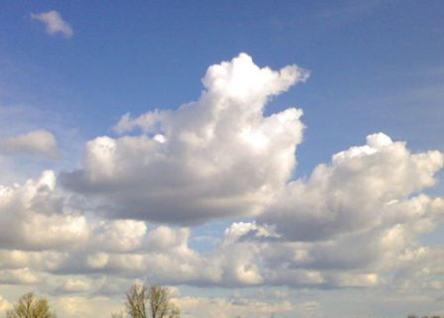
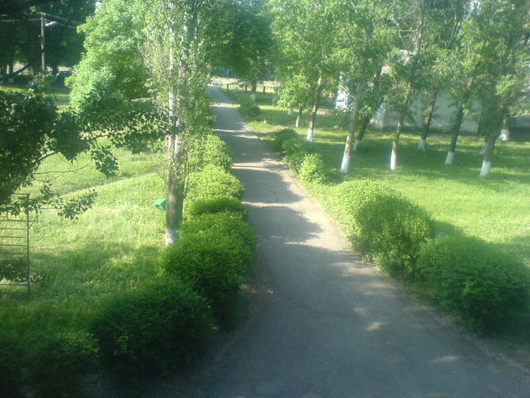
Our nature is some kind of masterpiece

Slide 7
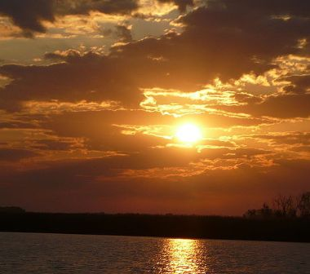
“From dawn to dusk”

Slide 8
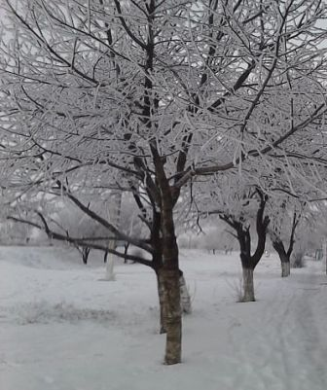
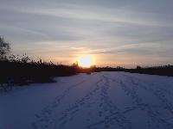
When winter comes…

Slide 9
Our school
It was named after
Hero of the Soviet Union Andreya Petrovicha Dubintsa

Slide 10
Our reconstructed House of culture

Slide 11
The administrative centre of Kavalersky

Slide 12
The parish of Kazan Russian Orthodox Church

Slide 13
Our local clinic

Slide 14
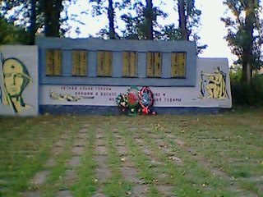
Monuments

Slide 15
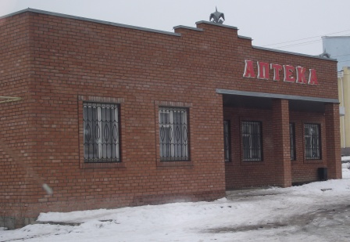
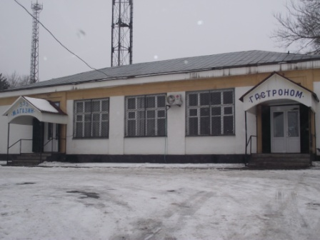
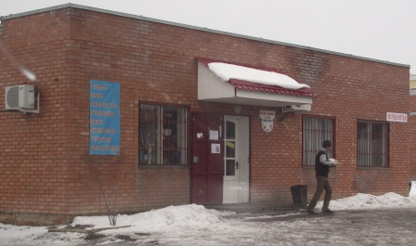
Other buildings
The Post Office
The Kindergarten “Rosinka”
Chemist’s shop
Shops

Slide 16
Our Kavalersky only 108 years old. We hope it will have tens and hundreds of glorious anniversaries

Slide 17
Использованные ресурсы:
http://avtor.tululu.org/product/30902/
http://infourok.ru/yubiley_rodnogo_hutora_statya_o_hutore_kavalerskom_egorlykskogo_rayona_rostovskoy_oblasti-168362.htm
Фотографии с сайта odnoklassniki.ru

