Slide 1
The 27th of january.
Music in my life.

Slide 2
Answer my questions.
1). What role does music play in your life?
2). Where can we hear music?
3). What do you think about when you listen to music?

Slide 3
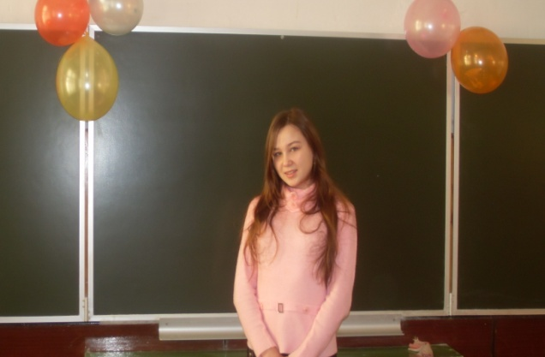
Smolina ira.
I am fond of jazz. Jazz was created in the United States by black Americans. It is a mixture of many different kinds of music. It is a combination of the music of West America. Improvisation is an important part of jazz.
Today, people all over the world play jazz. People who like jazz always remember American jazzman Louis Armstrong. And now let’s listen to jazz.

Slide 4
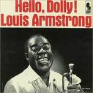
Jazz.

Slide 5
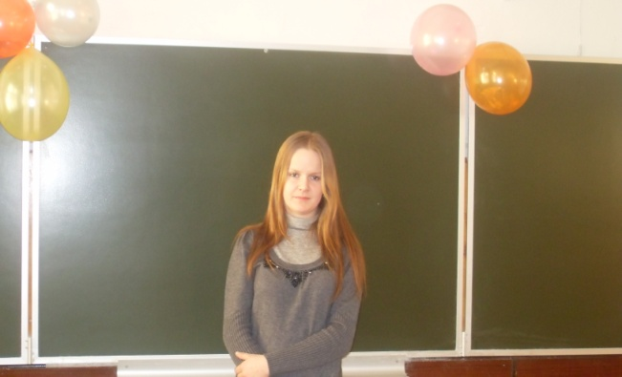
tufanova katya.
I want to tell you about classical music. Most of the people of my age prefer Eminem to Tchaikovsky, Bach, Mozart, Beethoven . But I find classical music relaxing.
This music has been living for centuries. Some people simply don’t understand classical music, but it has a deep intellectual appeal.
When I listen to the classical music , I enjoy this wonderful music. It helps me feel much better. Of course, we must be taught not only to listen but to understand classical music. And now I want you to listen to a peace of classical music.

Slide 6
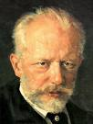
Classical music.

Slide 7
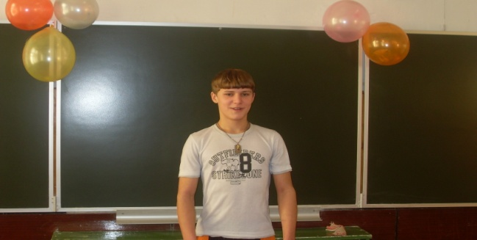
deryagin igor.
I am going to tell you about rock. It is my music! Rock music, or, rather rock-n-roll, appeared in the 1950-s. The first rock music is connected with the names of Elvis Presly, Chuck Berry, The Beatles, The Rolling Stones, Eric Clapton, The Doors and some others.
The70-s were the time of revolution in rock music. Lead Zeppelin, Deep Purple, Black Subbath told the world about the beginning of new era of hard rock. And now let’s listen to rock music.

Slide 8
Rock.

Slide 9
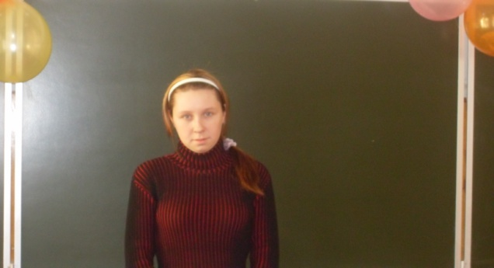
andrianova tonya.
I am going to tell you about folk music. This music lives on for centuries. Every nation has its own national music and dance ensembles and choirs. The British are very fond of their folk music. They held special Folk Festivals, where the young can learn about their national culture and folk music. It is a pity we don’t know much about Russian folk music.
But I know that there are some groups now. The members of these groups sing Russian folk songs. I like to listen to these songs because it is interesting to learn about the past. We know Nadezhda Babkina and Nadezhda Kadysheva. In Russian culture there is also a special form called “chastushka”. Russian people like them. Now I want you to listen to a peace of folk music

Slide 10
Folk music.

Slide 11
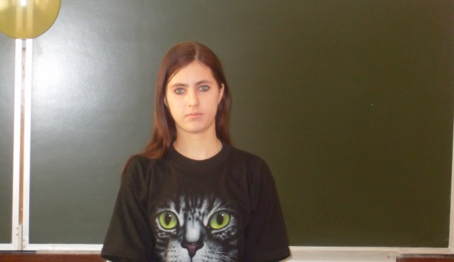
valova anya.
I love pop music. I think it is not difficult for understanding. I like to know more and more about popular talented groups and singers I like.
I want to add that only talented people can to be singers. As for me I like new rhythms, I prefer pop music. Pop music unites the teenagers all over the world and makes us feel a part of global family. We can hear this music every day and everywhere. Now let’s listen to my favourite singer Dima Bilan.

Slide 12
Pop music.

Slide 13
Listen to information and try to guess what type of music it is.
music | symphony | folk | pop | rock | jazz | rap
№

Slide 14
Dear ( 1) …..,
My name is (2) ________ . I am (3) _____years old and I’m your greatest fan. I think you are(4) _____________. The thing I like most about you is your (5)____________. And the way you (6)___________if you ever come to (7) _______________ . I hope you’ll come to see me . We could (8) ______________together and talk about
(9) ___________ .Then you could answer the one question I’ve always wanted to ask you (10) _______________________________?
Your(11)______________fan .
Suggestions
1.Nick, Brain, Britney, Craig, other
2.Olga, Peter, Natasha, Tanya, other
3.14, 15, 16 other
4.wonderful, fantastic, other
5.voice, smile, hair, nose, other
6.move, dance, sing, play the guitar, other
7.Moscow, Bereznik, St Petersburg, other
8.go to a disco, walk in the moonlight, have dinner at McDonald’s, other
9.music, money, life, our future, other
10. Will you love me? Is that your real hair? other
11.loving, number one, crazy, other

Slide 15
Look at the blackboard. There are some words there. Repeat them after me.
trouble seem though believe suddenly shadow hang hide
All these words are from the song “Yesterday”. Let us sing this song.

Slide 16
Yesterday
John Lennon and Paul McCartney
Yesterday, All my troubles seemed so far away, Now it looks as though they’re here to stay, Oh, I believe in yesterday.
Suddenly, I’m not half the man I used to be, There’s a shadow hanging over me, Oh, yesterday came suddenly.
Why she had to go I don’t know, she wouldn’t say, I said something wrong, now I long for yesterday.
Yesterday, Love was such an easy game to play, Now I need a place to hide away, Oh, I believe in yesterday.
Why she had to go I don’t know, she wouldn’t say, I said something wrong, now I long for yesterday.

Slide 17
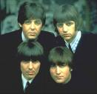
“Learn English through songs”.

