Slide 1
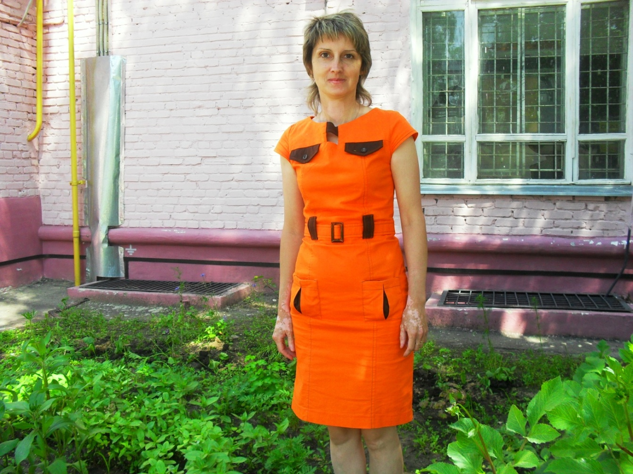
MY KINDERGARTEN. I WOULD LIKE TO TELL YOU A FEW WORDS ABOUT THE PLACE I WORK IN AND ABOUT MY PROFESSION.

Slide 2
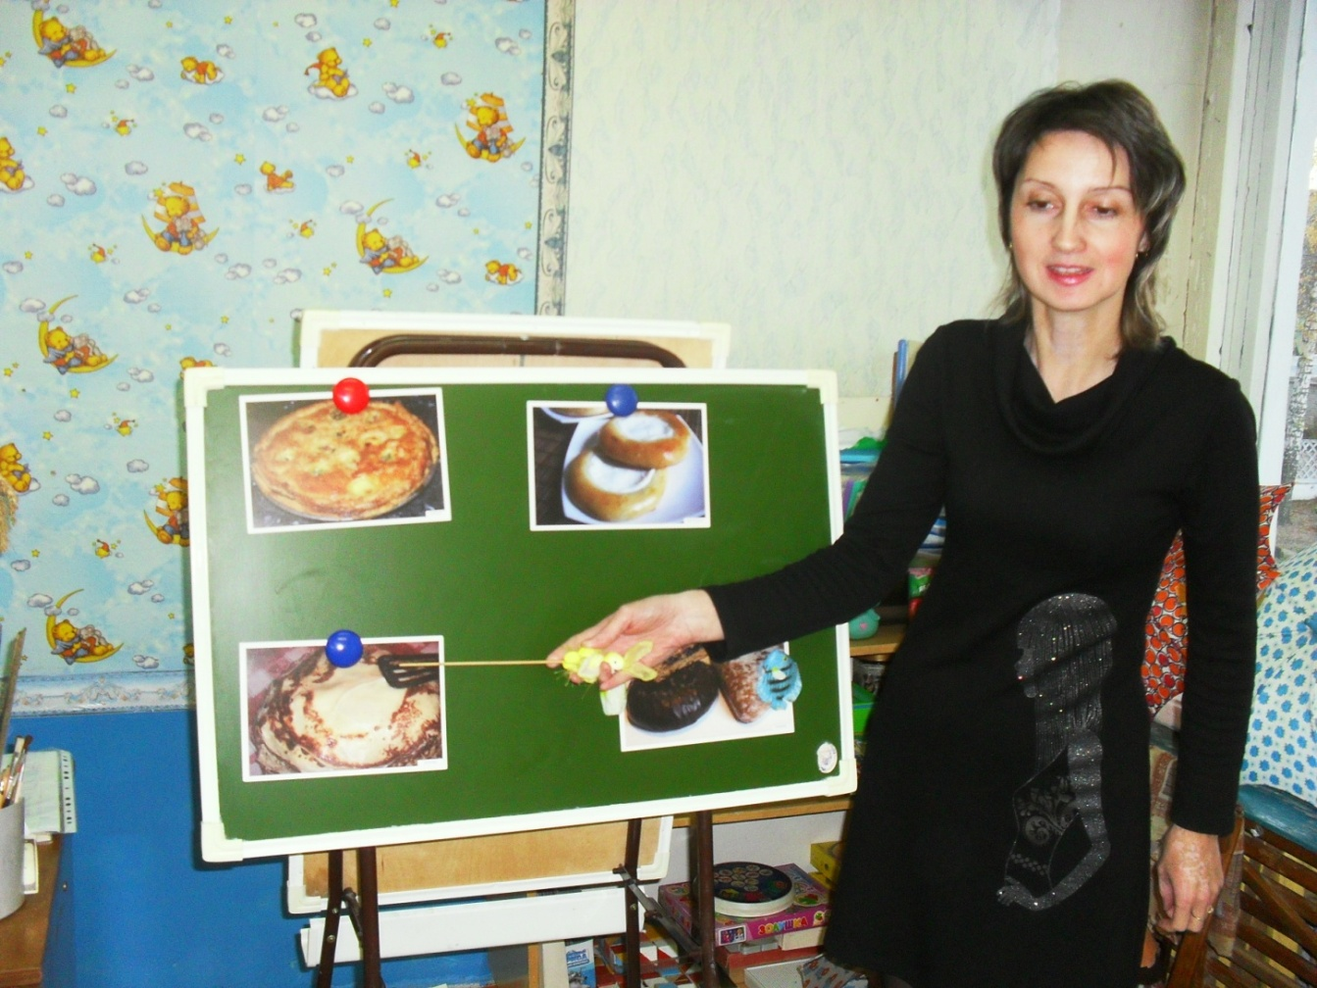
I am an educator in the kindergarten.

Slide 3
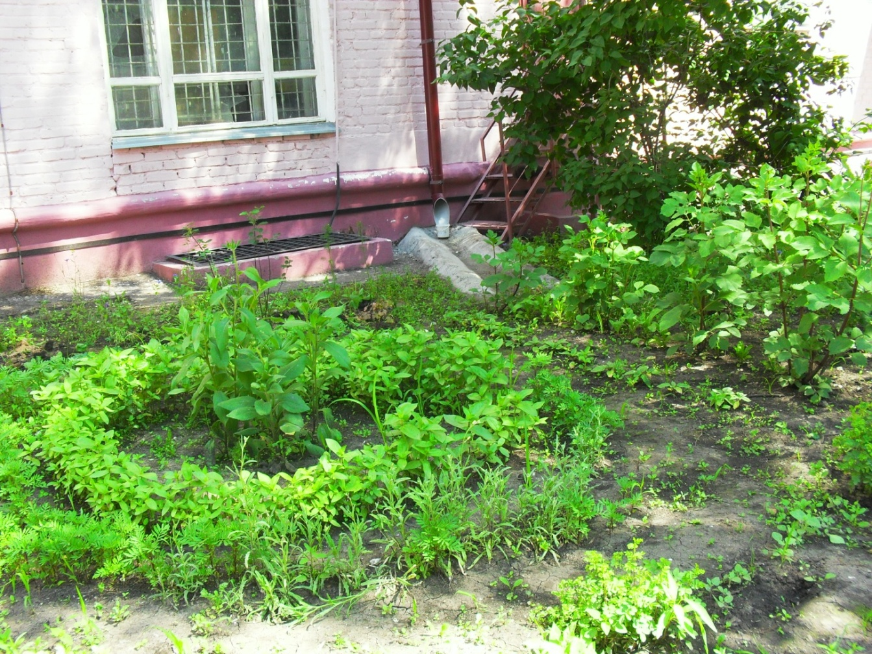
Our kindergarten is not very modern, but bright and cozy building.

Slide 4
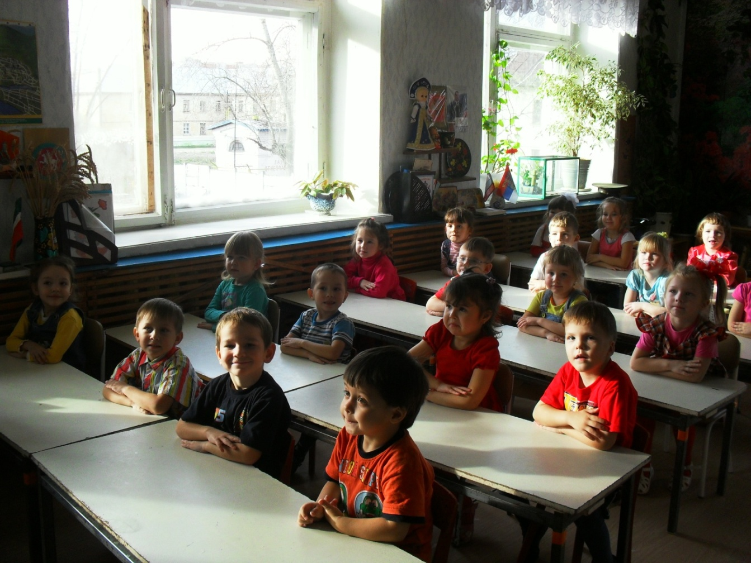
My group is rather big. There are 22 children in it.

Slide 5
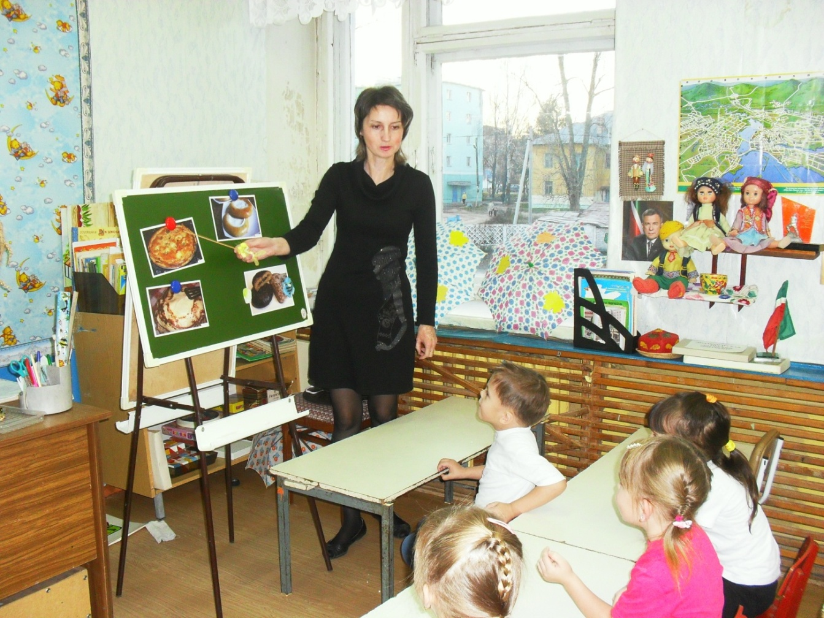
We study maths and foreign languages.

Slide 6
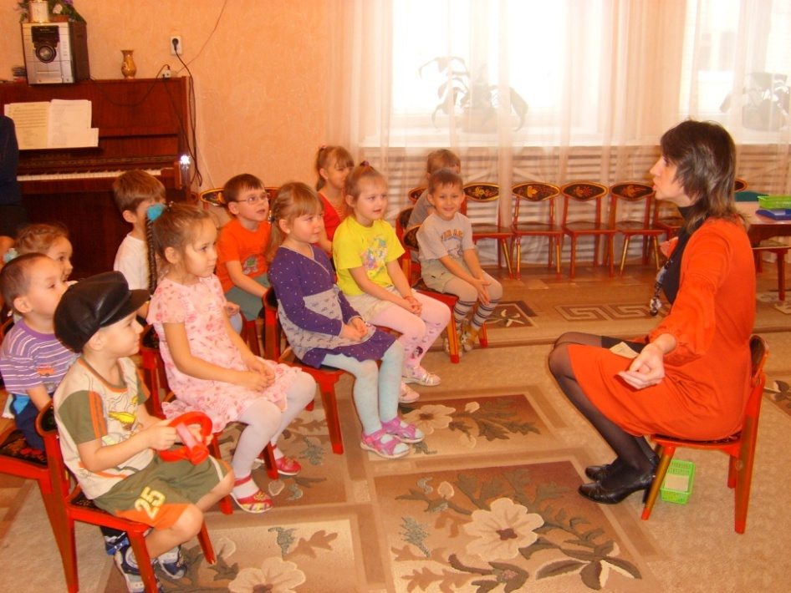
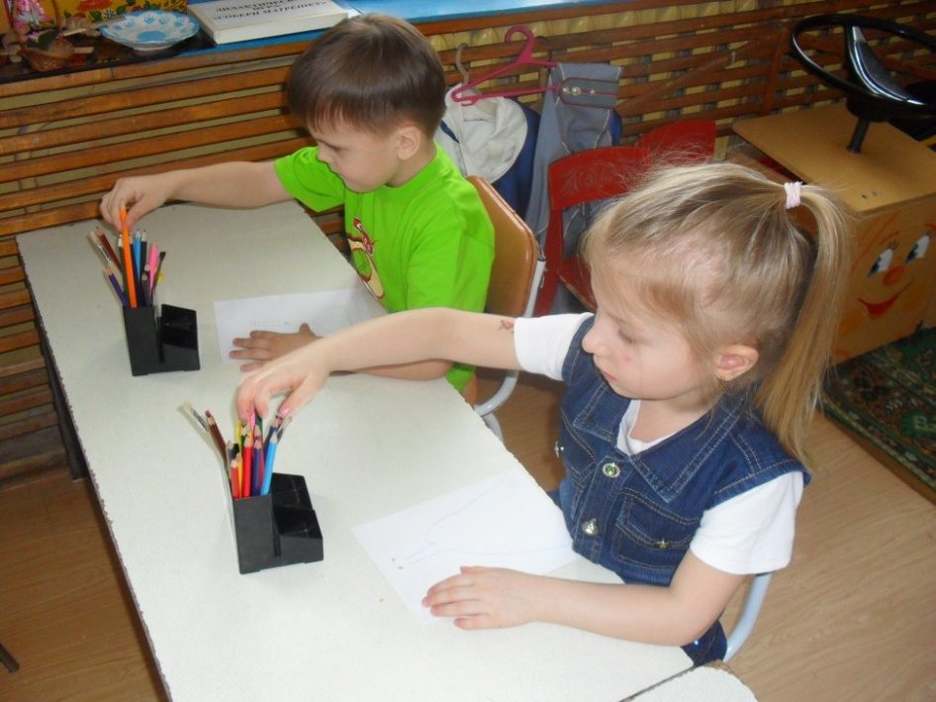
Moreover, we have different activities: vocal, drawing, cooking lessons.

