Slide 1
Ломаная. Состав числа 7

Slide 5
31 = 4
42 = 2
+
–
54 = 1
34 = 7
–
+
72 = 5
23 = 5
–
+
24 = 6
63 = 3
+
–
43 = 1
73 = 4
–
–

Slide 6
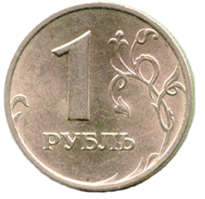
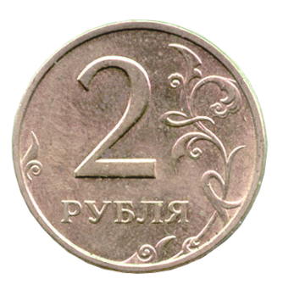
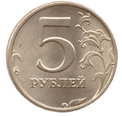
7=

Slide 7
7

Slide 8
7
1 | 2 | 3 | 4 | 5 | 6
6 | 5 | 4 | 3 | 2 | 1

Slide 9
