Slide 1
Lesson 4
Тема урока: Числа. Буква С с.

Slide 2
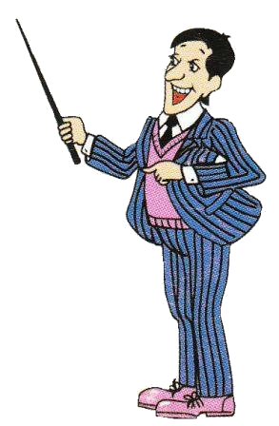
MR. Rule:
-Good morning, good morning,
-Good morning to you!
-Good morning, good morning,
-I am glad to see you!

Slide 3
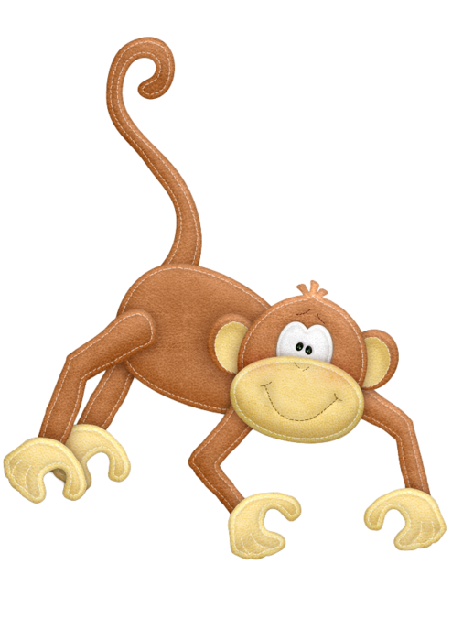
Monkey and Mr. Rule

Slide 4
-What is your name?

Slide 6
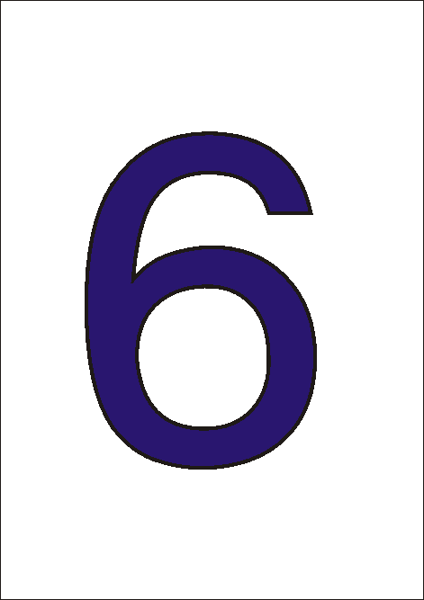

Slide 7
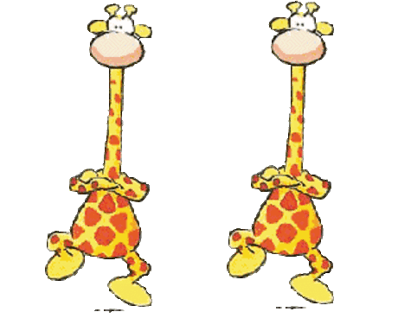
Физминутка

Slide 8
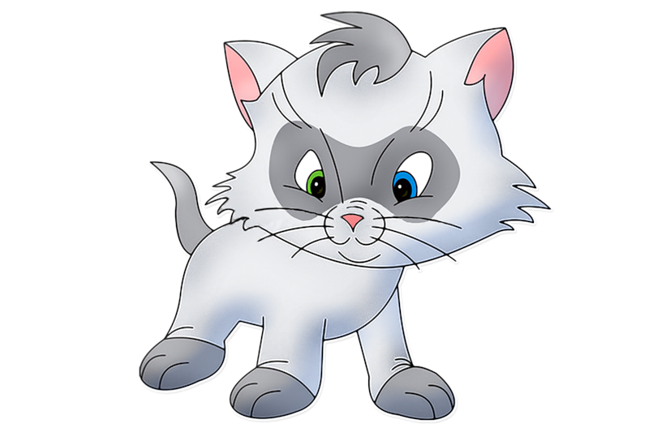
Mr. Rule:
My name is Mr. Rule. I am a cat. I am ten.

Slide 9
Буква С с
Согласная буква.
Может читаться
по-разному.

Slide 10
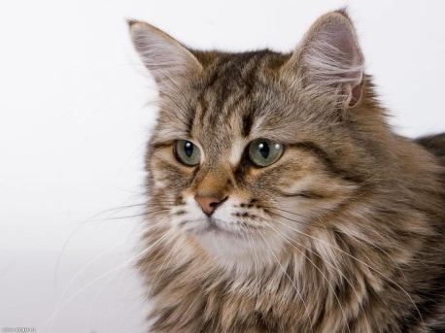
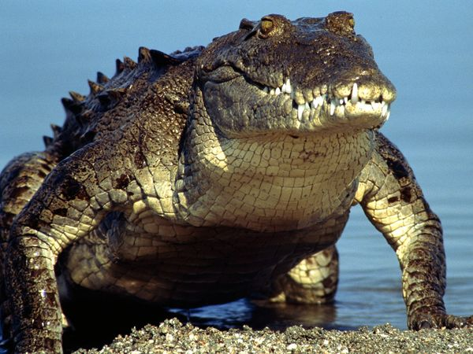
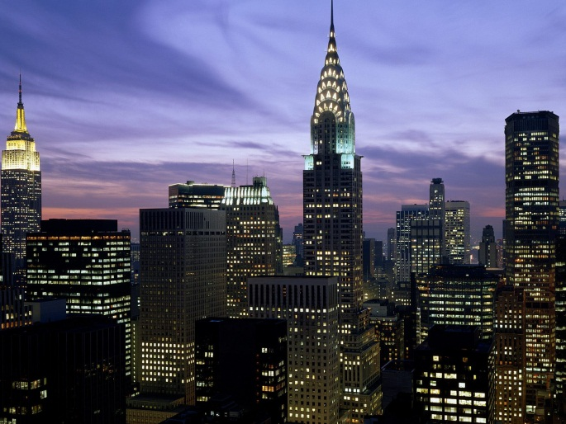
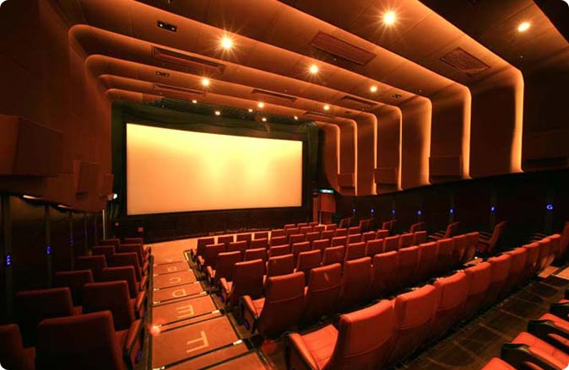
[ k ] [ s ]
cat
crocodile
cinema
city

Slide 11
Goodbye!

