Slide 1


Slide 2
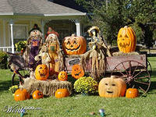

Slide 3

Choose the correct variant

Slide 4


Slide 5
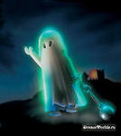
Hello! I’m A GHOST/ A SPIDER.

Slide 6
Hello! I’m A GHOST.

Slide 7
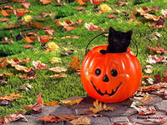
Hello! I’m A WITCH / LANTERN

Slide 8
Hello! I’m A LANTERN

Slide 9
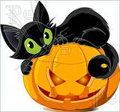
Hello! I’m A BLACK CAT / MONSTER

Slide 10
Hello! I’m A BLACK CAT

Slide 11
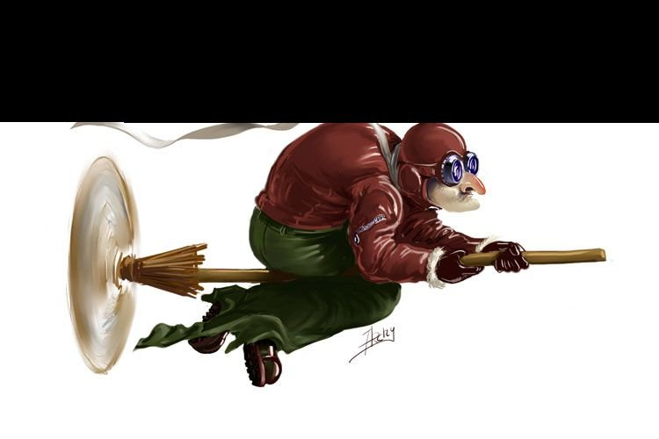
I’M A WITCH / VAMPIRE

Slide 12
I’M A WITCH

Slide 13
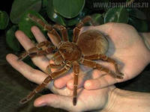
I’M A LANTERN/ SPIDER

Slide 14
I’M A SPIDER

Slide 15
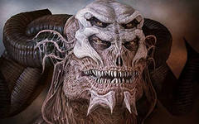
I’M A BLACK CAT/ MONSTER

Slide 16
I’M A MONSTER

Slide 17
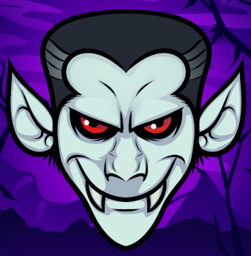
I’M A VAMPIRE/ MONSTER

Slide 18
I’M A VAMPIRE

Slide 19
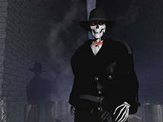
I’m a skeleton/ a witch

Slide 20
I’m a skeleton

Slide 21
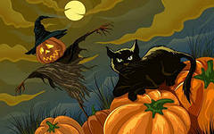
What
are they?

Slide 22
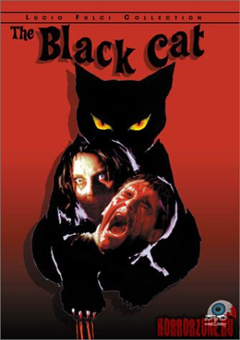
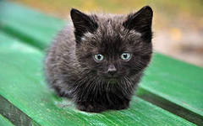
They are b……..

Slide 23
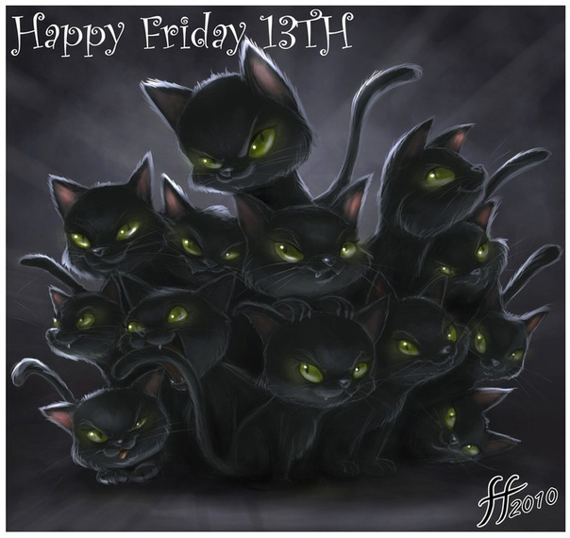
They are black cats

Slide 24
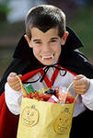
He is a V…….

Slide 25
He is a vampire

Slide 26
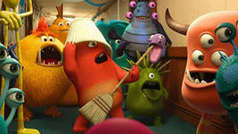
They are m……

Slide 27
They are monsters

Slide 28
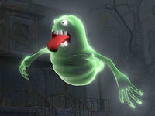
It is a g…

Slide 29
It is a gost

Slide 30
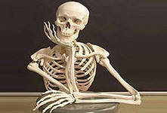
It’s a s……..

Slide 31
It’s a skeleton

Slide 32

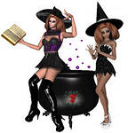
They are w……

Slide 33
They are witches.

Slide 34

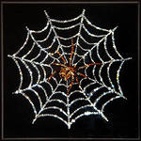
They are s…

Slide 35
They are spiders

Slide 36
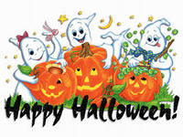

Slide 37
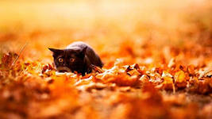

Slide 38
