Slide 1
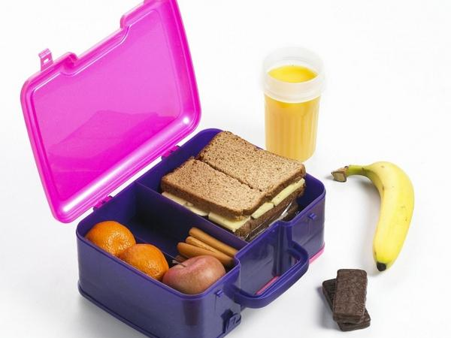
In my lunch box ( Module3)
Учитель английского языка
МБОУ «Оборонинская сош» Казакова Г.С.

Slide 2
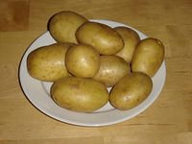
potatoes

Slide 3
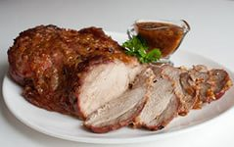
meat

Slide 4
biscuits

Slide 5
milk

Slide 6
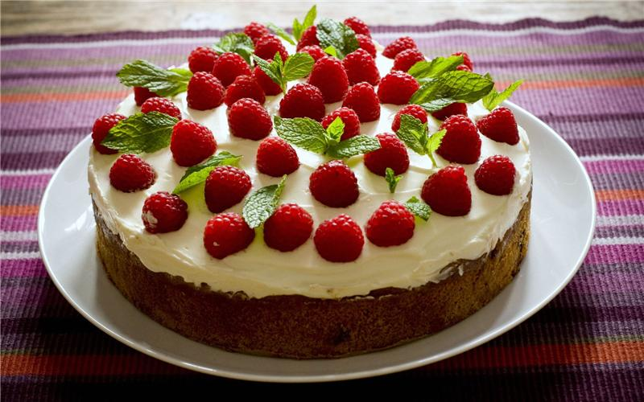
cake

Slide 7
Orange juice

Slide 8
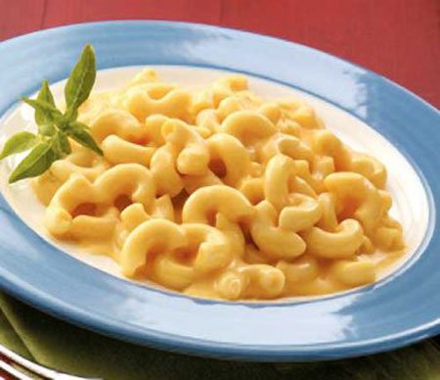
pasta

Slide 9
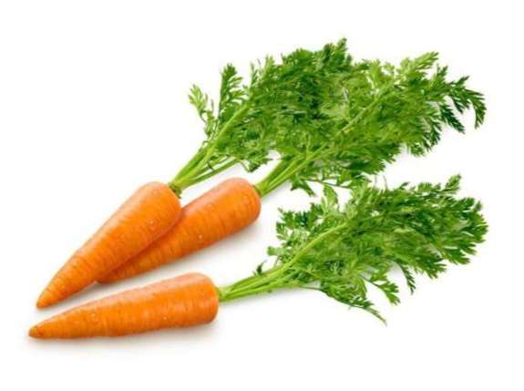
carrots

Slide 10
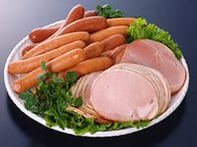
sausages

Slide 11
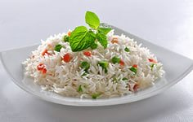
rice

Slide 12
popcorn

Slide 13
Coce

Slide 14
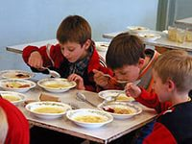
In the school canteen
- Can I have some meat and potatoes, please?
- Here you are!
- Thank you!

