Slide 1
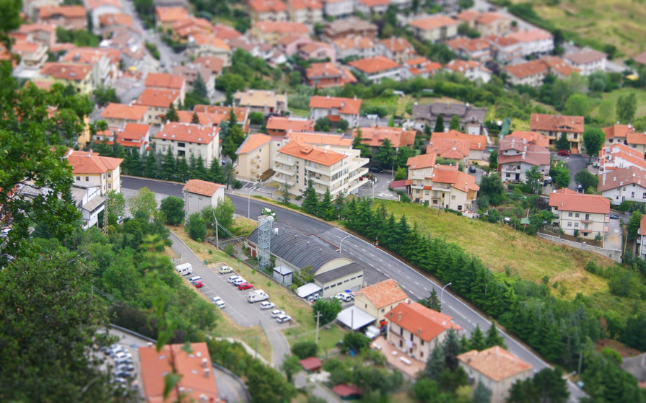
The country and the city

Slide 2
The city

Slide 3
The country

Slide 4
garden

Slide 5
house

Slide 6
bridge

Slide 7
park

Slide 8
forest

Slide 9
field

Slide 10
road

Slide 11
sheep

Slide 12
hill

Slide 13
tree

Slide 14
river

