Slide 1
Викторина по английскому языку 4 класс
Составитель: Долгова Д.А., учитель английского языка
МОУ СОШ № 16 с УИОП
г. Электросталь

Slide 2
My Rainbow English
Word’s world | 10 | 20 | 30
Write correctly | 10 | 20 | 30
Listen to | 10 | 20 | 30

Slide 3
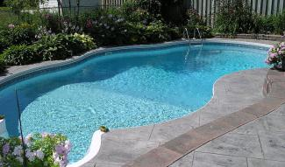
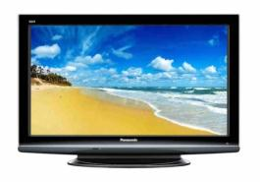
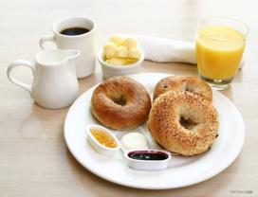
Word’s world task 1. Name the pictures
piano
Swimming pool
television
breakfast

Slide 4
Word’s world task 2. Make words
emtsioems
sometimes
erven
never
lusluay
usually
slywaa
always

Slide 5
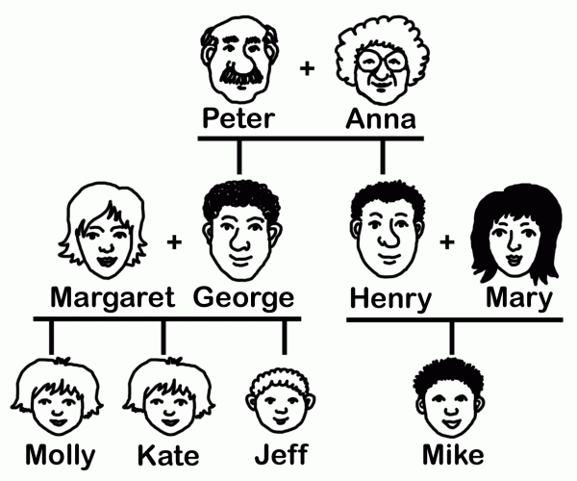
. Word’s world task3.
Hello! My name is Molly. My (5) is big.
I've got a (1). Her name is Margaret.
I've got a (4). His name is George.
I've got a (11). Her name is Kate. Kate and I are (9).
I've got a little (2). His name is Jeff.
I've got a (7). His name is Peter.
I've got a (10) Her name is Anna.
I've got an (3). His name is Henry.
I've got an (8). Her name is Mary.
I've got a (6). His name is Mike.
 |  |  |  |  |  | ⁴
 |  |  | ² |  |  |  |  | ⁵ |  | ⁶
 |  | ⁷
 | ¹
⁸ |  |  |  |  |  | ⁹
 |  |  |  |  | ³
 |  | ¹⁰
 | ¹¹
 |  |  |  |  |  | d
 |  |  | b |  |  | a |  | f |  | c
 |  | g | r | a | n | d | p | a |  | o
 | m |  | o |  |  |  |  | m |  | u
a | u | n | t |  |  | t | w | i | n | s
 | m |  | h |  |  |  |  | l |  | i
 |  |  | e |  | u |  |  | y |  | n
 |  | g | r | a | n | n | y
 |  |  |  |  | c
 |  |  |  |  | l
 | s | i | s | t | e | r

Slide 6
Write correctly task 1. Possessive
1. работа Джессики
2. имя доктора
3. машина Фрэнка
4. телевизор Ани
5. компьютер моих сыновей
6. дочь Марка и Виктории
7. дети Сюзанны
8. ключи моей сестры
9. сумки наших друзей
10. учитель моей дочери

Slide 7
Write correctly task 2. Present simple vs Present continuous
you / often / wear / jeans?
you / wear / jeans now?
it / rain / now?
it / often / rain / in your country?
you / study / English every day?
you / study / English at the moment?

Slide 8
Write correctly task3. A family tree
Jack is_______husband.
Kate is Mary’s_______.
Nick is_______father.
Sally is Ann’s_______.
Kate and Nick are Ann’s________.
Don is_____grandfather.

Slide 9
Listen to task1. Repeat ☺
http://yandex.ru/video/search?filmId=Xm4I1VgAUXI&text=wake%20up%20in%20the%20morning&redircnt=1446994898.1

Slide 10
Listen to task2.
b
a
a
b
a
b
b

Slide 11
Listen to task 3.
1.B
2.B

