Slide 1
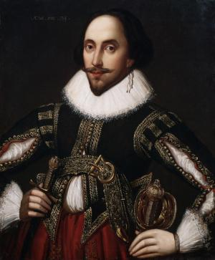
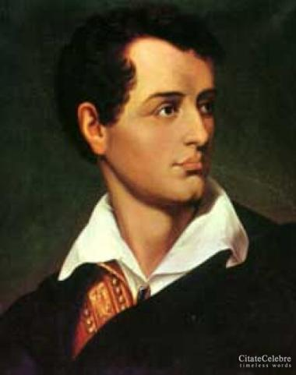
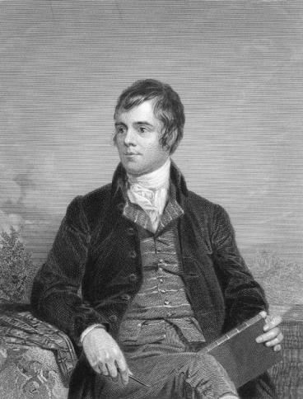
“My Heart Leaps Up...” (William Wordsworth)
An anthology of British and American Poetry.

Slide 2
William Shakespeare
(1564 - 1616)

Slide 3
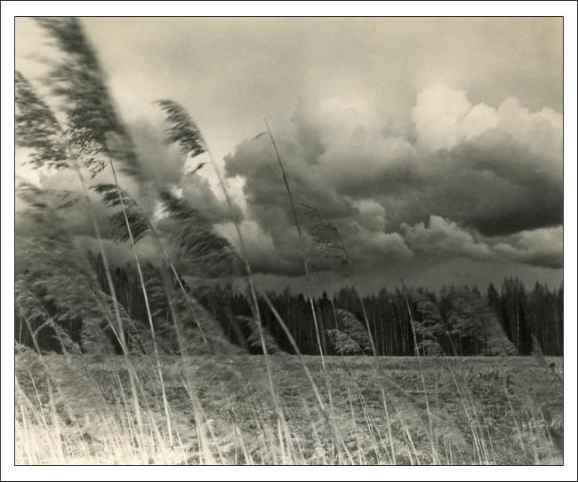
Blow, Blow, Thou Winter Wind
Blow, blow, thou winter wind Thou art not so unkind As man's ingratitude; Thy tooth is not so keen, Because thou art not seen, Although thy breath be rude.

Slide 4
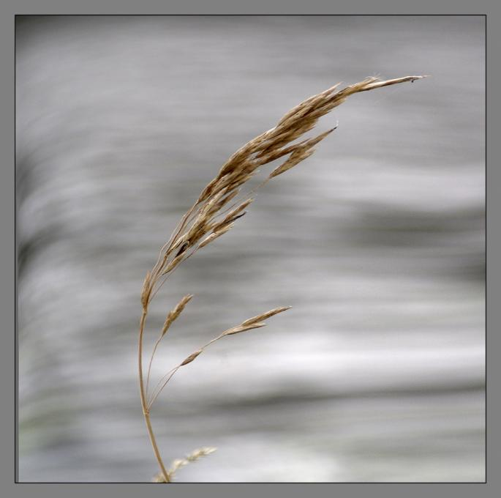
Freeze, freeze thou bitter sky, That does not bite so nigh As benefits forgot: Though thou the waters warp, Thy sting is not so sharp As a friend remembered not.

Slide 5
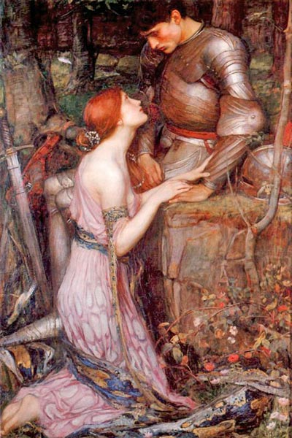
SONNET 116
Let me not to the marriage of true minds Admit impediments. Love is not love Which alters when it alteration finds, Or bends with the remover to remove: O no! it is an ever-fixed mark That looks on tempests and is never shaken; It is the star to every wandering bark, Whose worth's unknown, although his height be taken.

Slide 6
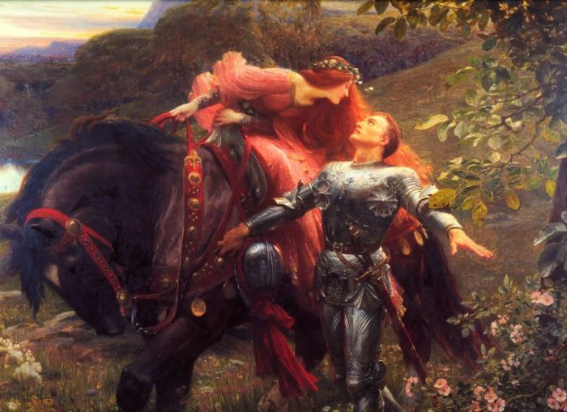
Love's not Time's fool, though rosy lips and cheeks Within his bending sickle's compass come: Love alters not with his brief hours and weeks, But bears it out even to the edge of doom. If this be error and upon me proved, I never writ, nor no man ever loved.

Slide 7
George Gordon, Lord Byron
(1788-1824)

Slide 8
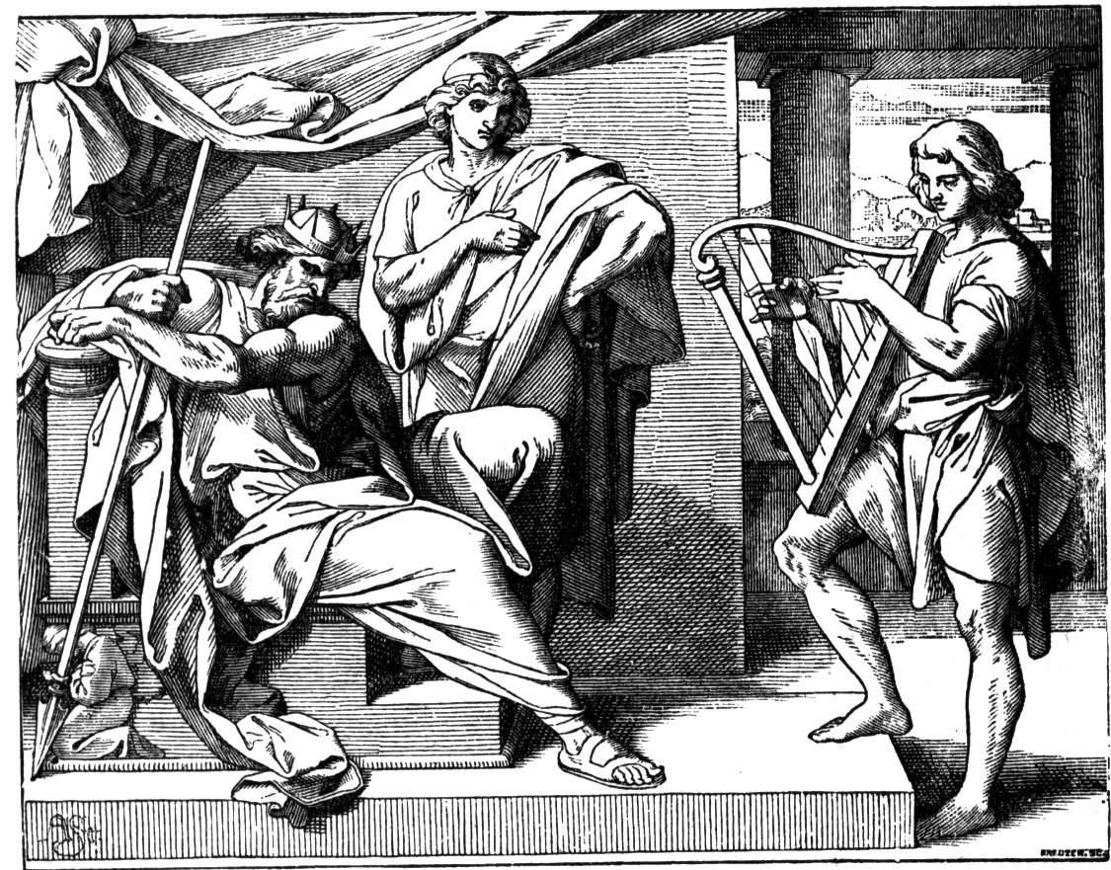
My Soul is Dark
My soul is dark - Oh! quickly string The harp I yet can brook to hear; And let thy gentle fingers fling Its melting murmurs o'er mine ear. If in this heart a hope be dear, That sound shall charm it forth again: If in these eyes there lurk a tear, 'Twill flow, and cease to burn my brain.

Slide 9
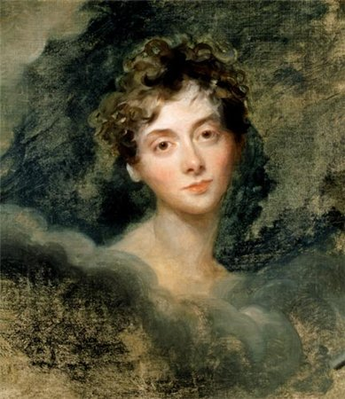
She walks in beauty’
She walks in beauty, like the night Of cloudless climes and starry skies; And all that's best of dark and bright Meet in her aspect and her eyes: Thus mellowed to that tender light Which heaven to gaudy day denies.

Slide 10
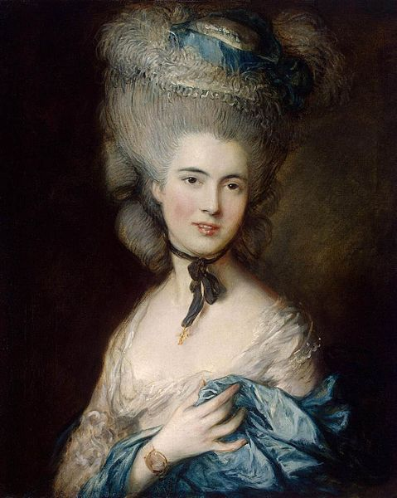
One shade the more, one ray the less,
Had half impair`d the nameless grace
Which waves in every raven tress,
Or softly lightens o'er her face;
Where thoughts serenely sweet express,
How pure, how dear their dwelling-place.

Slide 11
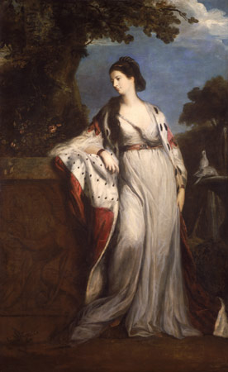
And on that cheek, and o'er that brow, So soft, so calm, yet eloquent, The smiles that win, the tints that glow, But tell of days in goodness spent, A mind at peace with all below, A heart whose love is innocent!

Slide 12
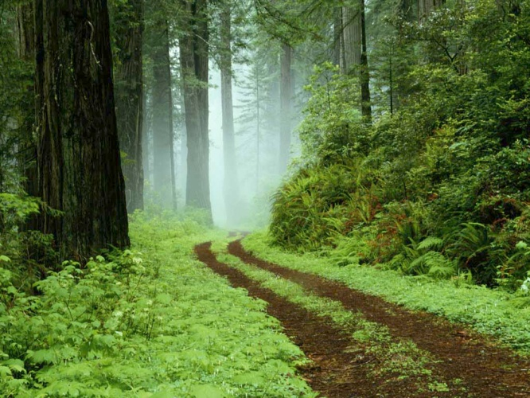
There is a pleasure in the pathless woods…
There is a pleasure in the pathless woods, There is a rapture on the lonely shore, There is society, where none intrudes, By the deep sea, and music in its roar: I love not man the less, but Nature more, From these our interviews, in which I steal From all I may be, or have been before, To mingle with the Universe, and feel What I can ne'er express, yet cannot all conceal.

Slide 13
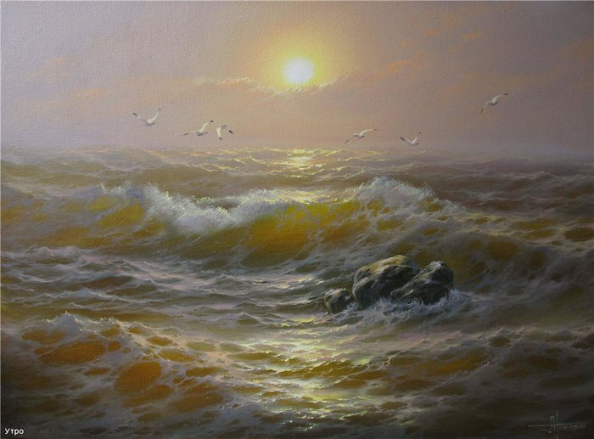
Adieu, adieu! My native shore
Fades o’er the waters blue;
The night – winds sigh,
The breakers roar,
And shrieks the wild sea – mew.
Yon sun that sets upon the sea
We follow in his flight;
Farewell awhile to him and thee,
My native Land – Good Night!

Slide 14
Robert Burns
(1759-1796)

Slide 15
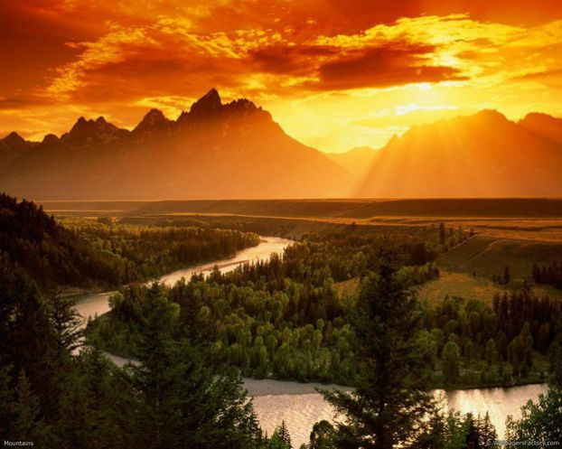
My heart's in the Highlands, my heart is not here, My heart's in the Highlands a-chasing the deer - A-chasing the wild deer, and following the roe; My heart's in the Highlands, wherever I go. Farewell to the Highlands, farewell to the North, The birth place of Valour, the country of Worth; Wherever I wander, wherever I rove, The hills of the Highlands for ever I love.

Slide 16
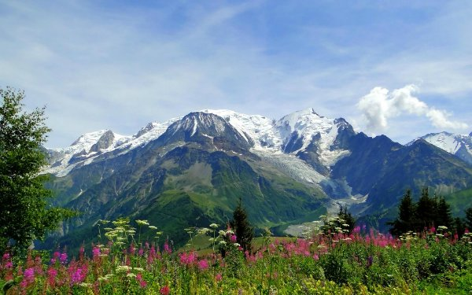
Farewell to the mountains high cover'd with snow; Farewell to the straths and green valleys below; Farewell to the forests and wild-hanging woods; Farwell to the torrents and loud-pouring floods. My heart's in the Highlands, my heart is not here, My heart's in the Highlands a-chasing the deer Chasing the wild deer, and following the roe; My heart's in the Highlands, wherever I go.

Slide 17
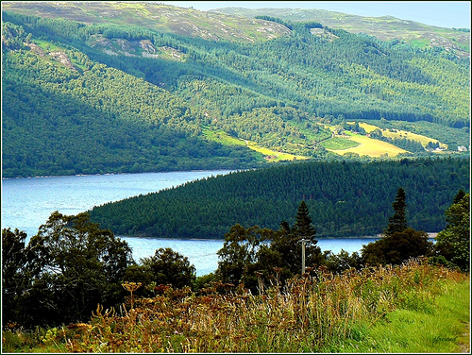
Out Over The Forth
Out over the Forth, I look to the North; But what is the north and its Highlands to me? The south nor the east gie ease to my breast, The far foreign land, or the wide rolling sea.
But I look to the west when I gae to rest, That happy my dreams and my slumbers may be; For far in the west lives he I loe best, The man that is dear to my babie and me.

Slide 18
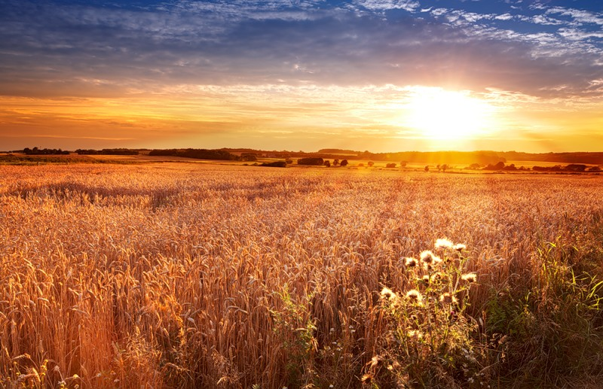
One night as I did wander…
One night as I did wander,
When corn begins to shoot,
I sat me down to ponder
Upon and auld tree root:
Auld Ayr ran by before me,
And bickered to the seas;
A cushat croodled o’er me,
And echo’d through the braes.

Slide 19
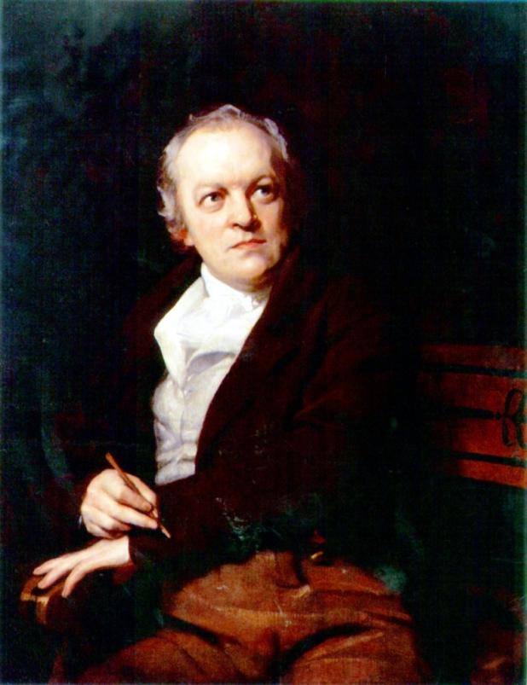
William Blake (1757-1827)

Slide 20
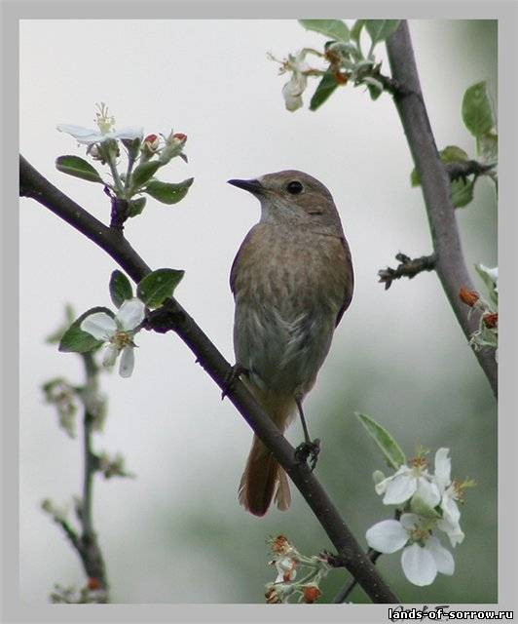
Spring.
Sound the flute! Now it's mute! Bird's delight, Day and night, Nightingale, In the dale, Lark in sky,-- Merrily, Merrily merrily, to welcome in the year.

Slide 21
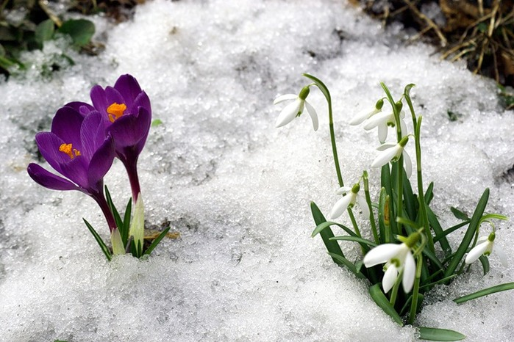
Little boy, Full of joy; Little girl, Sweet and small; Cock does crow, So do you; Merry voice, Infant noise; Merrily, merrily, to welcome in the year.

Slide 22
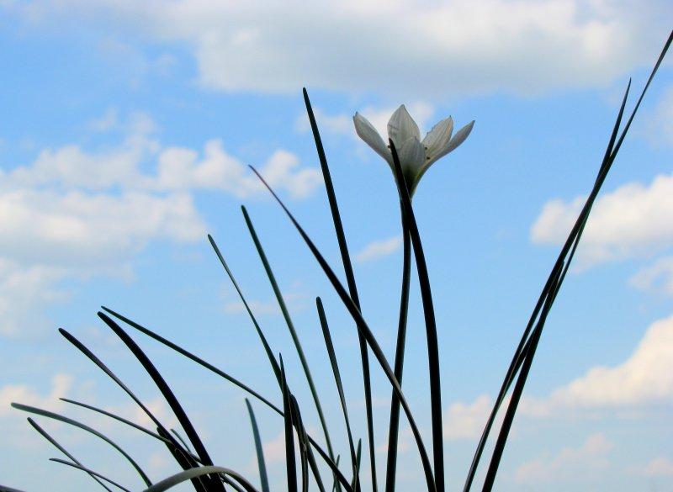
To see a World in a grain of sand,
To see a World in a grain of sand, And a Heaven in a wild flower, Hold Infinity in the palm of your hand, And Eternity in an hour.

Slide 23
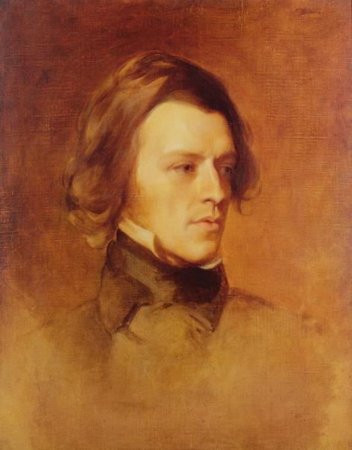
Afred, Lord Tennyson (1809-1892)

Slide 24
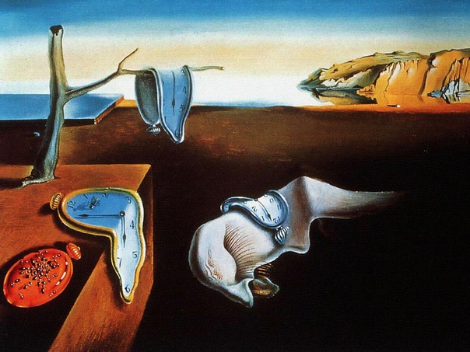
Who can say?
Who can say
Why Today
Tomorrow will be yesterday?
Who can tell why to smell
The violet, recalls the dewy prime
Of youth and buried time?
The cause is nowhere found in rhyme.

Slide 25
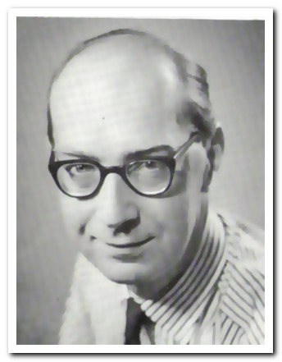
Philip Arthur Larkin (1922-1985)

Slide 26
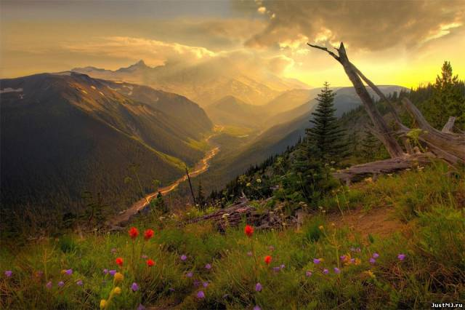
What are days for?
What are days for?
Days are where we live.
They come, they wake us
Time and time over.
They are to be happy in:
Where can we live but days?
Ah, solving that question
Brings the priest and the doctor
In their long coats
Running over the fields.

Slide 27
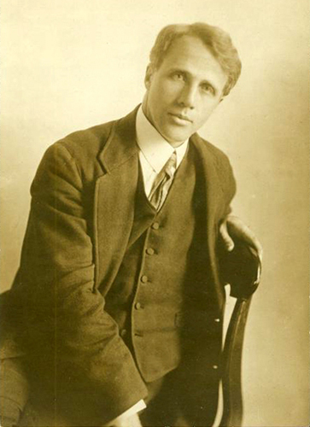
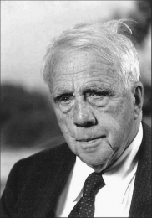
Robert Frost
(1874-1963)

Slide 28
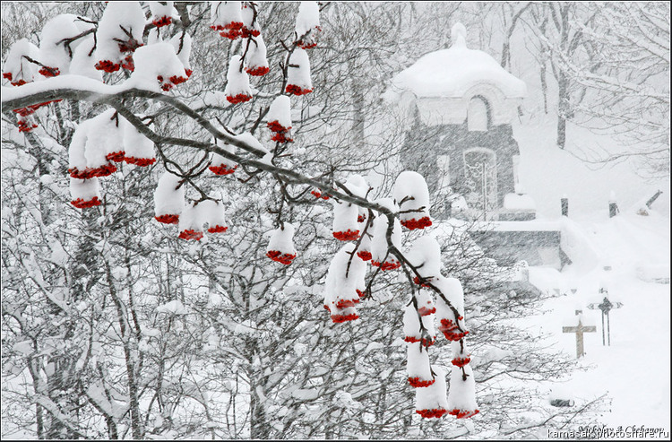
Dust of Snow
The way a crow Shook down on me The dust of snow From a hemlock tree Has given my heart A change of mood And saved some part Of a day I had rued.

Slide 29
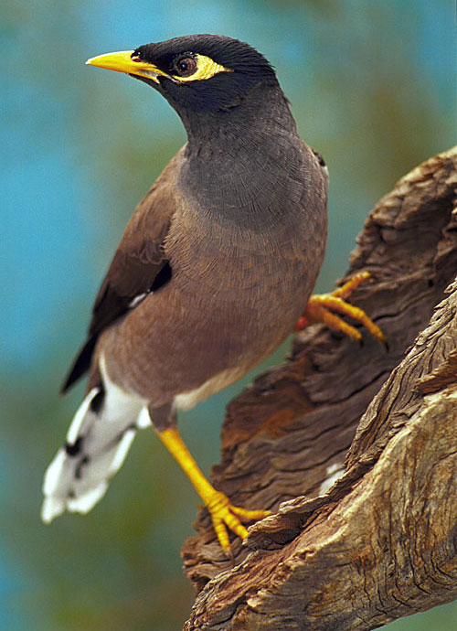
A Minor Bird
I have wished a bird would fly away, And not sing by my house all day; Have clapped my hands at him from the door When it seemed as if I could bear no more. The fault must partly have been in me. The bird was not to blame for his key. And of course there must be something wrong In wanting to silence any song.

Slide 30
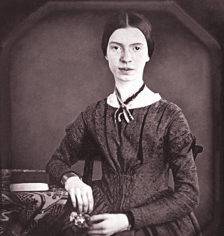
Emily Dickinson
(1830-1886)

Slide 31
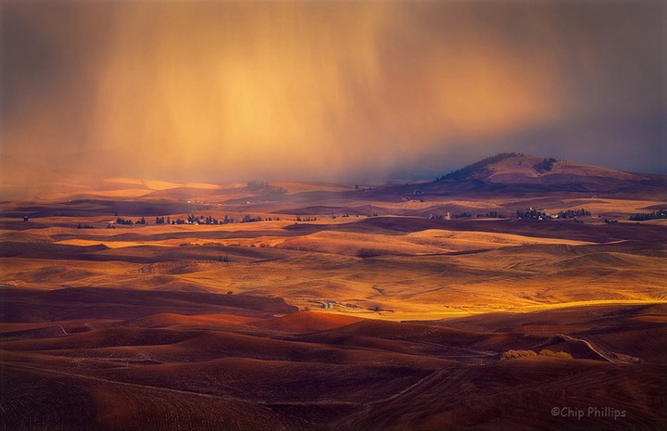
Nature is what we see…
"Nature" is what we see –
The Hill - the Afternoon –
Squirrel - Eclipse - the Bumble bee –
Nay - Nature is Heaven –
Nature is what we hear –
The Bobolink - the Sea –
Thunder - the Cricket –
Nay - Nature is Harmony –
Nature is what we know –
Yet have no art to say –
So impotent Our Wisdom is
To her Simplicity.

Slide 32
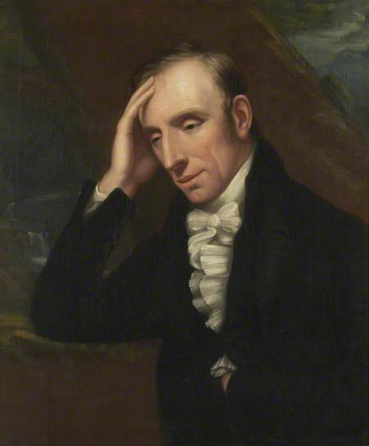
WilliamWordsworth
(1770-1850)

Slide 33
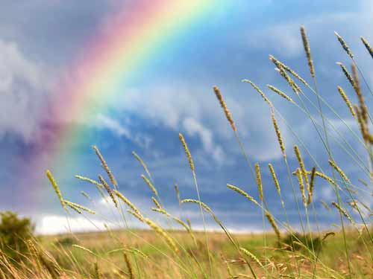
My Heart Leaps Up
My heart leaps up when I behold A rainbow in the sky: So was it when my life began; So is it now I am a man; So be it when I shall grow old, Or let me die! The Child is father of the Man; And I could wish my days to be Bound each to each by natural piety.

Slide 34
Should old acquaintance be forgot…
2)And there’s a hand my trusty friend ! And give us a hand o’ thine ! And we’ll take a right good-will draught, for auld lang syne.
CHORUS
1)Should old acquaintance be forgot, and never brought to mind ? Should old acquaintance be forgot, and old lang syne ?
CHORUS:
For auld lang syne, my dear,
for auld lang syne,
we'll take a cup of kindness yet,
for auld lang syne.

