Slide 1
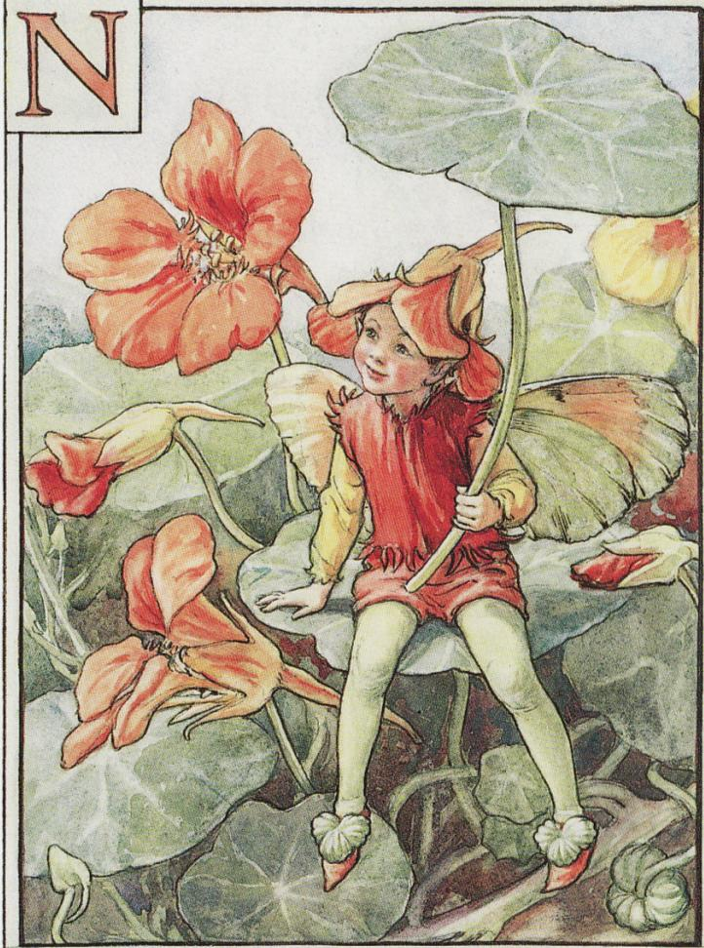
NASTURTIUM

Slide 2
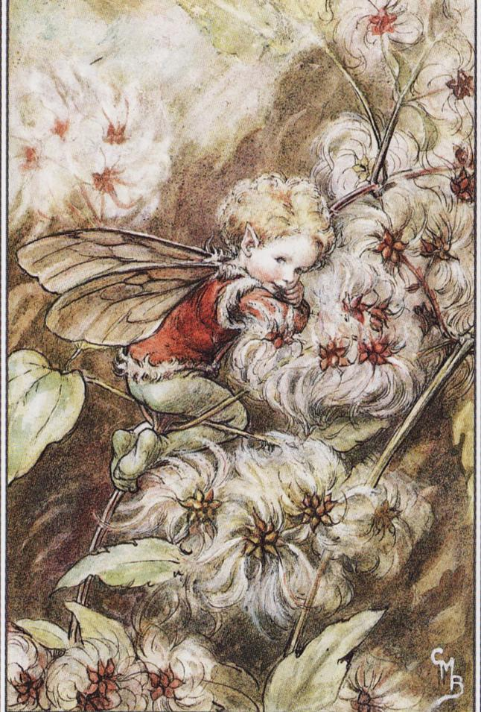
OLD-MAN’S BEARD

Slide 3
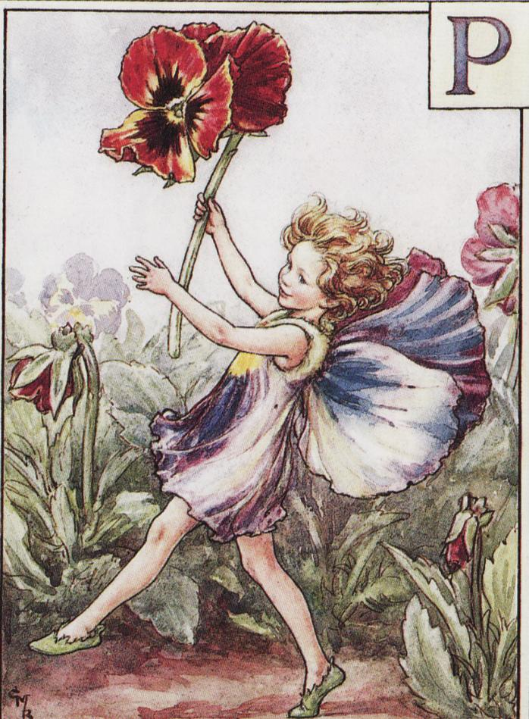
PANSY

Slide 4
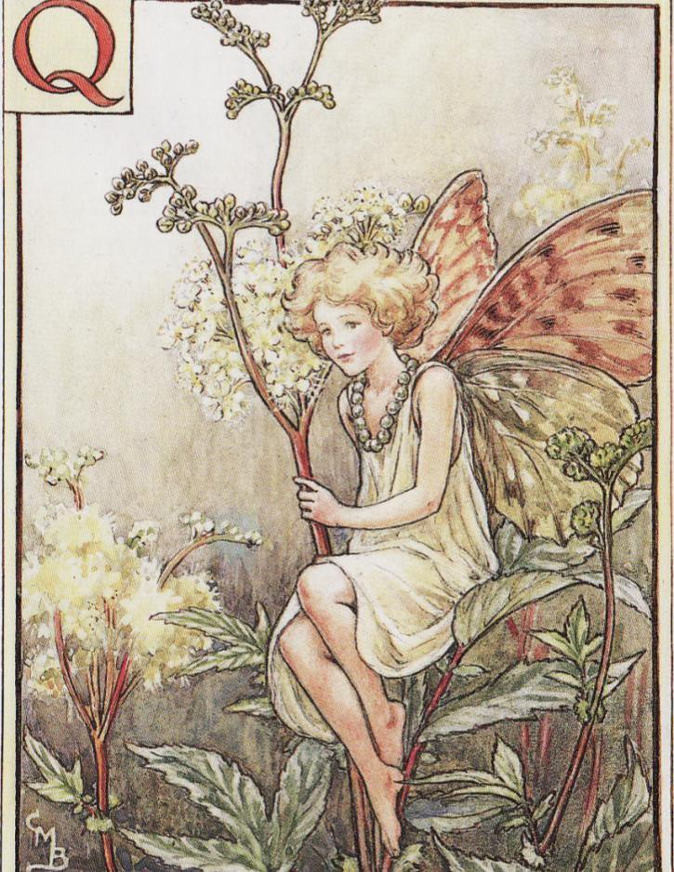
QUEEN OF THE MEADOW

Slide 5
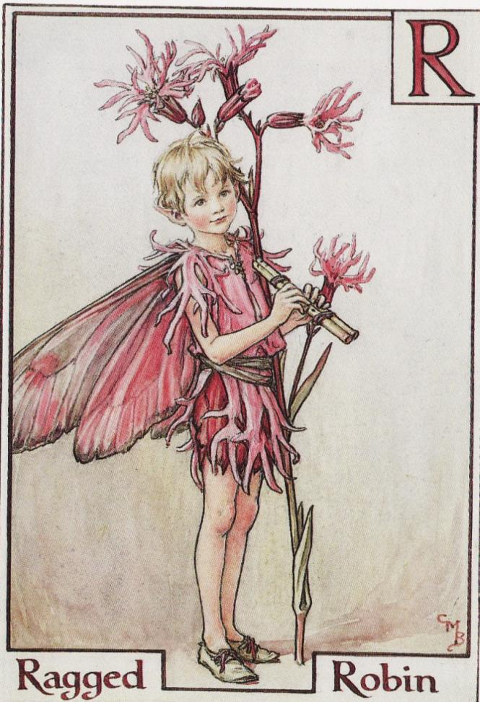
RAGGED ROBIN

Slide 6
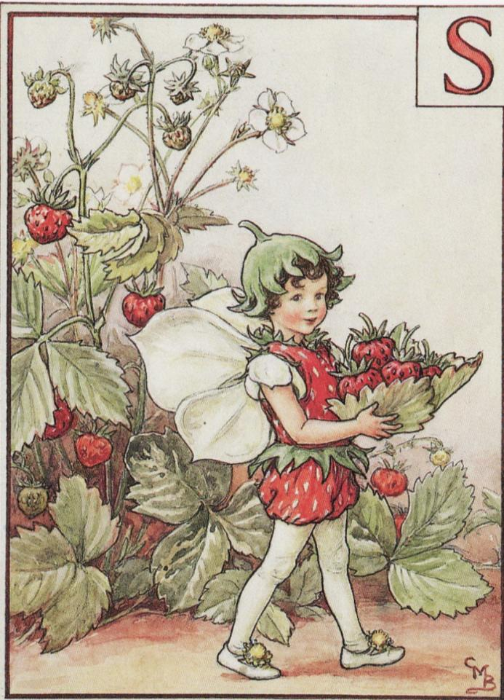
STRAWBERRY

Slide 7
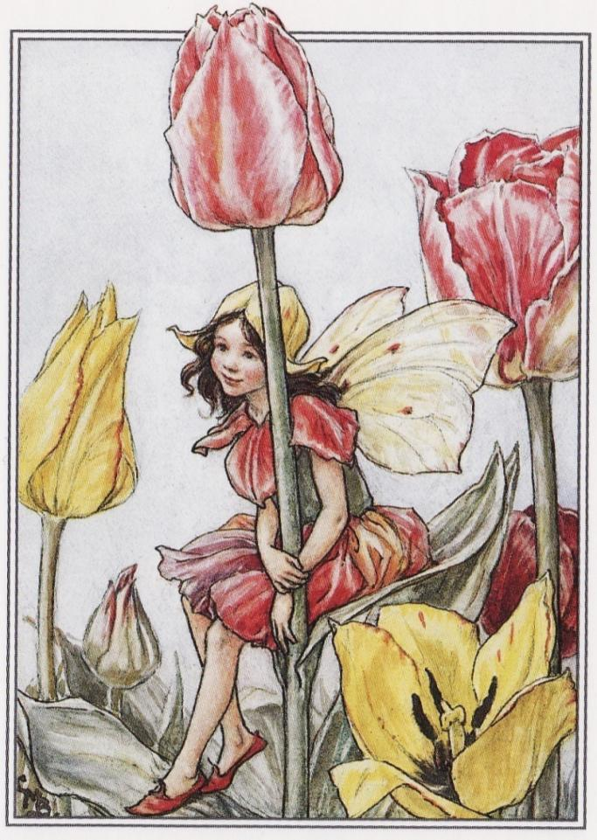
TULIP

Slide 8
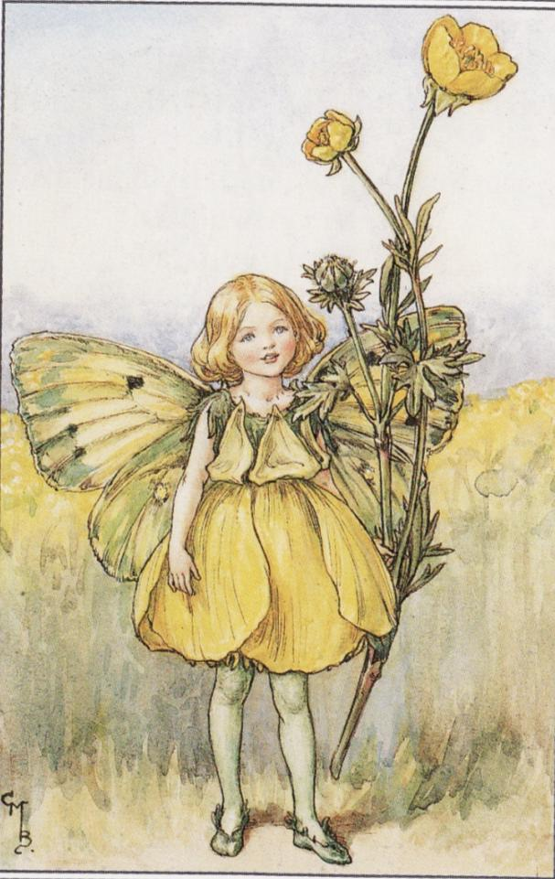
BUTTERCUP

Slide 9
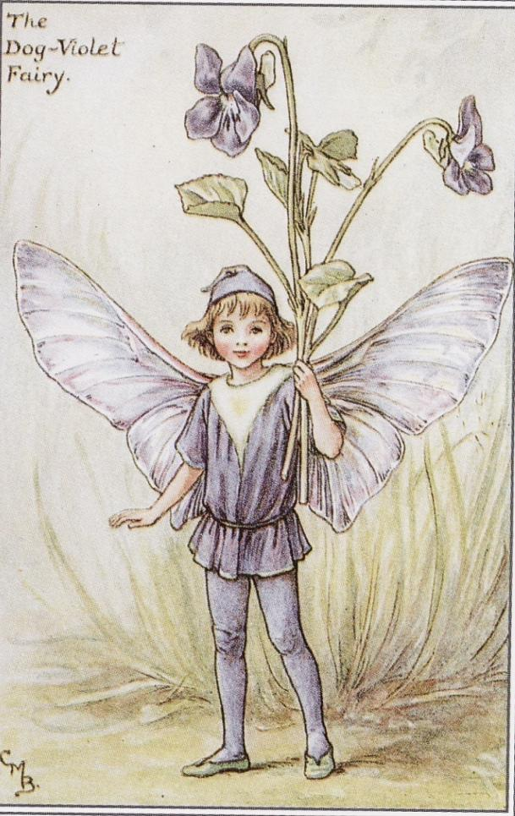
VIOLET

Slide 10
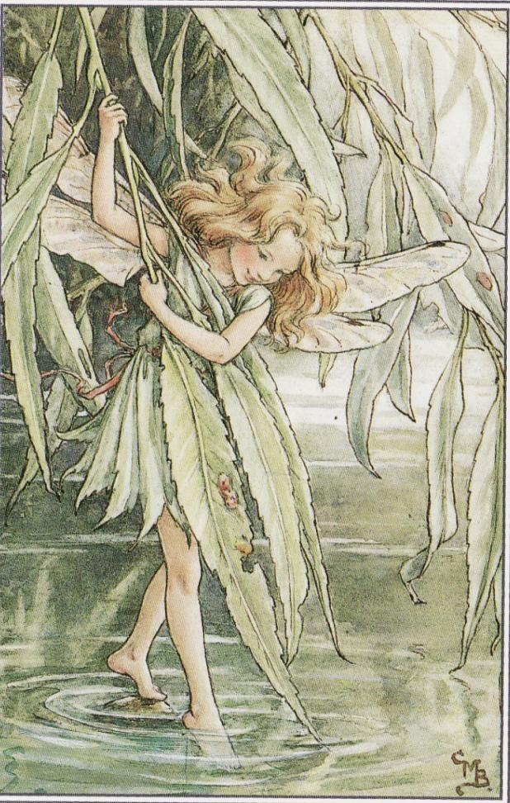
WILLOW

Slide 11
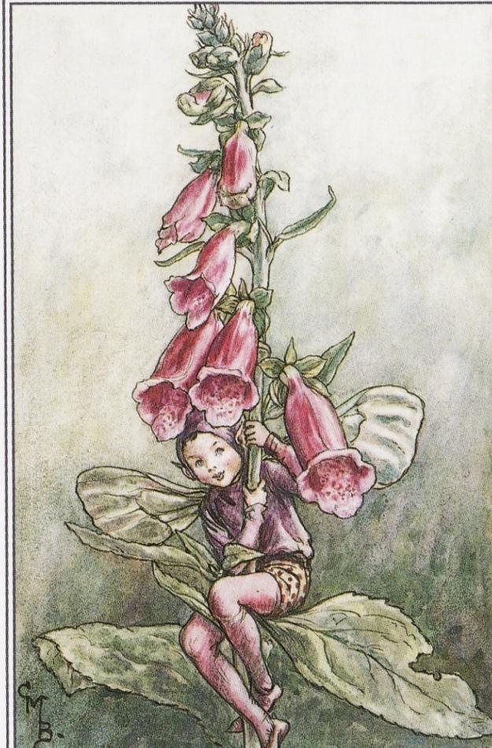
FOXGLOVE

Slide 12
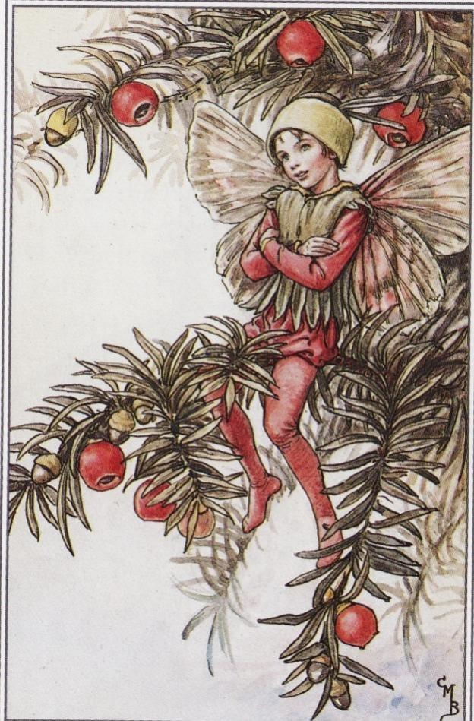
YEW

Slide 13
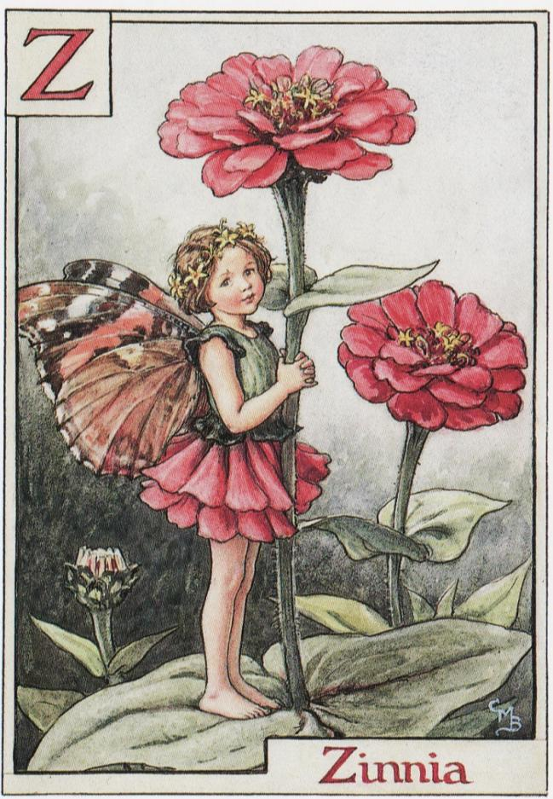
ZINNIA

Slide 14
THANK YOU!

