Slide 1
The Flower Alphabet
From A to Z

Slide 2
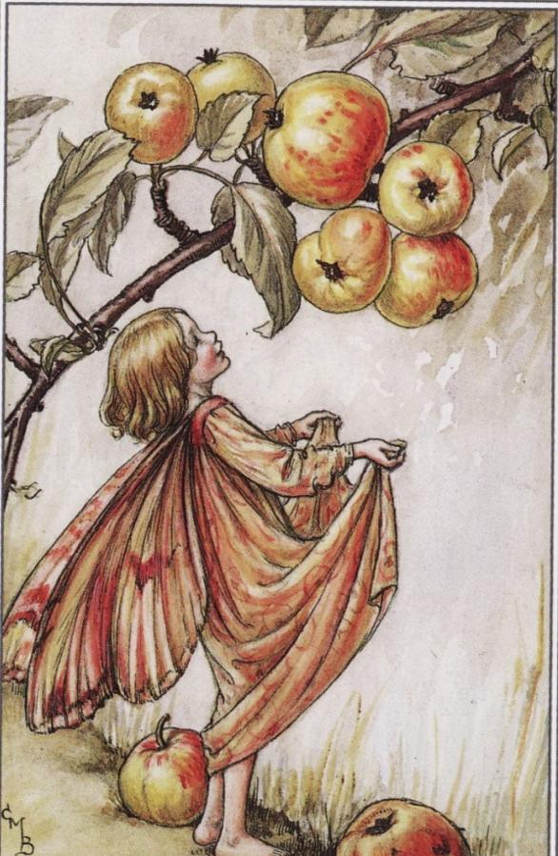
APPLE

Slide 3
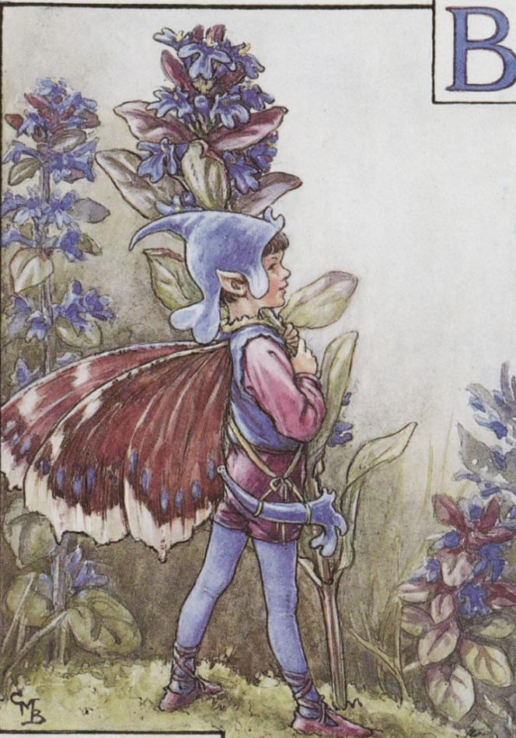
BUGLE
Bugle
Bugle

Slide 4
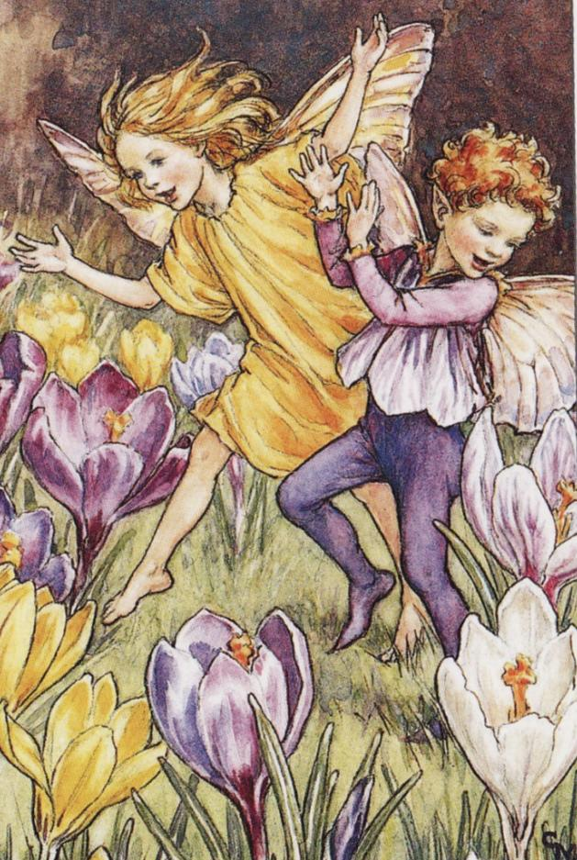
CROCUS

Slide 5
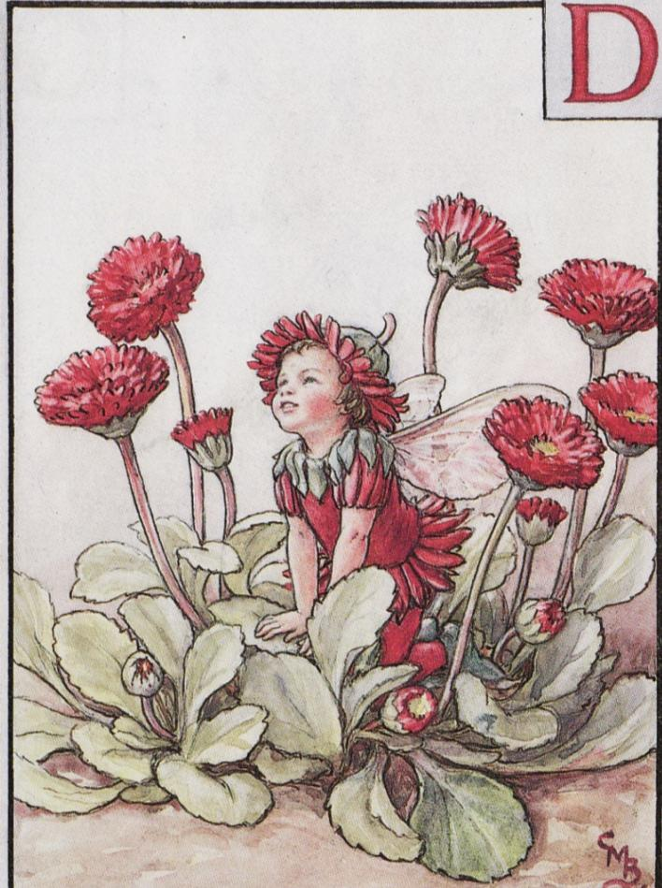
DOUBLE DAISY

Slide 6
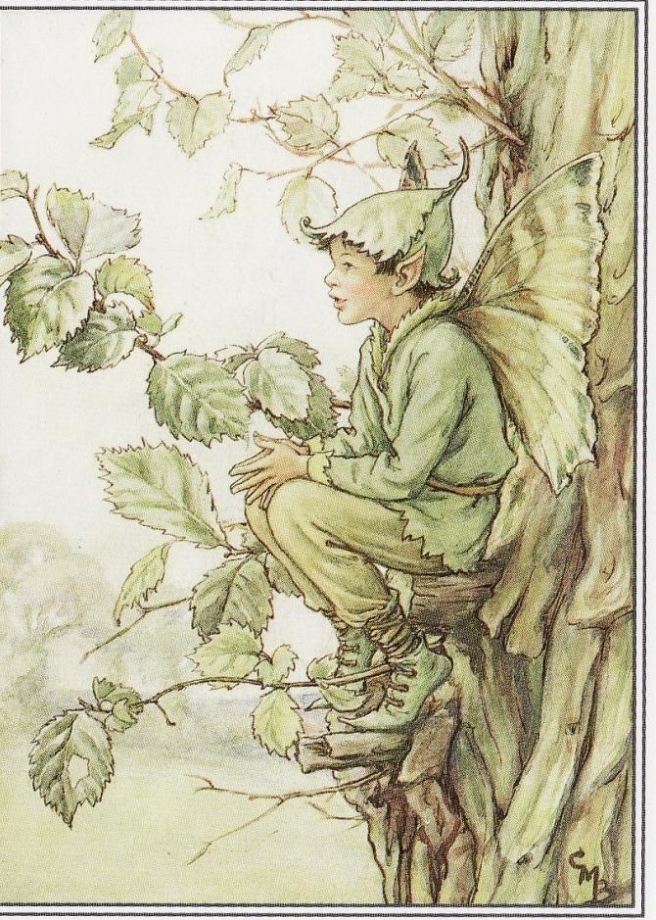
ELM TREE

Slide 7
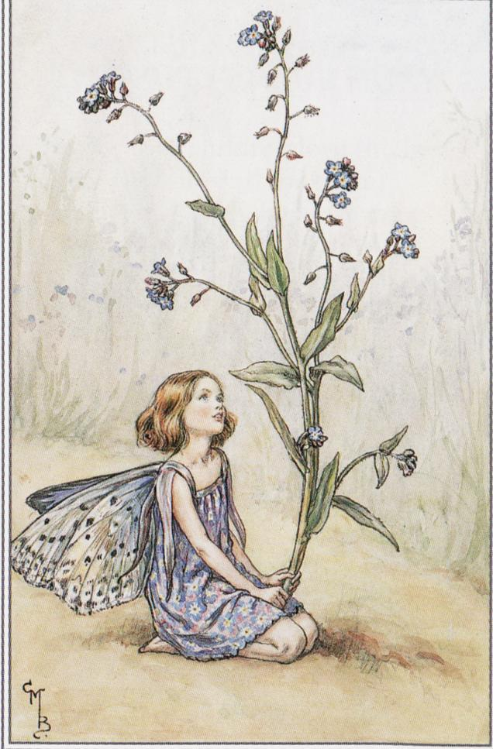
FORGET-ME-NOT

Slide 8
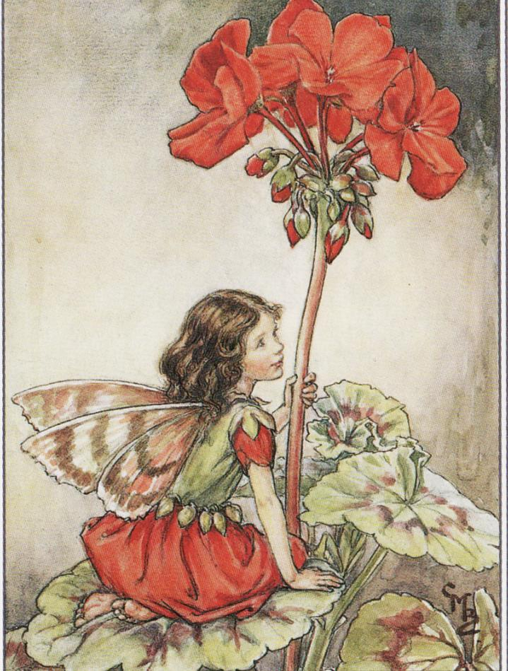
GERANIUM

Slide 9
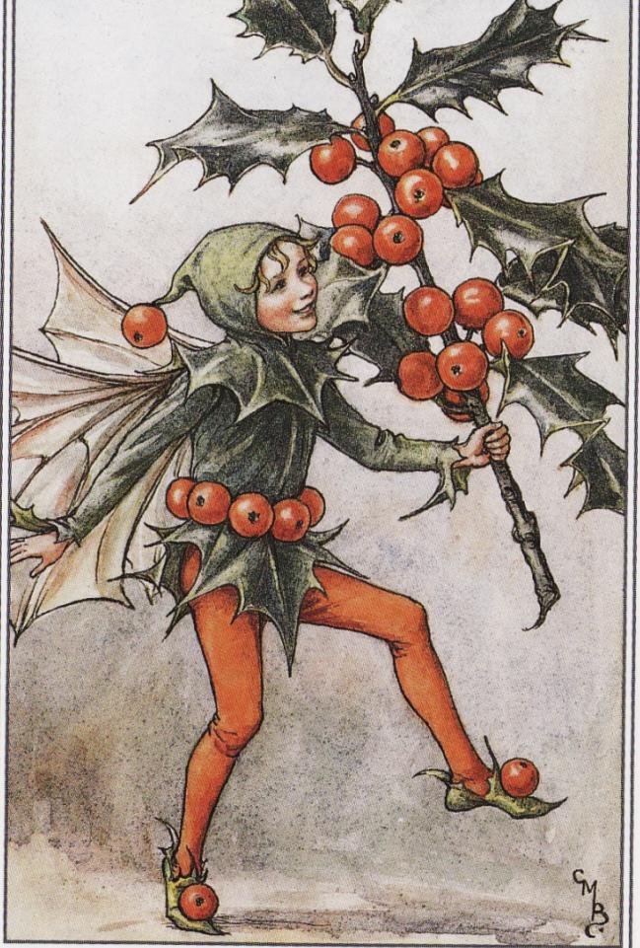
HOllY

Slide 10
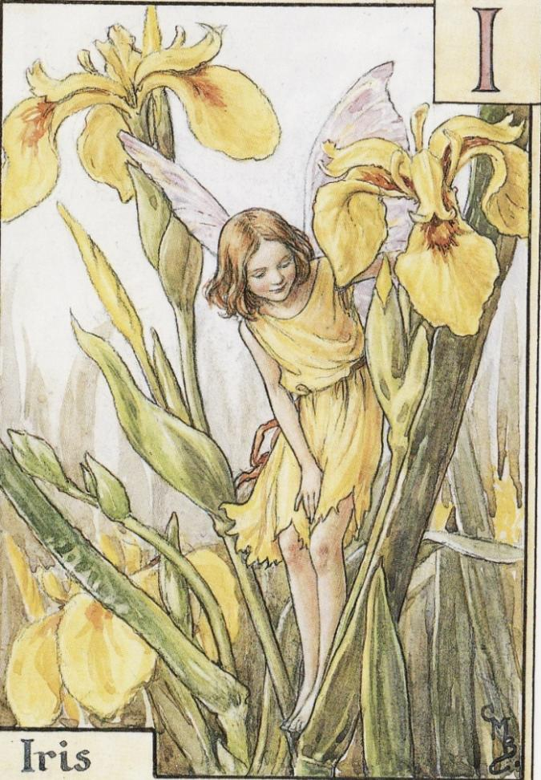
IRIS

Slide 11
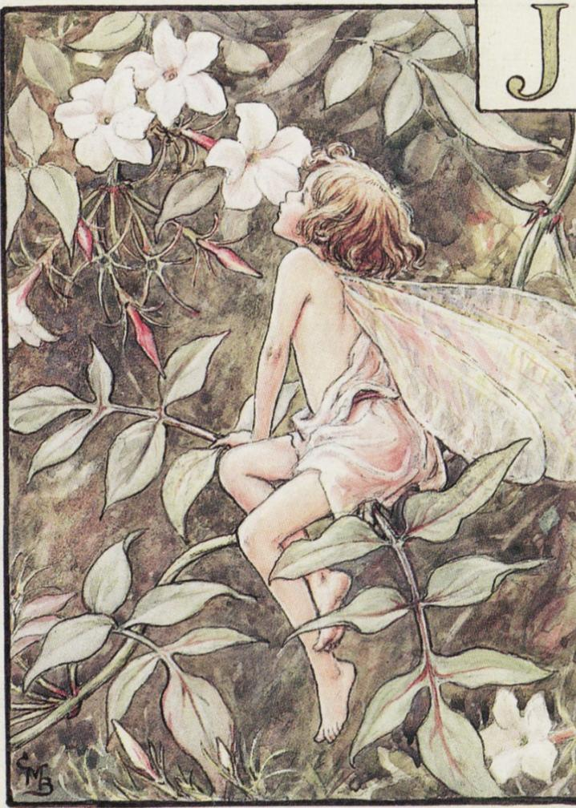
JASMINE

Slide 12
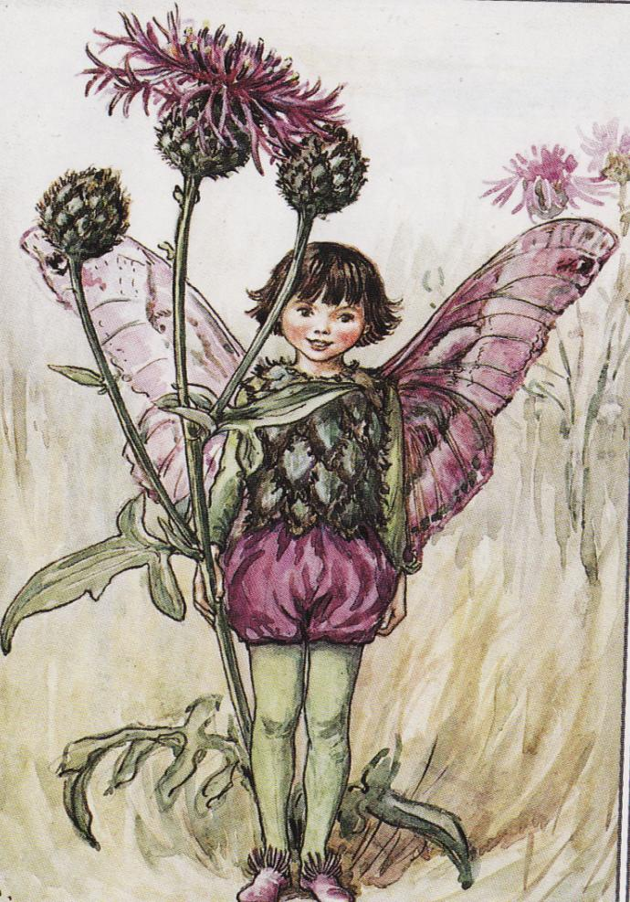
KNAPWEED

Slide 13
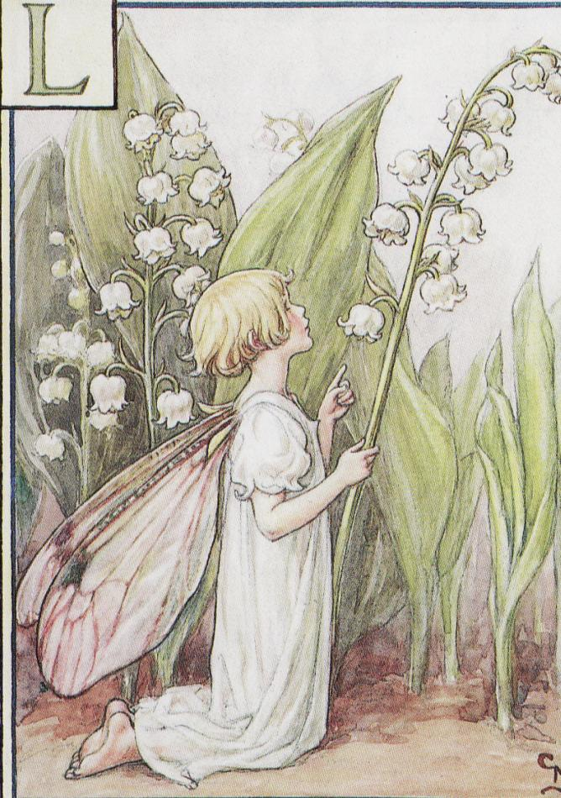
LILY-OF-THE VALLEY

Slide 14
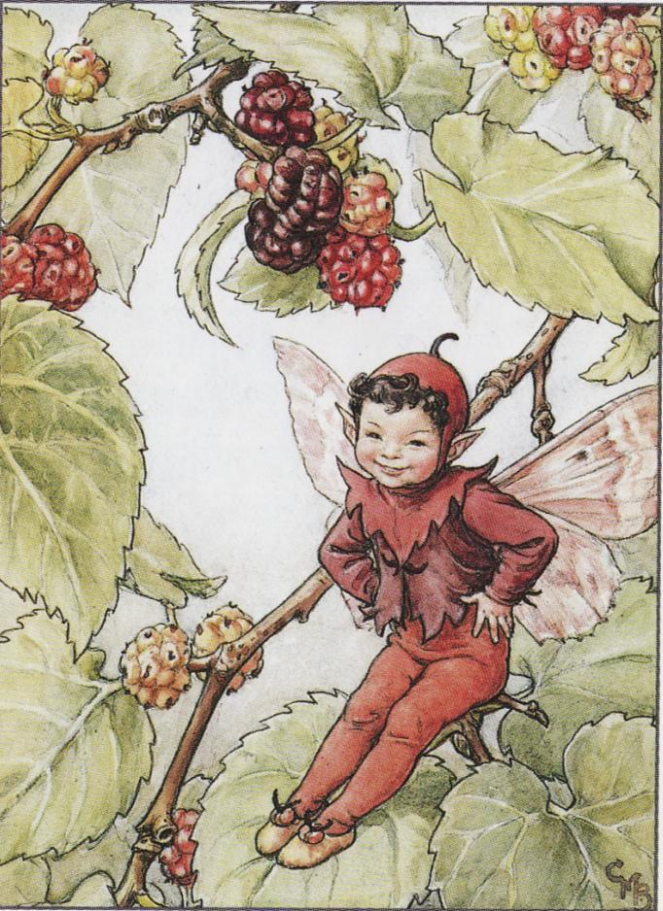
MULBERRY

