Slide 1
We Enjoy English
Our Favourite Poems

Slide 2
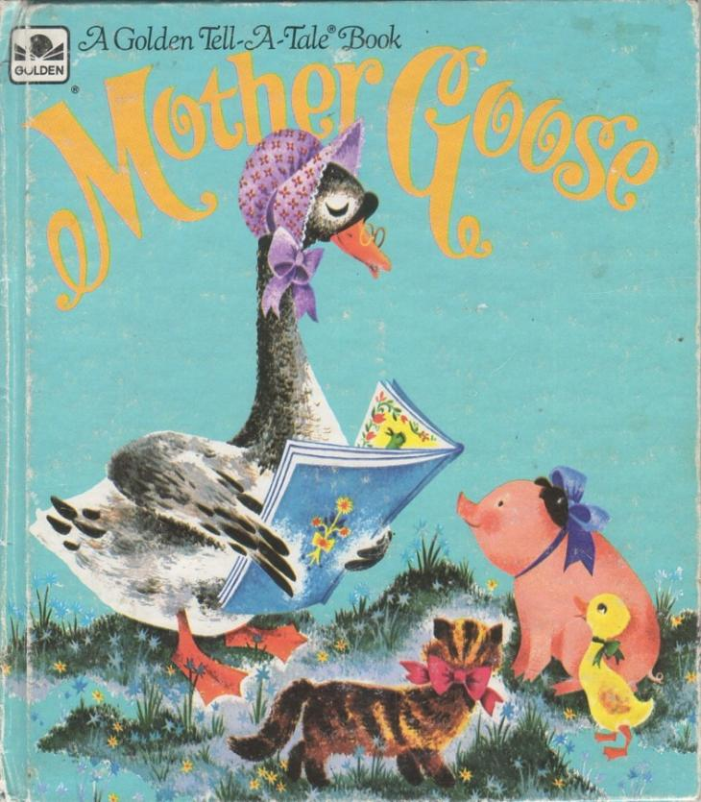
Nursery Rhymes

Slide 3
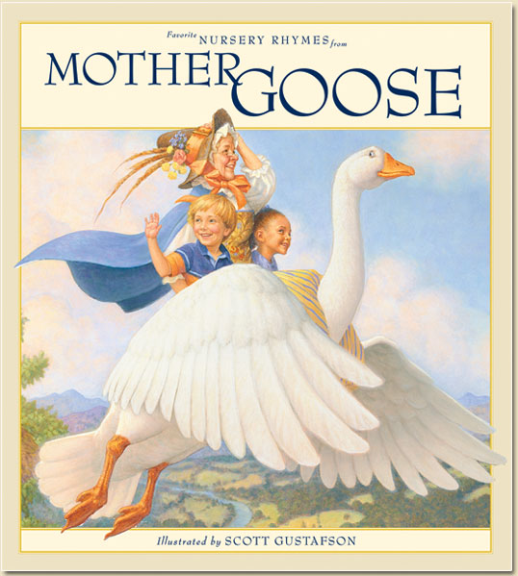

Slide 4
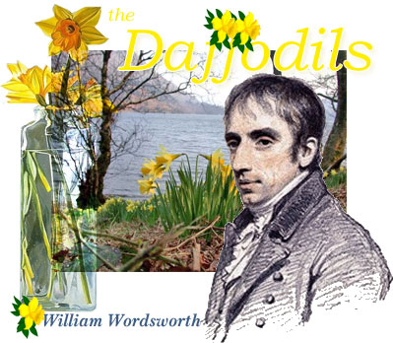
William Wordsworth
(1770-1850)

Slide 5

"Snowflakes"

Slide 6


Slide 7
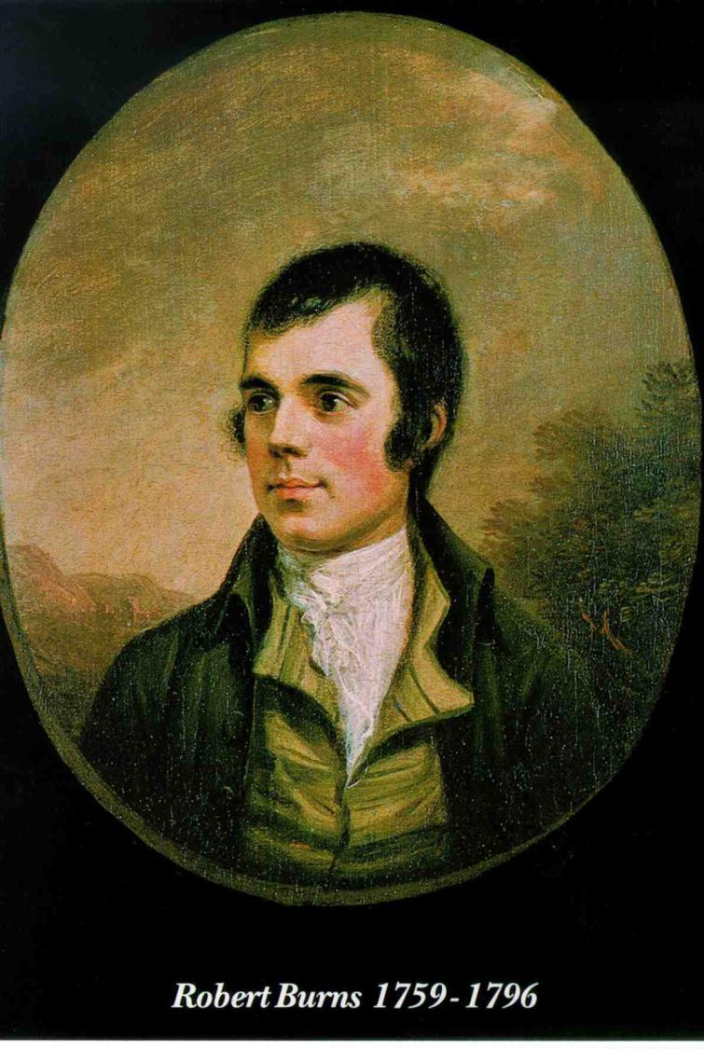

Slide 8
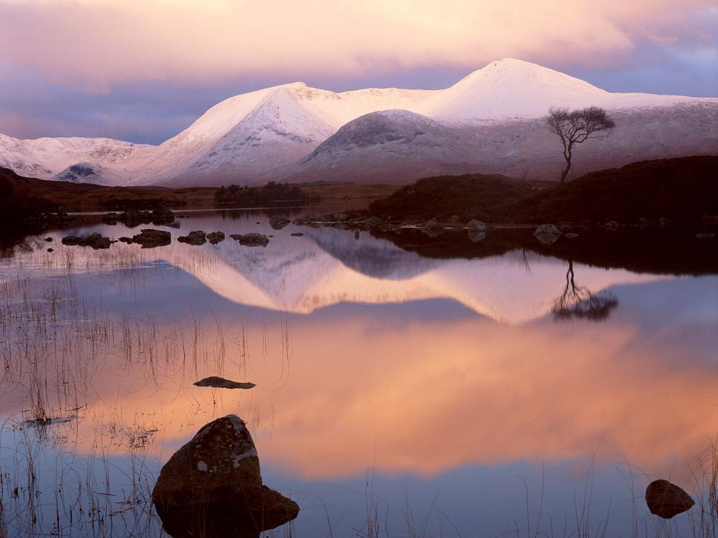
"My Hearts in the Highlands" by Robert Burns

Slide 9
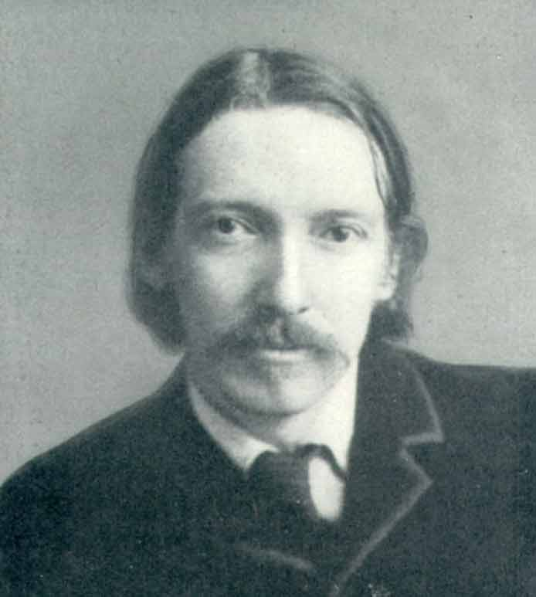
Robert Louis Stevenson
(1850 – 1894)

Slide 10
"The Song of Seasons" by Robert Louis Stevenson
Sing the song of seasons,
Something bright in all.
Flowers in the summer,
Fires in the fall.

Slide 11
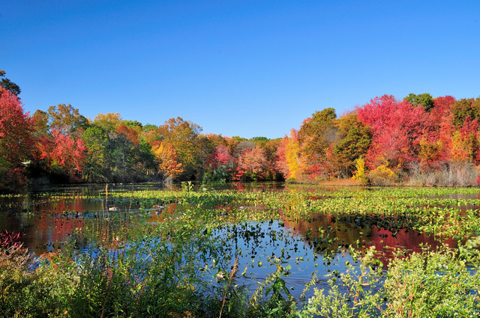
"Months" by R.L.Stevenson
Thirty days has September,
April, June and November.
February has twenty eight alone,
And the rest have thirty one,
Excepting leap-year
That’s the time
When February days are twenty nine.

Slide 12
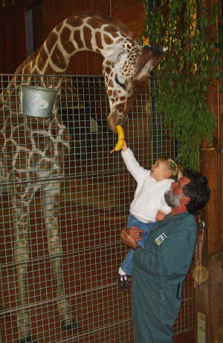
"
“To the Zoo"
by R. L. Stevenson

Slide 13

"The Swing" by Robert Louis Stevenson

Slide 14
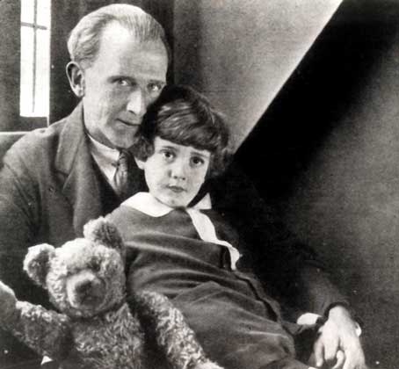
Alan Milne
(1882 – 1856)

Slide 15
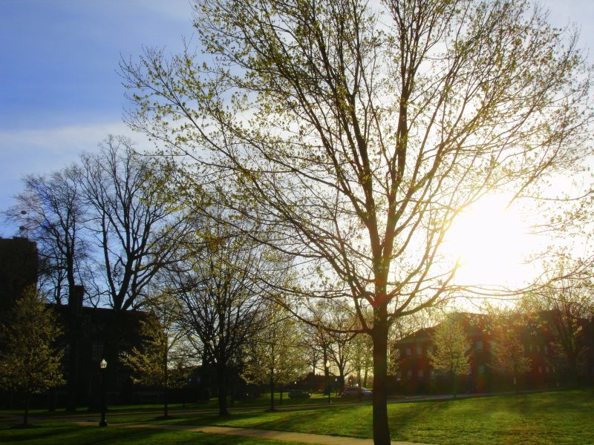
"Spring Morning" by Alan Milne

Slide 16
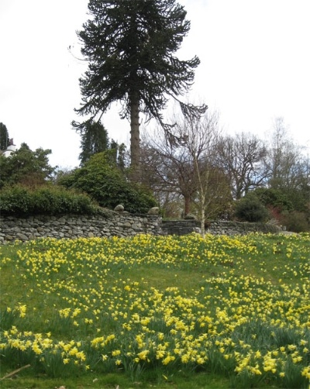

Slide 17
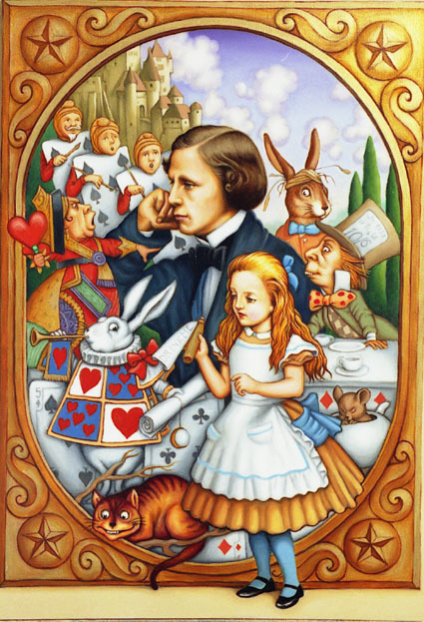
Lewis Carrol
(1832-1898)
wrote the fairy tale “Alice in Wonderland”.
He also wrote funny poems for children and grown - ups.

Slide 18
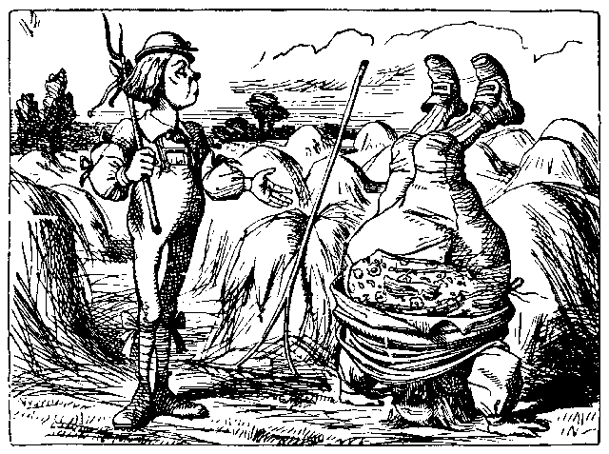
"Father William" by Lewis Carroll

Slide 19
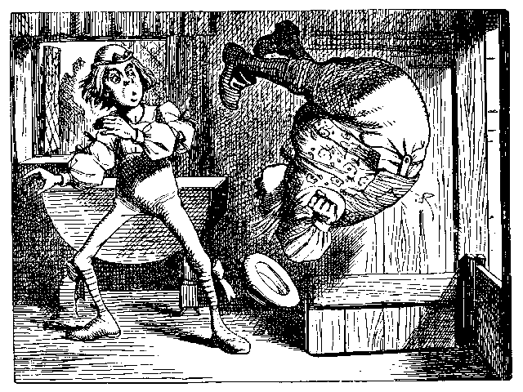
"Father William"

Slide 20
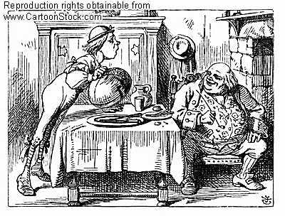
"Father William"

Slide 21
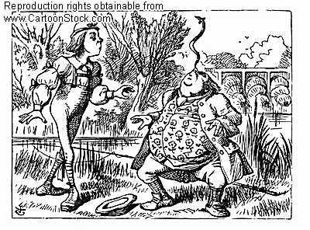
"Father William"

Slide 22
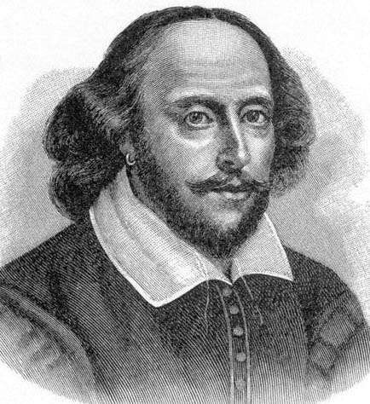
William Shakespeare
(1564-1616)

Slide 23
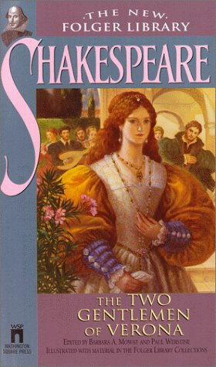

Slide 24
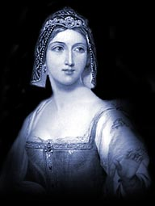
Sylvia

Slide 25
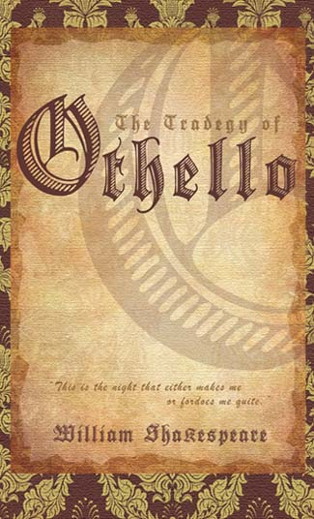

Slide 26
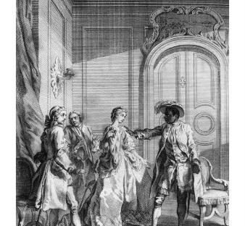
Good name in man and woman
Is the immediate jewel of their souls.
Who steals my purse steals trash – ‘tis something, nothing.
‘Twas mine, ‘tis his and has bee n slave to thousands.
But he that filches form me my good name
Robs me of that which not enriches him
And makes me poor indeed.

Slide 27
Thank you!
Goodbye!

