Slide 1

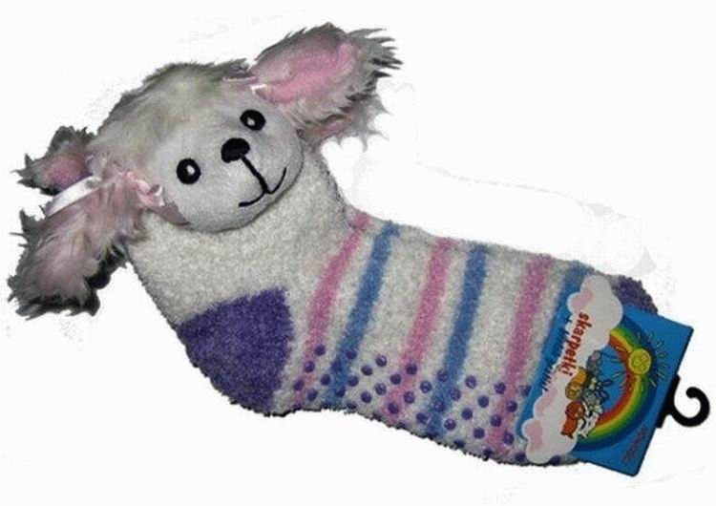
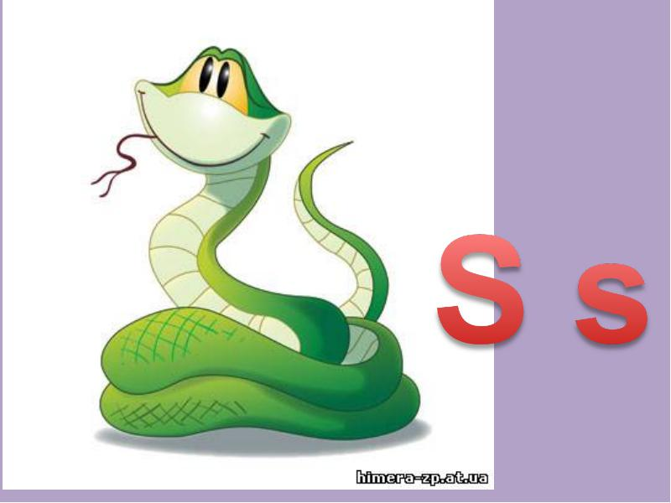
LISTEN, POINT AND SAY
WHAT SOUND DO THE WORDS BEGIN WITH?
sun
sock
snake

Slide 2
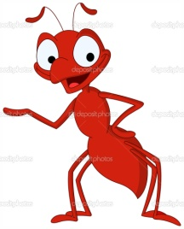
LISTEN, POINT AND SAY
WHAT SOUND DO THE WORDS BEGIN WITH?
ANT
apple
alligator

Slide 3

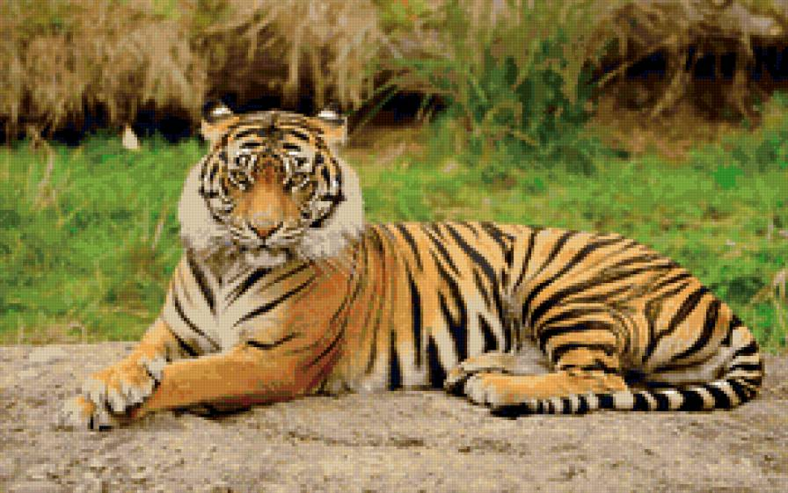
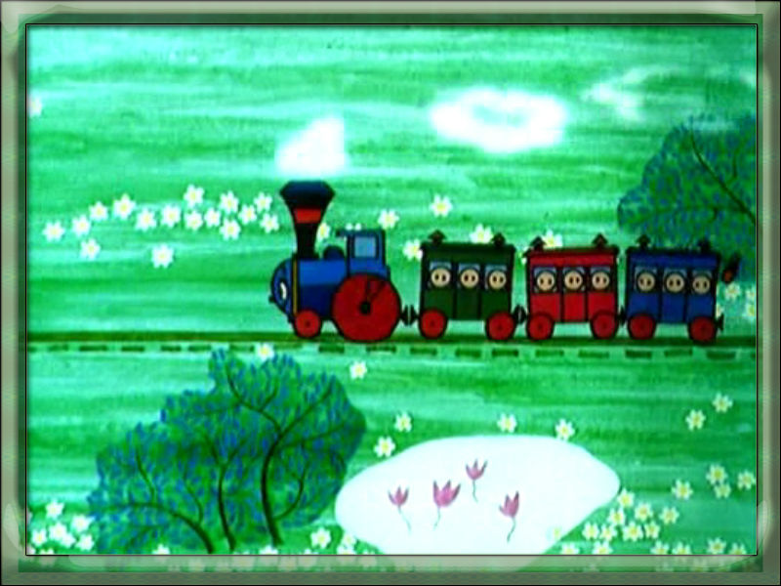
LISTEN, POINT AND SAY
WHAT SOUND DO THE WORDS BEGIN WITH?
TEN
TIGER
TRAIN

Slide 4
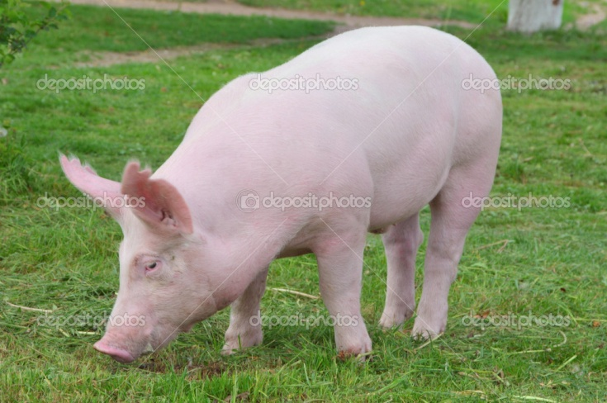
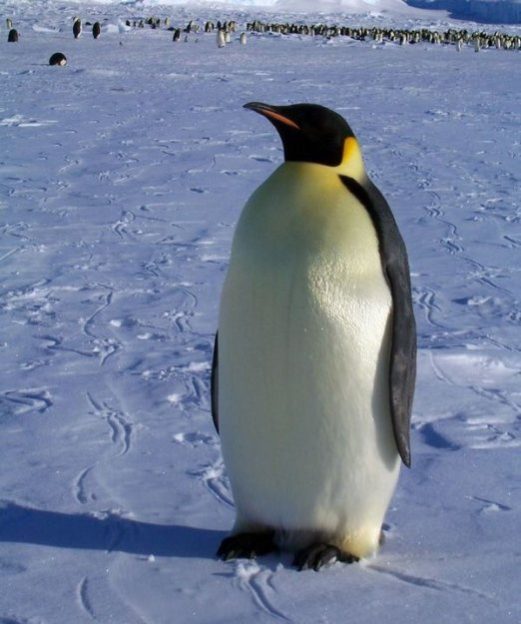
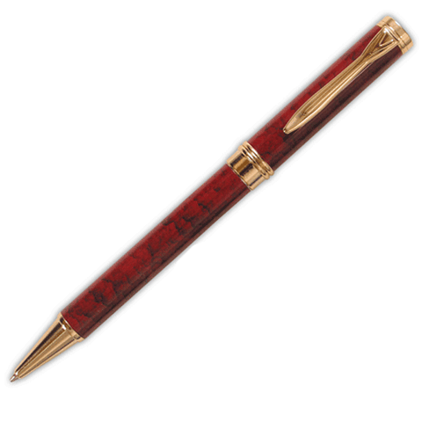
LISTEN, POINT AND SAY
PIG
pen
PENGUIN

Slide 5
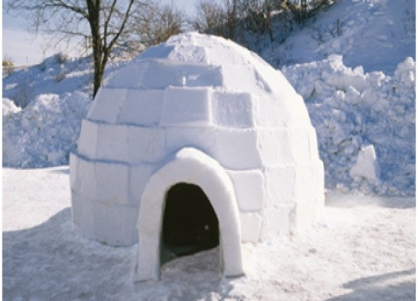
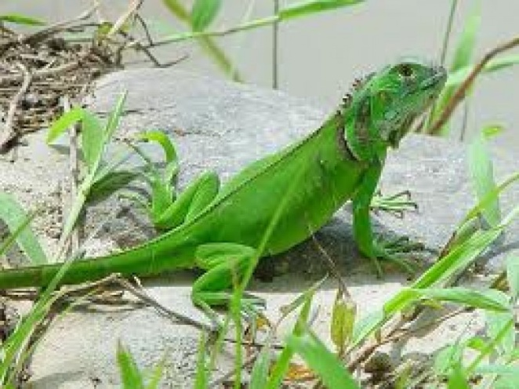
LISTEN, POINT AND SAY
IGLOO
IGUANA

Slide 6
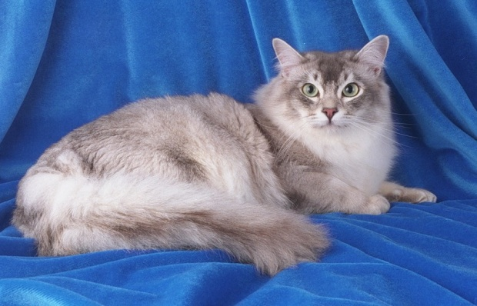
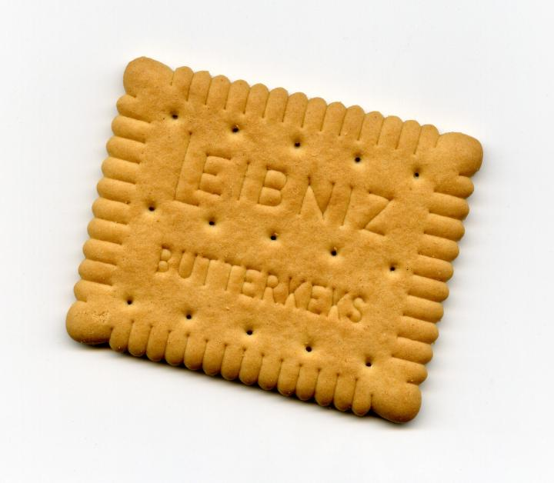
LISTEN, POINT AND SAY
CAT
COOKIE

Slide 7
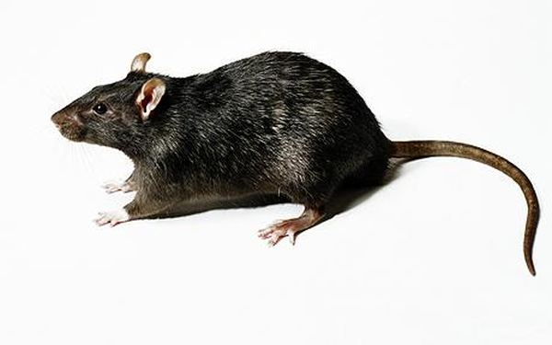

LISTEN, POINT AND SAY
RAT
rain

Slide 8
speed sounds:
s
i
t
Let’s read
i
t
i
t
it
s
si
sit
sits
It sits.

Slide 9

speed sounds
s
a
t
p
n
Let’s read:
ant Pat
a
an
ant
a
an
ant
at
Pat

Slide 10


Let’s read:
I
sit.
I
tap
Pat.
“Pat,
sit!”
tap
Pat
sits.

Slide 11
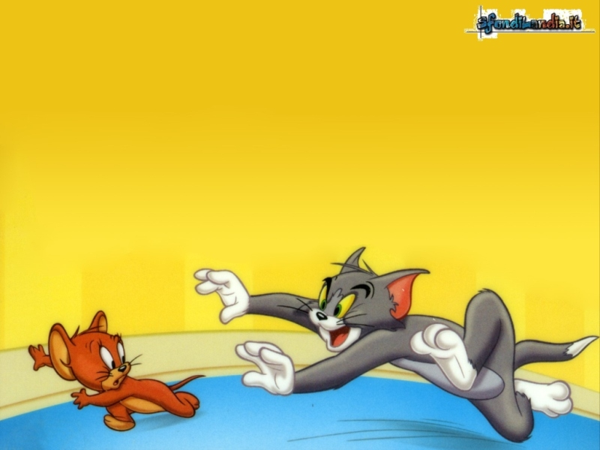
Let’s chant together
at,
cat,
rat,
A cat and a rat!
The cat chases the rat!
Perfect! You are good chanters!
Bye!

Slide 12
Let’s read together
at
A cat and a rat.
The cat chases the rat.
Bravo!
Bye!

