Slide 1
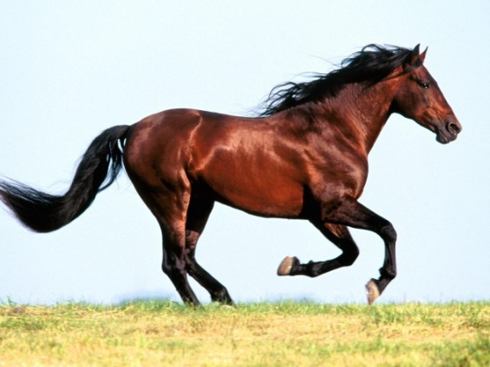
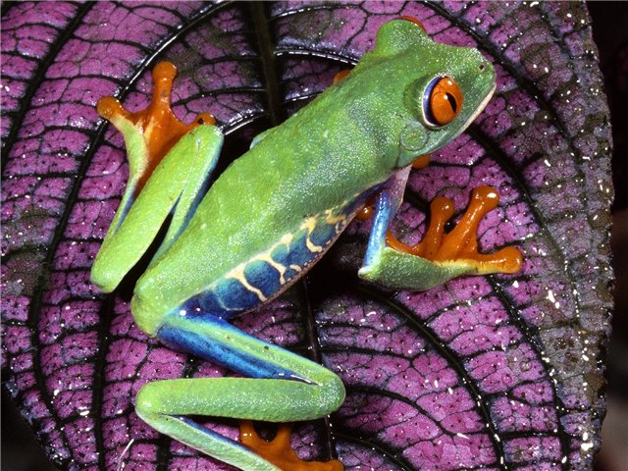
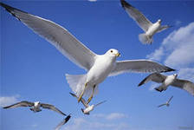
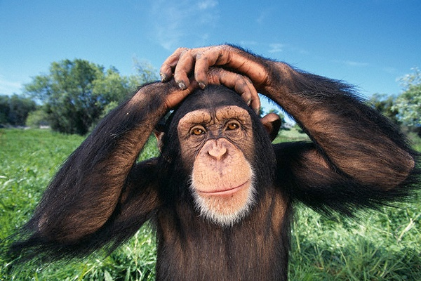
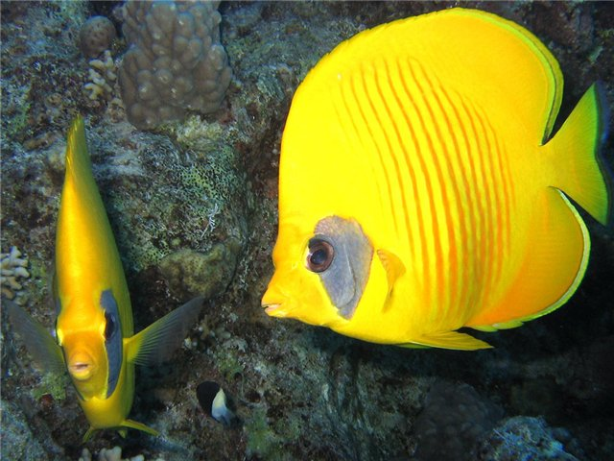
My animals
Разработала:Пьянкова Юлия Александровна
Учитель английского языка
ГБОУ СОШ №68
Г. Санкт-Петербург

Slide 2
fish
swim

Slide 3
frog
jump

Slide 4
chimp
dance

Slide 5
horse
run

Slide 6
frog
лягушка
fish
рыба
horse
лошадь
chimp
шимпанзе
bird
птица

Slide 7
frog
sing
chimp
swim
horse
dance
fish
jump
bird
run

Slide 8
What can a frog do?
A frog can jump.
What can a horse do?
A horse can run.

Slide 9
What can a bird do?
A bird can sing.
What can a fish do?
A fish can swim.

Slide 10
What ̕ s this?
What ̕ s this?

Slide 11
What ̕ s this?
What ̕ s this?

Slide 12
What ̕ s this?

Slide 13
I can swim like a fish.
I can jump like a frog.

Slide 14
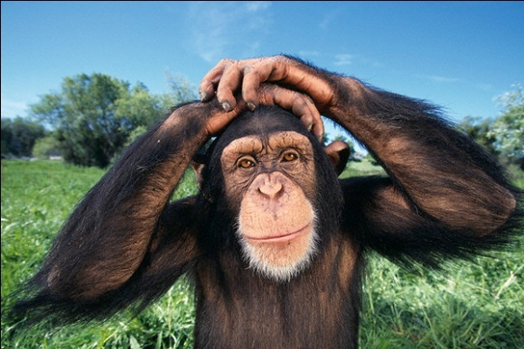
I can sing like a bird.
I can dance like a chimp.
I can run like a horse.

Slide 15
Thank you!

