Slide 1
KAZAN is the host city of the Universiade 2013

Slide 2
The Key mission of volunteers is to help.
That is why the stylized image of a funny disheveled small man was chosen as Kazan 2013 volunteers logotype.

Slide 3
On the one hand this logotype is a smile on the other hand it is an open palm that has always been a symbol of sincerity, goodwill and help.
The Five colors of the palm are the five brand colors of the International University Sports Federation (FISU), symbolizing the 5 continents of the Globe.

Slide 4
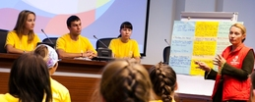
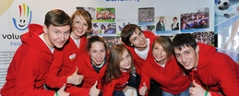
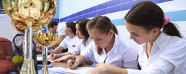
How to be a good volunteer
Be selfless
Be well-trained
Be dependable
Be enthusiastic
Be open-minded
Be respectful
Be cooperative
Be understanding
Be humble
Be friendly

Slide 5
Kazan 2013 volunteers’ slogan “Make U real” reflects the importance of each volunteer in holding large-scale sports event and a huge amount of opportunities that the Universiade 2013 offers to all the participants.

Slide 6
The mascot of the Universiade in Kazan is Uni, the kitten of winged snow leopard.

Slide 7
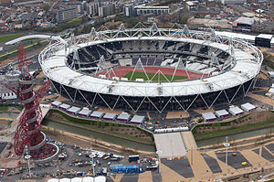
Sports objects in Kazan and in London
“Kazan – Arena” is “ Olympic stadium”
a unique stadium

Slide 8
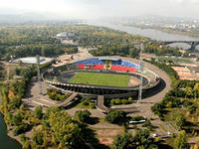
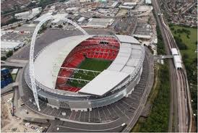
“Center Stadium” “Wembley Stadium”

Slide 9
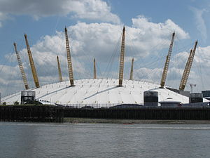
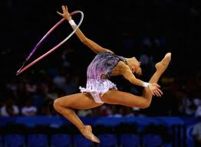
“Gymnastics Palace” “The 02 Arena”

Slide 10
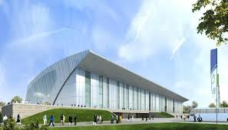
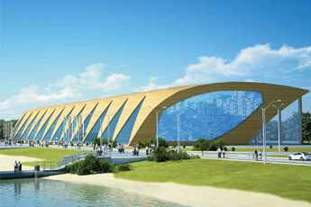
“The Palace of Water Sports” “London Aquatics Centre”

Slide 11
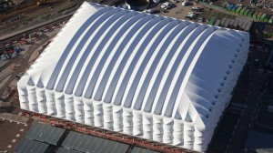
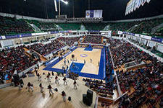
“The Baskethall” “The Basketball Arena”

Slide 12
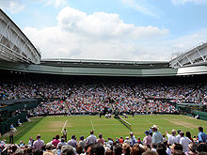
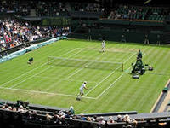
Tennis Academy All England Lawn Tennis and Croquet Club (AEL TC)

Slide 13
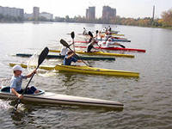
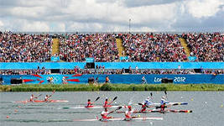
Centre of rowing sports Hyde Park

