Slide 1
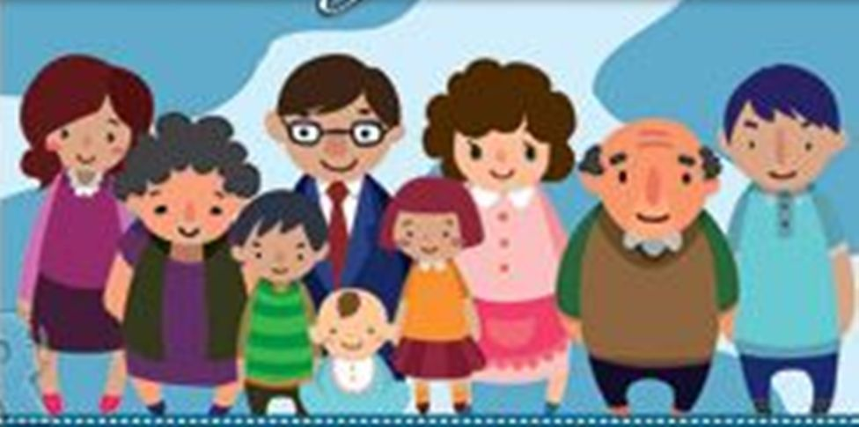
My family

Slide 2
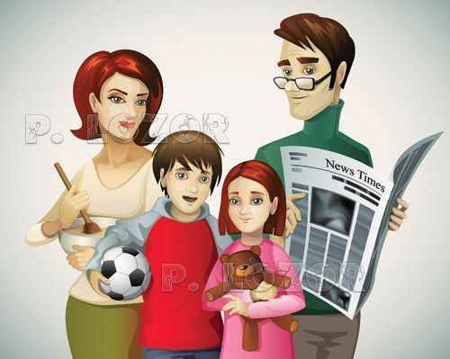
This is Mother
This is Father
This is Brother
This is Sister

Slide 3
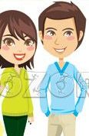
This is Uncle
This is Aunt

Slide 4
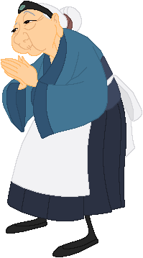
This is Grandmother

Slide 5
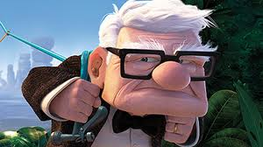
This is Grandfather

