Slide 1
Let’s do phonetic exercises

Slide 2
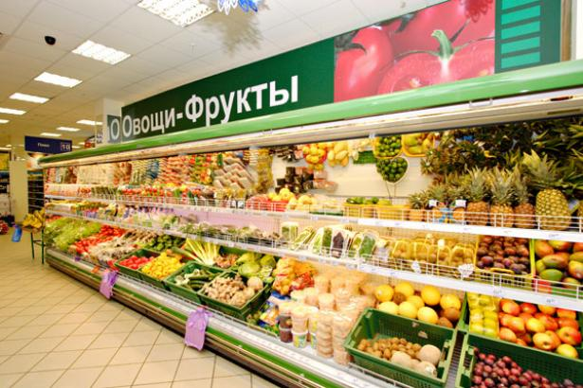
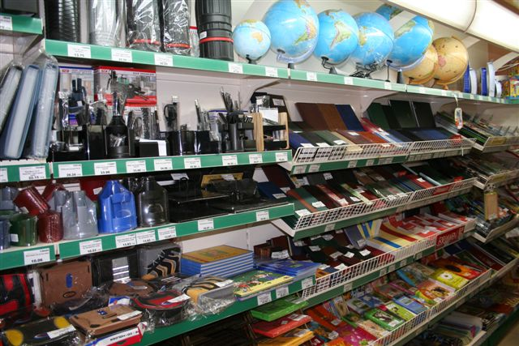
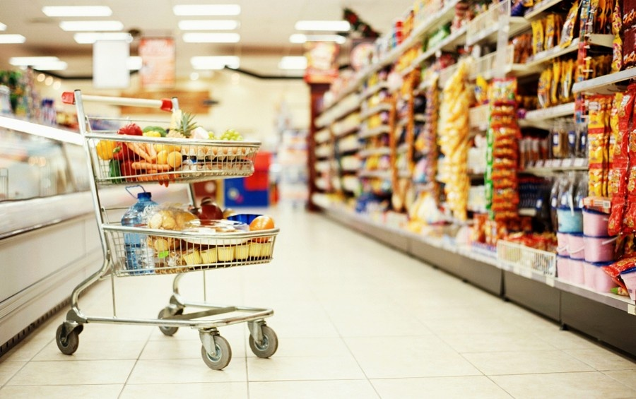
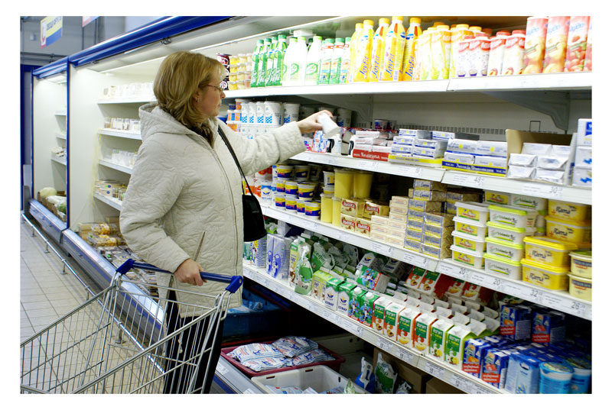
Let’s go to the shop!

Slide 3
Game “Agree or disagree”
You like corn.
Cats drink coffee.
Rabbits eat fish.
Your friends like ice cream.
Birds eat cheese.
Parrots drink juice.
Your brother/sister likes a cake.
Dogs drink milk.

Slide 4
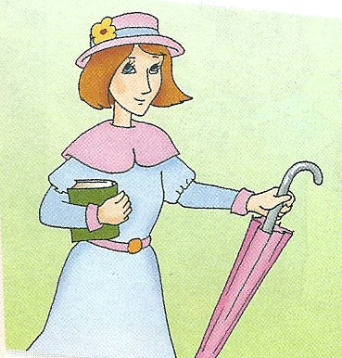
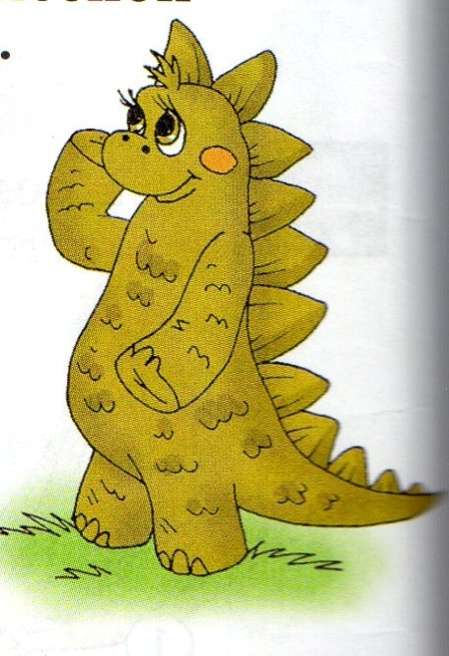
They would like to buy….

Slide 5
I think I can buy ………………in the Green shop. I think I can buy..……………. in the White shop. I think I can buy……………… in the Sweet shop. I think I can buy …………….. in the School shop.

Slide 7
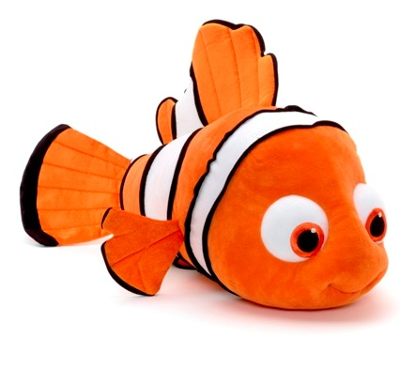
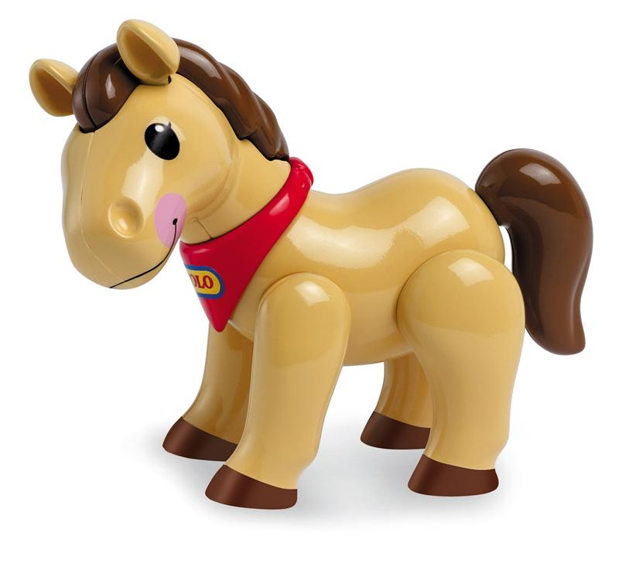
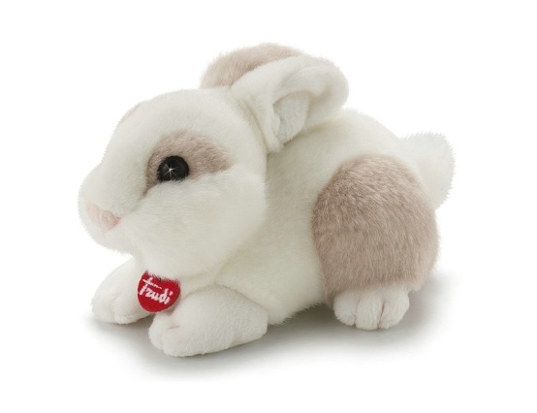
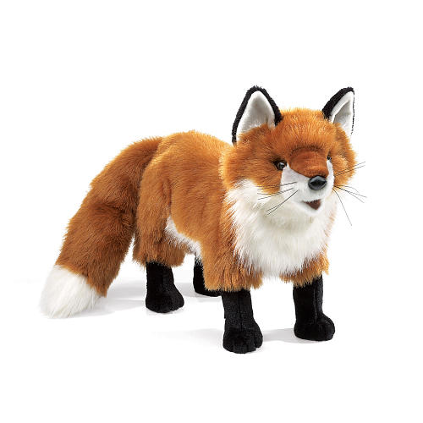
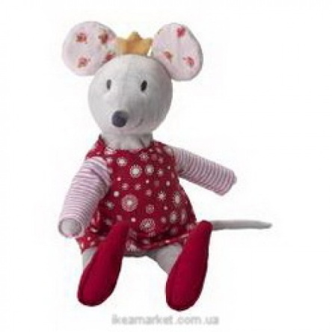
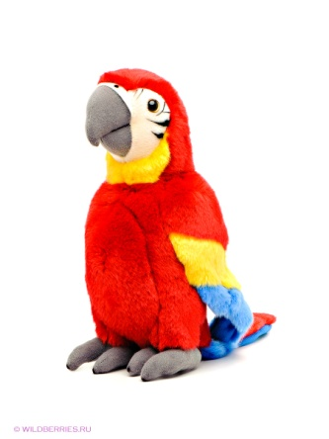
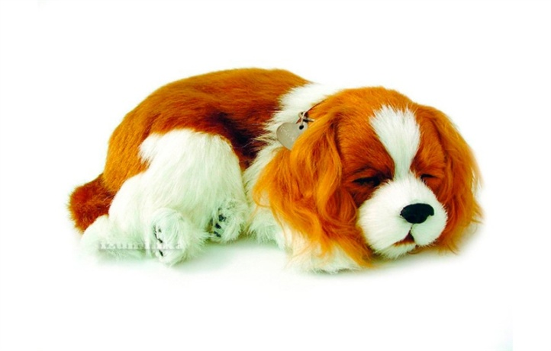

Slide 8
1. What’s the bird’s name?
2.Is the bird big?
3. What does Rocky eat?
4. What can the parrot do?
5. Can the bird speak or dance?
6. Can the bird speak well?
7. Do Mr Greenwood and his pet like to play chess on Monday?
8. What can’t the parrot do?
9. Who teaches Rocky to read?

