Slide 1
The English Quiz

Slide 2
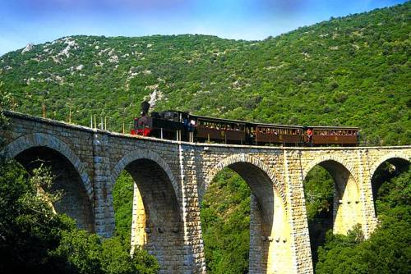
Have a good voyage!

Slide 3
It gives us milk and butter too. It is very kind and likes to moo!

Slide 4
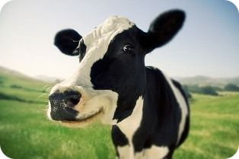

Slide 5
My long, thin legs are good and fast, I like to gallop and to run!

Slide 6
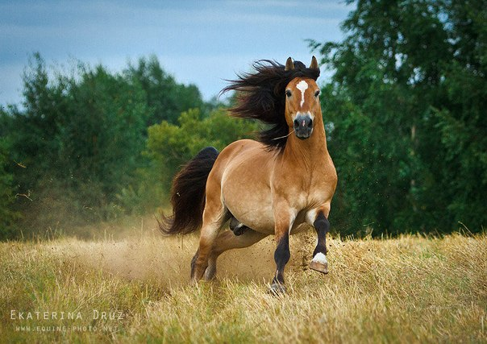

Slide 7
I can go without food and water for a long time!

Slide 8
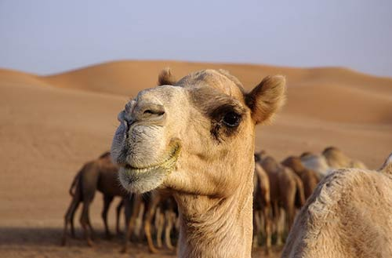

Slide 9
I’m green and big. I live in the water and like to eat meat!

Slide 10
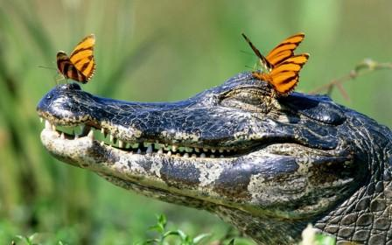

Slide 11
1. I a pupil.
2. You from England.
3. My dad tall and strong.
4. My mum very good.
5. This dog fat.
6. We big.
7. Pete and Bob students.
8. It interesting book.
is
are
am
am
are
are
is
am
is
are
is
am

Slide 12
s
1. Ann and Mike is pupils. 2. We English are. 3. I have five book. 4. They has two stars. 5. What is your names? 6. I see one dogs. 7. Pete run in the park.
8. You often swims in the river.
have
s
s
s
s
are

Slide 13
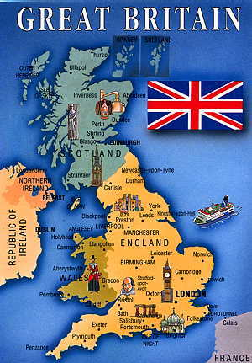
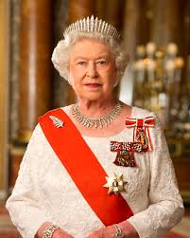

Slide 14
