Slide 1
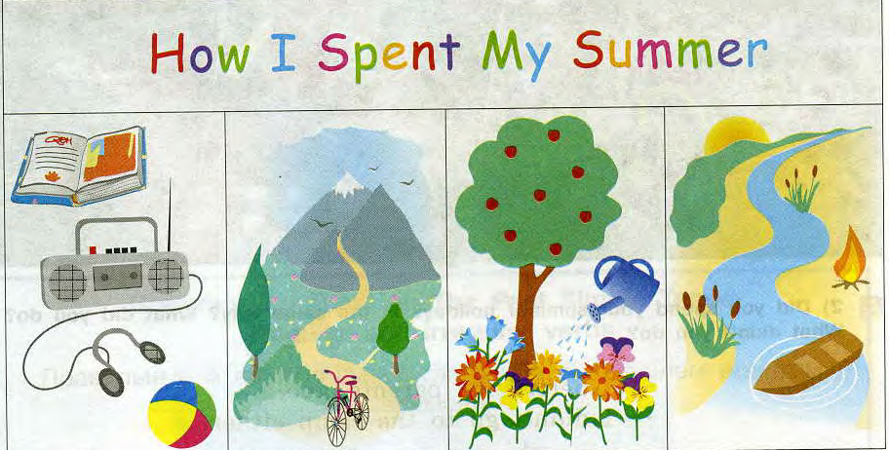

Slide 2
Summer
June
July
August
in

Slide 3
Past simple
+
ed
( 2).
did not
-
? Did
?

Slide 6
Неправильные глаголы
ride rode
read read
go went
do did
swim swam
see saw
take took

Slide 7
[t] | [d] | [id]
liked | played | visited
watched | listened | invited
danced | watered | wanted
helped | travelled | collected
worked | enjoyed | started

Slide 9
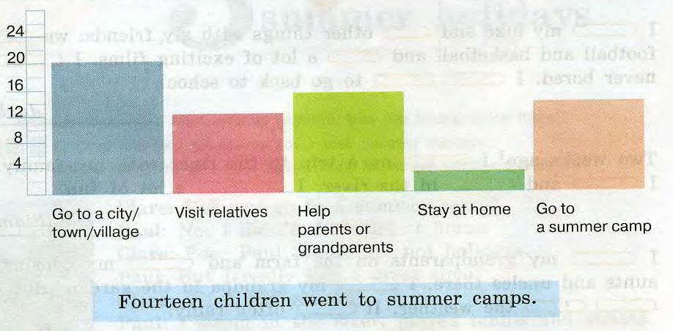

Slide 10
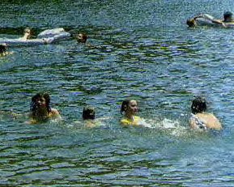
Finish the sentences
1. In June I
2. In June I did not
3. In July I
4. In July I did not
5. In August I
6. In August I didn’t

