Slide 1
Today is the 15th of April. It’s Friday.
Let’s read the poem
Spring is green.
Summer is bright!
Autumn is yellow.
Winter is white.

Slide 2
MY FAVOURITE SEASON
LEARN NEW WORDS
ENDING –S (ES)
STORY ABOUT A SEASON

Slide 3
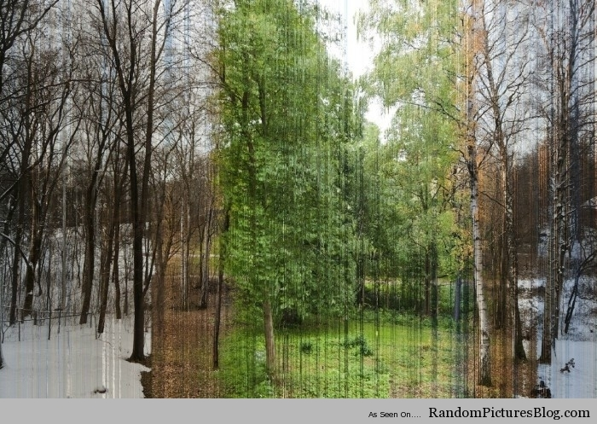

Slide 4
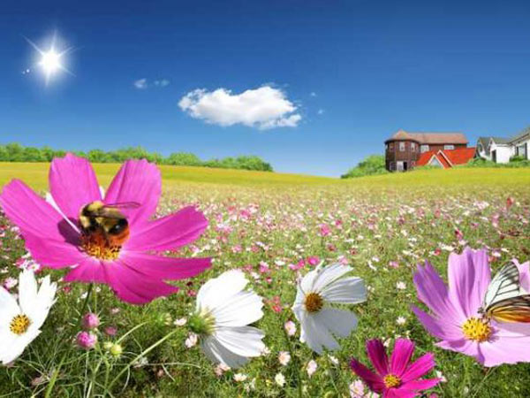

Slide 5
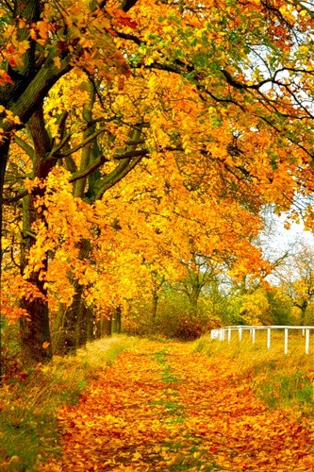

Slide 6
