Slide 1
The 15th of April.

Slide 2
3.
 |  |  |  | 6.
 |  | 4.
 | s |  | 5. |  | d
1. |  |  | 2.
 | a | g |  | c
Translate into Russian:
Лето 4. цветы
музыка 5. осень
весна 6. зима

Slide 3
3.
 |  |  |  | 6.
 |  | 4.
 | s |  | 5. |  | d
1. S |  |  | 2.
u
m
m | a | g |  | c
e
r
Translate into Russian:
Лето 4. цветы
музыка 5. осень
весна 6. зима

Slide 4
3.
 |  |  |  | 6.
 |  | 4.
 | s |  | 5. |  | d
1. S |  |  | 2. m
u |  |  | u
m |  |  | s
m | a | g | i | c
e |  |  | C
r
Translate into Russian:
Лето 4. цветы
музыка 5. осень
весна 6. зима

Slide 5
3. s
p |  |  |  | 6.
r |  | 4.
i | s |  | 5. |  | d
n
g
1. S |  |  | 2. m
u |  |  | u
m |  |  | s
m | a | g | i | c
e |  |  | C
r
Translate into Russian:
Лето 4. цветы
музыка 5. осень
весна 6. зима

Slide 6
3. s
p |  |  |  | 6.
r |  | 4. f
i | s | l | 5. |  | d
n |  | o
g |  | w
 |  | e
 |  | r
 |  | s
1. S |  |  | 2. m
u |  |  | u
m |  |  | s
m | a | g | i | c
e |  |  | C
r
Translate into Russian:
Лето 4. цветы
музыка 5. осень
весна 6. зима

Slide 7
3. s
p |  |  |  | 6.
r |  | 4. f
i | s | l | 5. a |  | d
n |  | o | u
g |  | w | t
 |  | e | u
 |  | r | m
 |  | s | n
1. S |  |  | 2. m
u |  |  | u
m |  |  | s
m | a | g | i | c
e |  |  | C
r
Translate into Russian:
Лето 4. цветы
музыка 5. осень
весна 6. зима

Slide 8
3. s
p |  |  |  | 6. w
r |  | 4. f |  | i
i | s | l | 5. a | n | d
n |  | o | u | t
g |  | w | t | e
 |  | e | u | r
 |  | r | m
 |  | s | n
1. S |  |  | 2. m
u |  |  | u
m |  |  | s
m | a | g | i | c
e |  |  | C
r
Translate into Russian:
Лето 4. цветы
музыка 5. осень
весна 6. зима

Slide 9
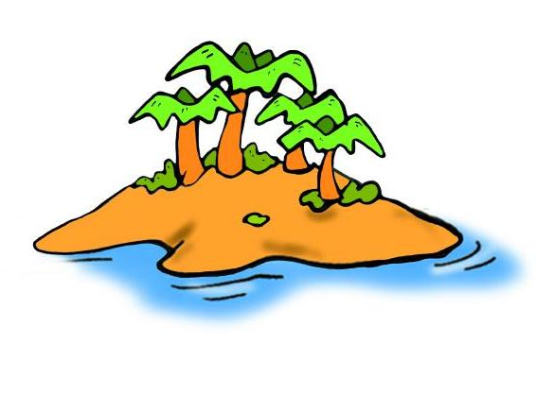
A magic island!

Slide 10
Let´s sing!

Slide 11
A magic island!
What is the weather like?

Slide 12
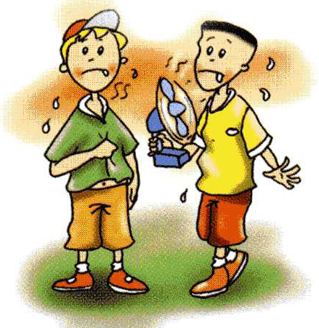
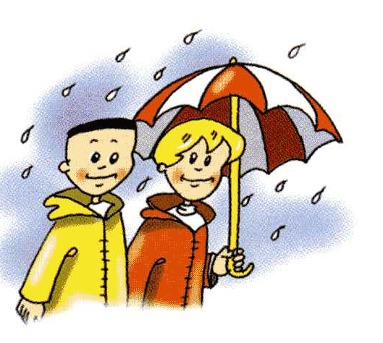
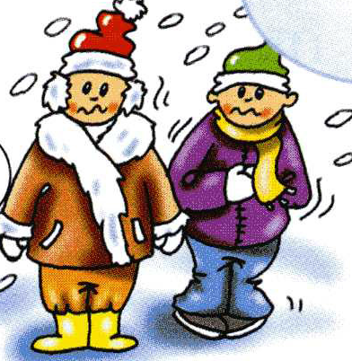
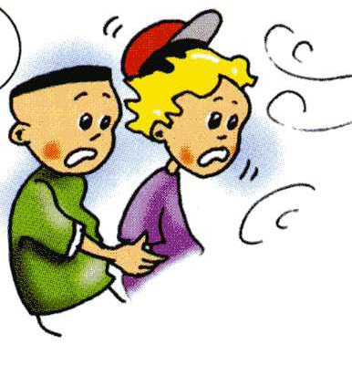

Slide 13
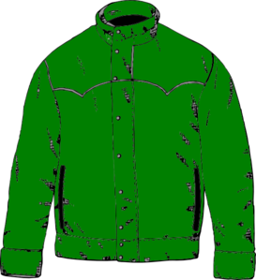
1. It´s sunny. I´m wearing my
,
and
.
2. It´s raining. He´s wearing his
,
and
.
3. It´s hot. She´s wearing her
,
and
.

Slide 14
It´s ………. today.
I´m wearing ……. .

Slide 15
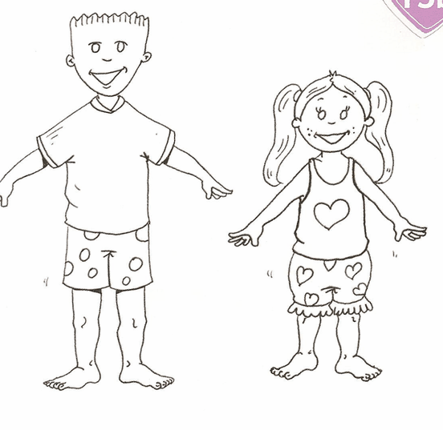
Let´s dress Larry and Lulu!

Slide 16
H/t:
WB ex. 3-4 p. 59

