Slide 1

Государственное бюджетное общеобразовательное учреждение
школа №394
Красносельского района города Санкт-Петербурга
урок по английскому языку
в 8 классе
What can we do to save the Earth?
Учитель: Степанова Людмила Викторовна

Slide 2

Phonetic drill
[ I ] ecology, eclipse, effect, enough, eruption.
[ p ] protect, pollution, pack, prohibit, prevention.
[ d ] dangerous, endangered, damage, desert, destroy.

Slide 3
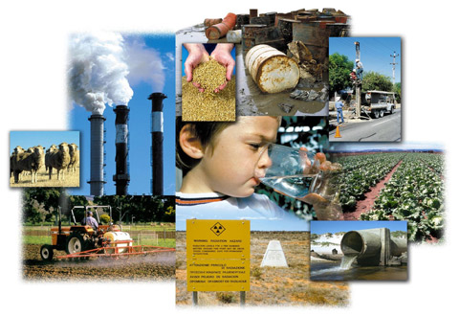
Problems of ecology

Slide 4
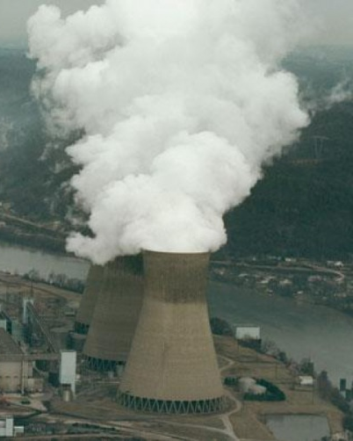
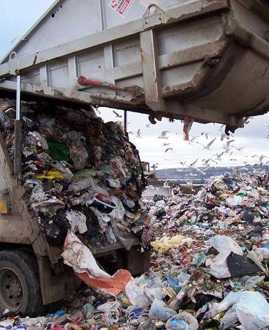
Problems of ecology

Slide 5
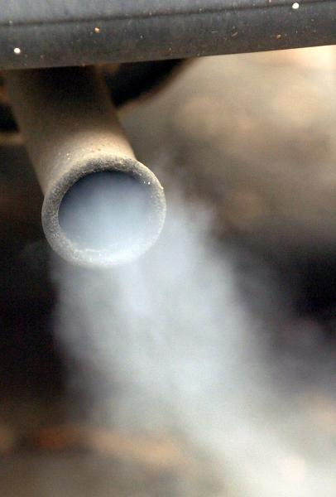
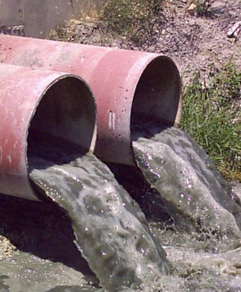
Problems of ecology

Slide 6

Speech drill
We can protect…
We can save...
We can help…

Slide 7
New words
Avoid – избегать, стараться не делать что-либо.
Avoid such people
Avoid talking to…/ using something
Avoid being recognized
least – наименьший, по крайней мере, последний
The least money/ time
At least

Slide 8
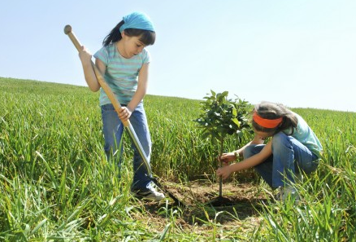
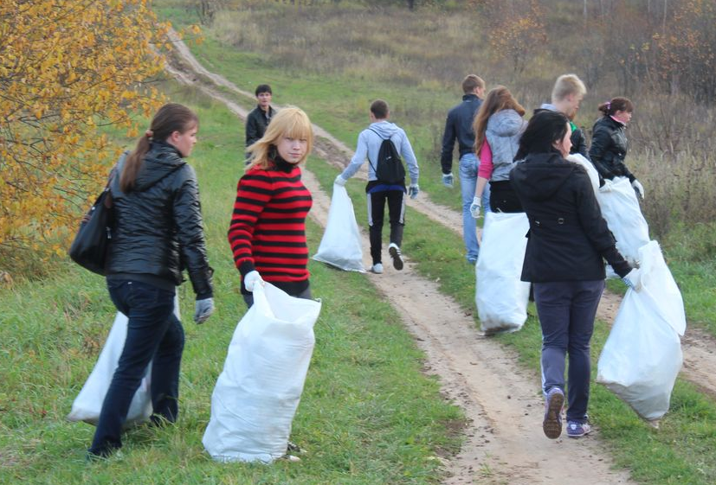



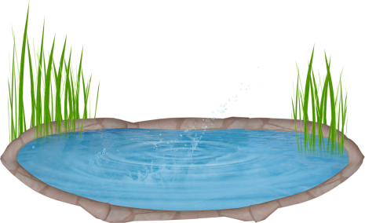

Slide 9
Complete the sentences:
If all the people decided to save our world, …
If people took cans, bottles, papers to local recycling centres, …
If people bought only the things they really needed, …
If people tried to walk or cycle instead of driving cars, …
If people didn’n drop litter in the country side, …
If people avoided buying packed goods, …
If people didn’t waste paper, …

Slide 10

Miriam Mackley. уроки\louis_armstrong_-_wonderful_world.mp3
The world needs a friend
To love and depend on
In times of trouble…
The world has hope yet
If the children let it
And if we do it right
Together we can make the world
A better place
Because the world’s best friend
Is you!

