Slide 1
SIGHTS OF LONDON

Slide 2
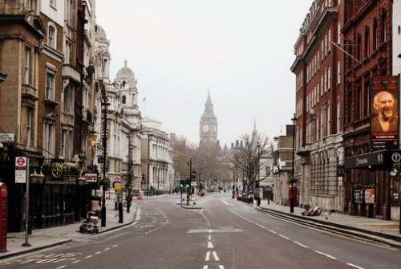

Slide 3
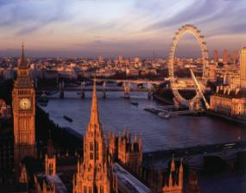
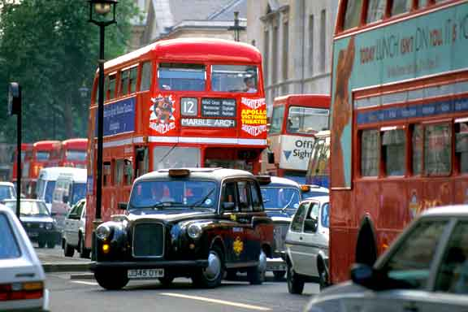
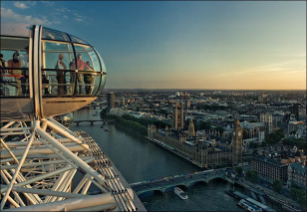
then to hear about it a hundred times
It’s better to see something once

Slide 4
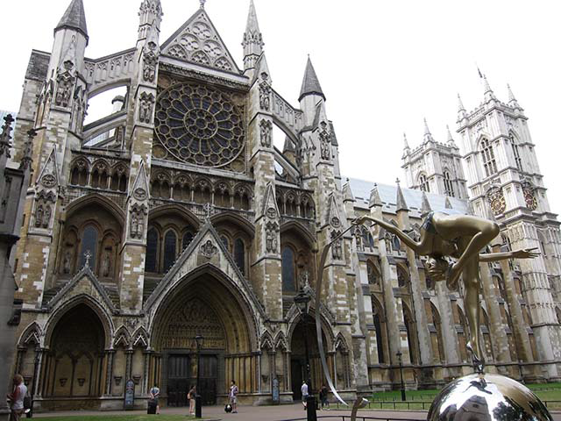
Westminster Abbey

Slide 5
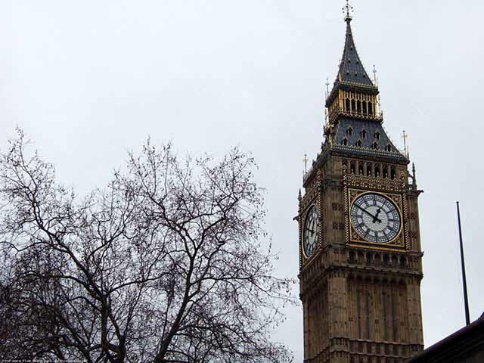
Big Ben

Slide 6
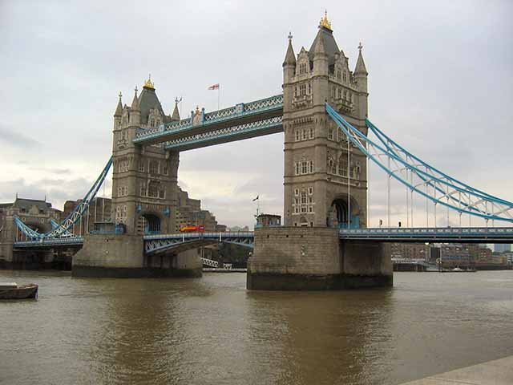
The Tower of London

Slide 7
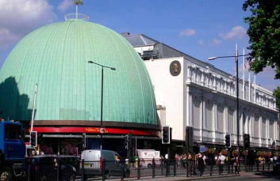
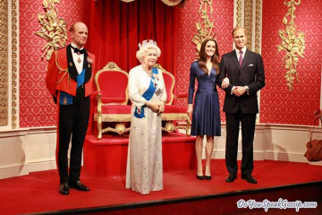
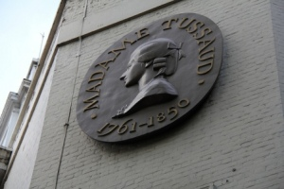
Madam Tussaud’s Museum

Slide 8
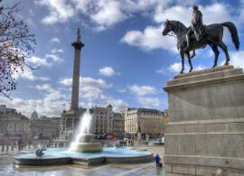
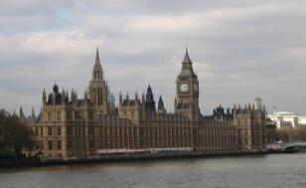
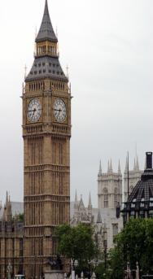
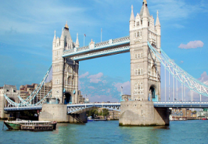
It’s a clock in the tower and it is a big bell. You can hear it every hour
It’s a place where the British Government sits. It’s the largest modern building. It consists of three parts: the Royal Apartments, the House of Lords and the House of Commons
It’s the oldest and famous bridge across the Thames. Originally it was made of wood by the Romans, but it was burnt down. It was rebuilt and made of concrete
It is the central square of London and traditional place for people to meet : all sorts of protest meetings are held there. The statue of national hero Admiral Nelson stands there

Slide 9
“Say true or false”
Buckingham Palace is the official residence of the Queen
The Tower of London used to be a palace, a fortress and a prison
The Nelson’s column is situated on Trafalgar square
Big Ben is a beautiful London museum
The Houses of Parliament consist of two Houses
The Changing of the guard takes place near the Tower Bridge

Slide 10
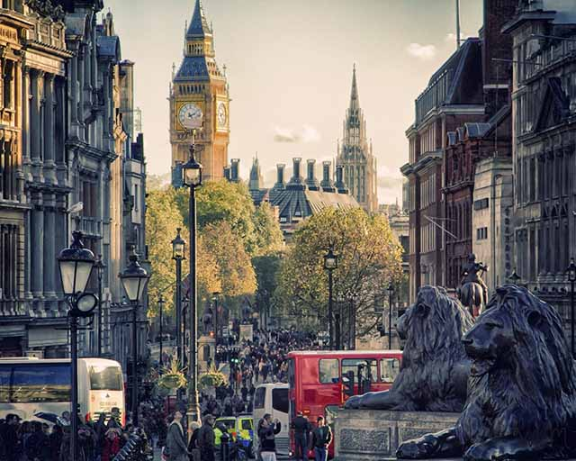
Thank you for the lesson

