Slide 1
Old and New Art

Slide 2
Art movements
Abstract /'æbstrækt/ art
Romanticism /rəʊˈmæntɪˌsɪzm/
Cubism /ˈkjuːbɪzm/
Expressionism /ɪkˈspreʃnˌɪzm/
Classicism /ˈklæsɪˌsɪzm/
Realism /ˈrɪəˌlɪzm/
Surrealism /səˈrɪəˌlɪzm/

Slide 3
Topical Vocabulary
to create one’s work
to follow different tendencies and styles
to be connected with the art of ancient Greece (Rome, …)
to be influenced by the art of ancient Greece (Rome, …)
to develop Cubism (Expressionism,…)
to prefer
to be famous
masterpiece
complicated colour scheme [skiːm]

Slide 4
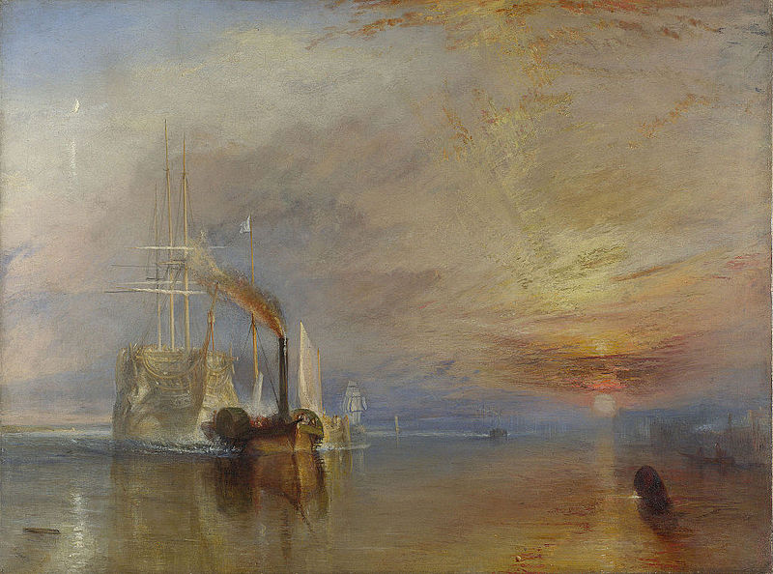
The Fighting Temeraire William Turner

Slide 5
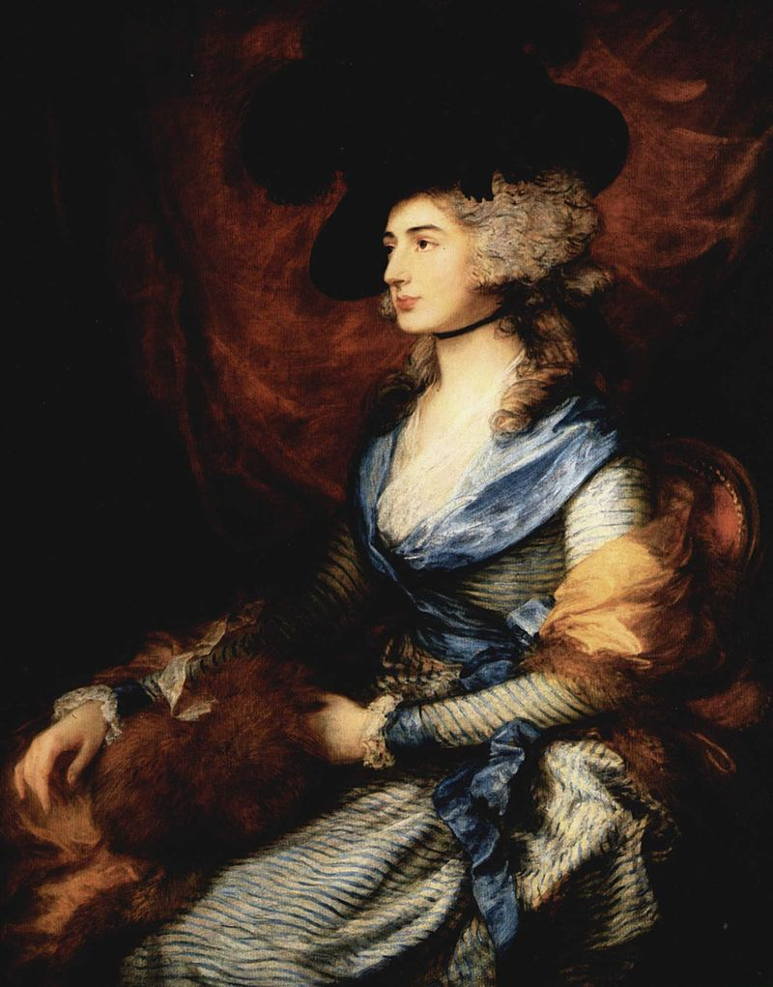
Mrs. Siddons

Slide 6
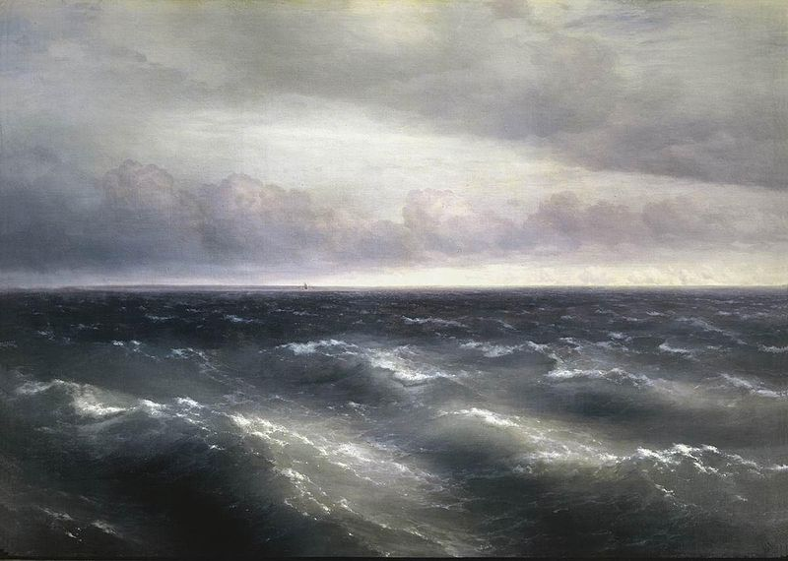
The Black Sea

Slide 7
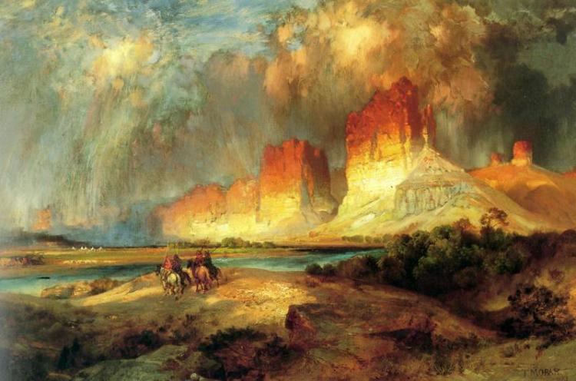
Cliffs of the Upper Colorado River
Thomas Morgan

