Slide 1
Урок повторения
Подготовила:
Учитель английского языка: СОШ с. Заволжское
Абушинова Н.В.

Slide 2
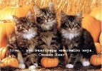
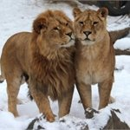
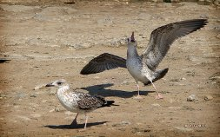
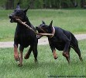
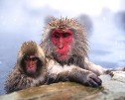
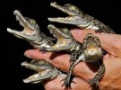
How many … are there?

Slide 3
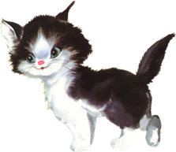
Where is the cat?

Slide 4
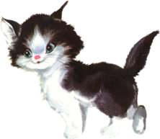
Where is the cat?

Slide 5
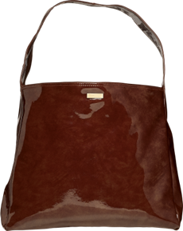
Where is the cat?

Slide 6
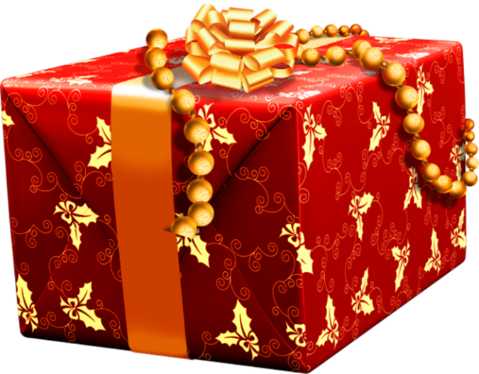
Where is the cat?

Slide 7
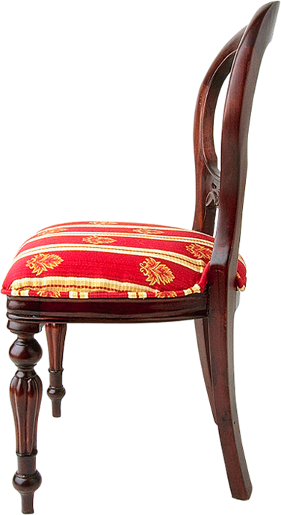
Where is the cat?

Slide 8
Translate
I like salad
I don’t like salad
I like pizza
I don’t like pizza
I like milk shake
I don’t like milk shake

Slide 9
Translate
Misha likes milk shake
Misha doesn’t like bananas
Kate likes apples
Kate doesn’t like milk
He likes burgers
He doesn’t like pizza
She doesn’t like burgers

