Slide 1
The weather forecast
Прогноз погоды

Slide 2
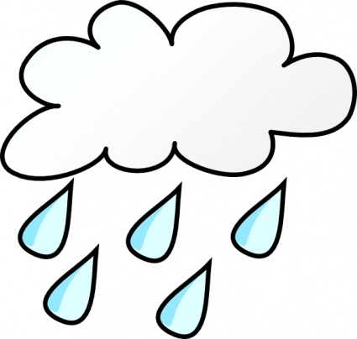
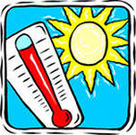
The weather forecast for tomorrow
Moscow
Sochi

Slide 3
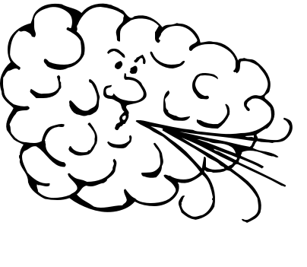
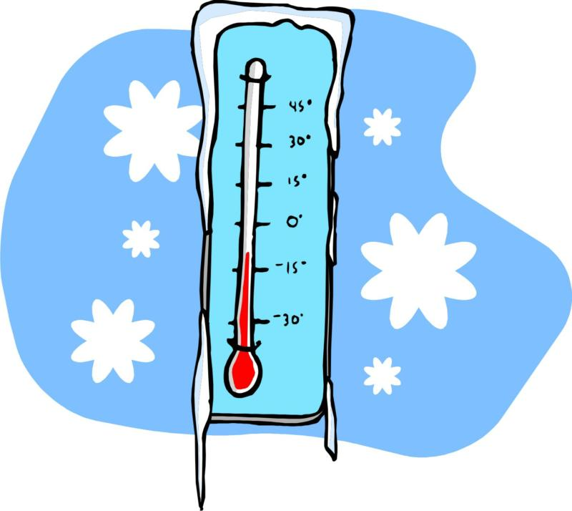
The weather forecast for tomorrow
Kazan
Yakutsk

Slide 4
The weather forecast for tomorrow
Tomsk
Vladimir

