Slide 1
We are going to the Moon

Slide 2
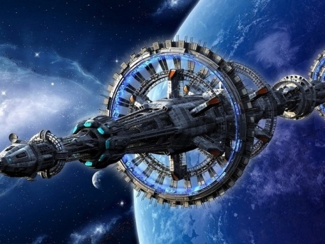
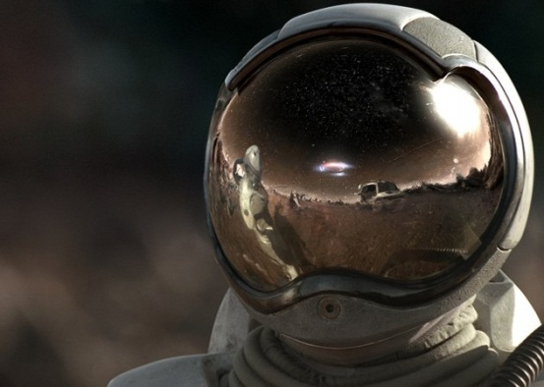
Spaceship
Helmet
A rocket

Slide 3
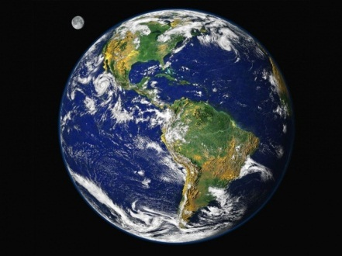
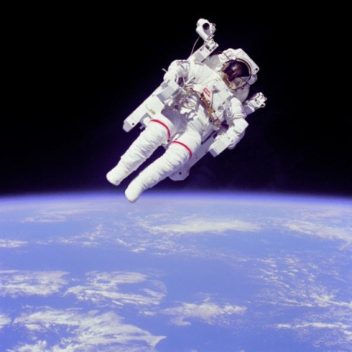
The Earth
An astronaut
The Moon

Slide 4
go
do
lift
sit
ing
walk
put
take

Slide 5
am
To be is Ving
are
I am making a robot
He is putting on his helmet
We are flying to the moon

