Slide 1
The 10-th of October Friday

Slide 2
[æ]
[æ]
[æ]

Slide 3
[æ]
A cat
A black cat
A black cat sat on a mat
A black cat sat on a mat and ate
A black cat sat on a mat and ate a fat rat

Slide 4
[æ]
cat
black
sat
mat
fat
rat

Slide 5
[æ]
A cat
A black cat
A black cat sat on a mat
A black cat sat on a mat and ate
A black cat sat on a mat and ate a fat rat

Slide 6
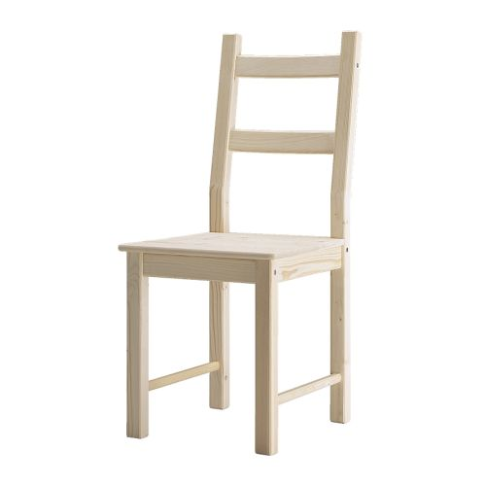
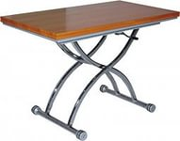
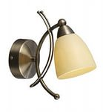
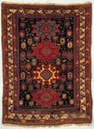
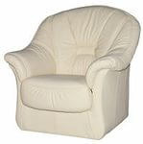
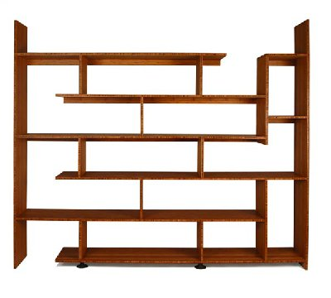
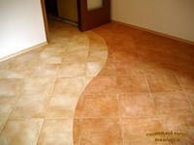
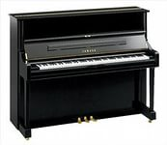
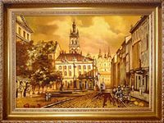
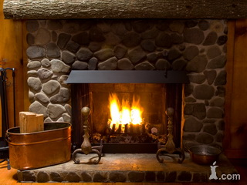
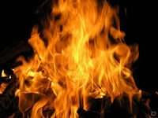
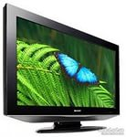
Picture
Fireplace
TV
Fire
Shelf
Chair
Floor
Piano
Carpet
Armchair
Lamp
Table

Slide 7
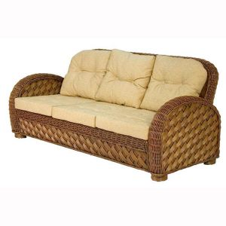

Slide 8
What do you have at home?
A have a TV at home.

Slide 9
There is…
There are…
There is a picture in the living room.

Slide 10
There are … in the living room
There are books in the living room

Slide 11
Is
there a
-говорим об одном предмете
Are
there any
-говорим о нескольких предметах

Slide 12
Is there a…?
Yes, there is./ No, there isn’t
Is there a sofa in the living room?
Yes, there is.
Is there the piano in the living room?
No, there isn’t

Slide 13
Are there any…?
Yes, there are./ No, there aren’t
Are there any books in the living room?
Yes, there are
Are there any toys in the living room?
No, there aren’t

Slide 14
Is there are pictures in the living room?
Are there a fireplace
fire
shelf
armchairs
lamps
piano
sofa
table
TV
chair
floor Yes, there is./ No, there isn’t – говорим об одном объекте
Yes, there are./ No there aren’t – говорим о множестве объектах

Slide 15
homework
(Wb)- p.27 ex.18 –сравнить
ex.19- читать, переводить.

