Slide 1
Answer the questions:
1.Where do you live ?
2. How many rooms are there in your flat?
3. Is your flat big or small?
4. Have you got a room of your own?
5. Do you share a room with your brother or sister?

Slide 2
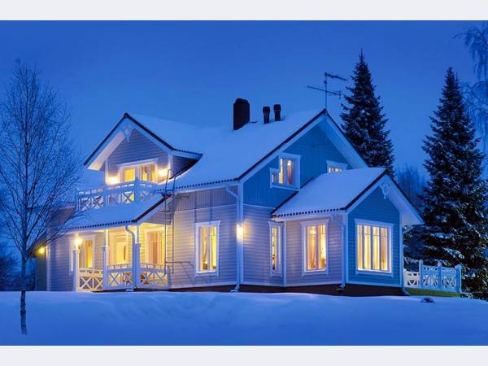
Home sweet home

Slide 3
lamp | pantry | flat
fireplace | hall | living room
home | floor | house
bathroom | table | wall
door | window | armchair
kitchen | bedroom | carpet

Slide 4
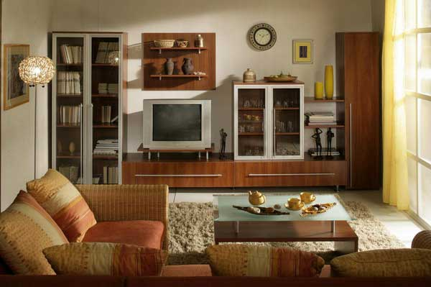

Slide 5
Find ten words:
X | R | W | C | H | A | I | R
R | I | A | H | C | M | R | A
W | V | R | P | W | S | E | U
P | O | D | Y | O | H | L | P
M | Z | R | O | D | E | B | S
A | U | O | R | N | L | A | O
L | P | B | M | I | F | T | F
A | B | E | D | W | M | A | H

Slide 6
Fill the letters:

Slide 7
