Slide 1
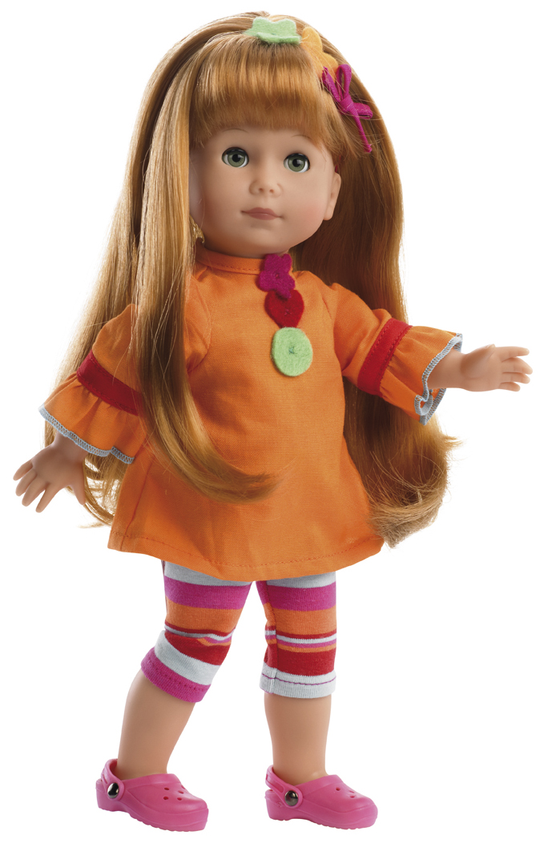
TOYS
Litvinova Tatiana
School 213

Slide 2
