Slide 1
Презентация к уроку «The Way We Look»
Подготовила Зеленская Л.Н
МБОУ СОШ №1c.Арзгир

Slide 2
Everybody says I look like my mother
Everybody says I look like my aunt Bee
Everybody says my nose is like my father’s
But I want to look like me.

Slide 3
Do you remember the parts of our body?

Slide 4
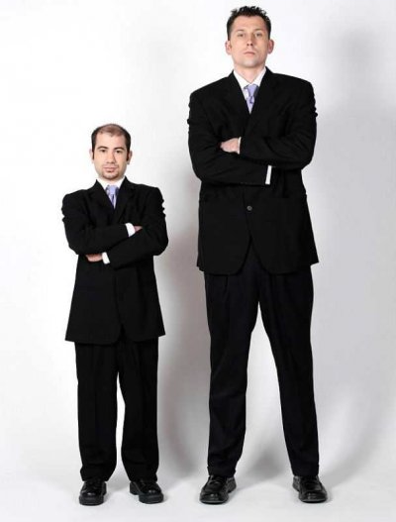
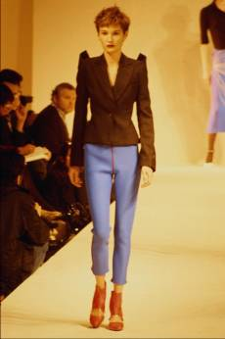
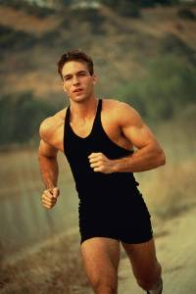
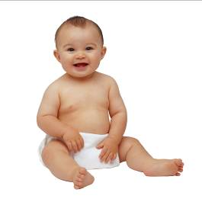
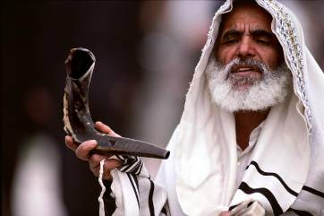
Match words and the pictures
Tall
Short
Slim
Young
Well-built
Old

Slide 5
Which parts of the body do these words describe? Complete the table.
blonde, tall, small, big, dark, slim, short, straight, tall, black, curly, fat, green, red, blue, long ,nice, turned-up, round, oval, narrow.
hair eyes body nose face

Slide 6
Do you know the meanings of these words?
Clothes

Slide 7
A coat

Slide 8
a T-shirt

Slide 9
A raincoat

Slide 10
A dress

Slide 11
A sweater

Slide 12
trousers

Slide 13
Find the odd word
1. sandals, shoes, boots, cap 2. tights, scarf, trousers, jeans 3. T-shirt, coat, shorts, sandals 4. mittens, put on, take off, wear 5. blouse, tights, shirt, sweater
You are right! Very good!

Slide 14
- Do you agree or disagree with the statements?
1.I usually wear boots in winter
2.We never wear mittens in summer.
3.Kids always put on scarf in winter.
4.Children put on their fur coats in June.
5.When it is hot we usually wear T- shirt and shorts
6.Girls always wear silk dresses in winter.
7.If it is cold, we put on socks and sandals.

Slide 15
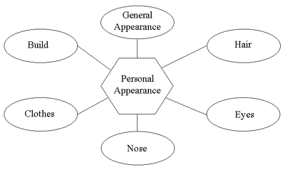
SCHEME

Slide 16
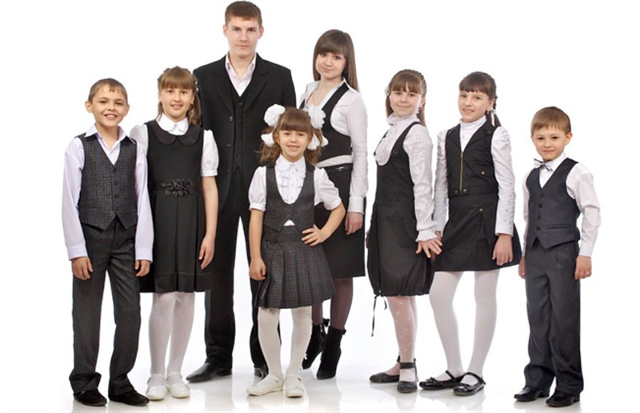
school uniform
1. Do children have a school uniform? 2. What do they wear to school? 3. What can you say about your clothes? 4. What do you wear to school? 5. What are your favourite clothes?

Slide 17
Your home task : ex.8 p. 217

