Slide 1
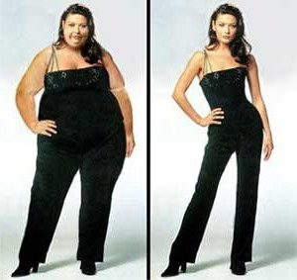
Diet
To be or not to be?

Slide 2
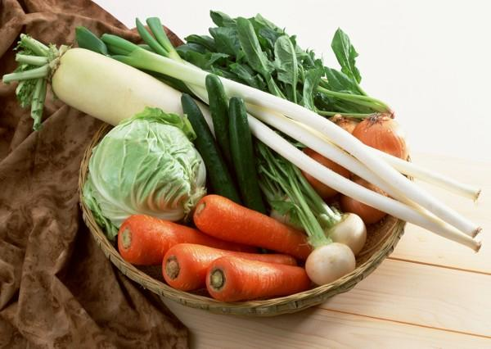
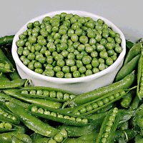
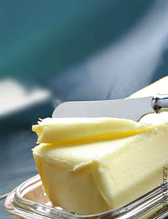
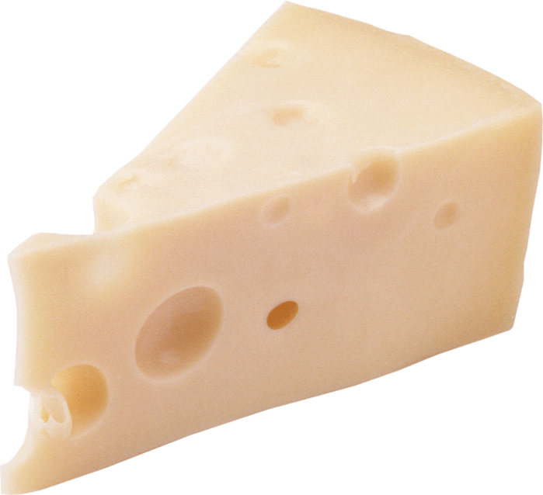
Good products
fruits
vegetables
butter
beans
cheese

Slide 3
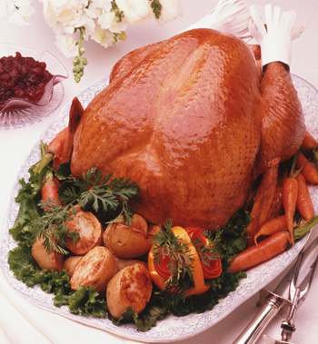
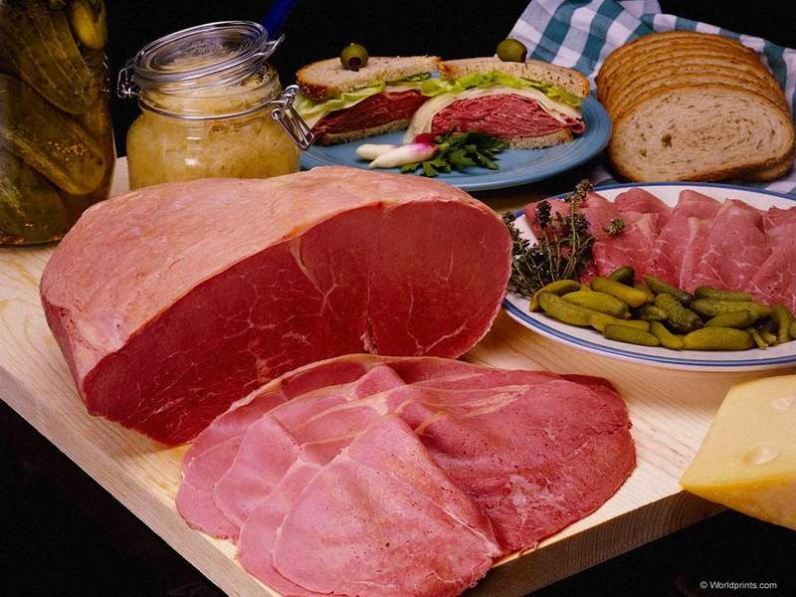
Good products
meat
poultry
fish

Slide 4
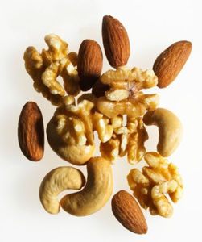
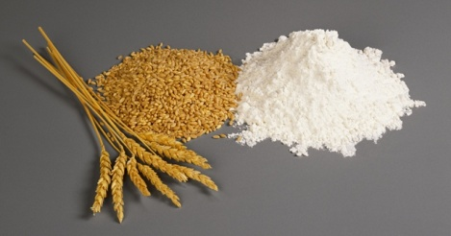
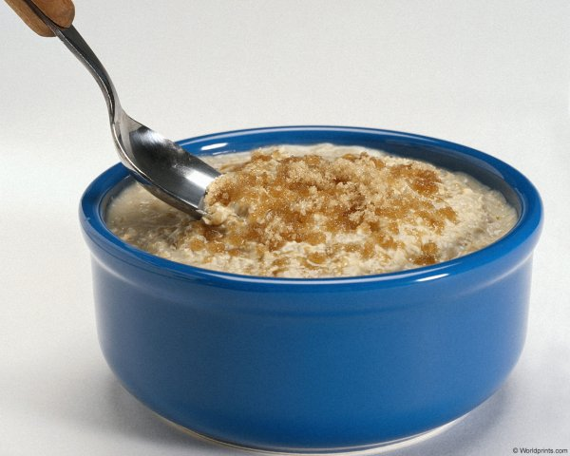
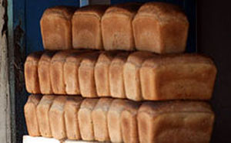
Good products
cereals
milk
nuts
porridge
brown bread

Slide 5
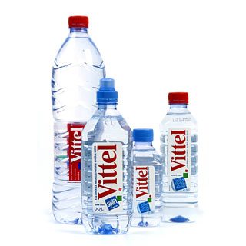
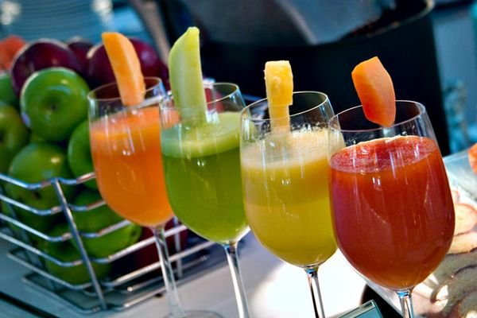
Good drinks
mineral
water
green tea
juices

Slide 6
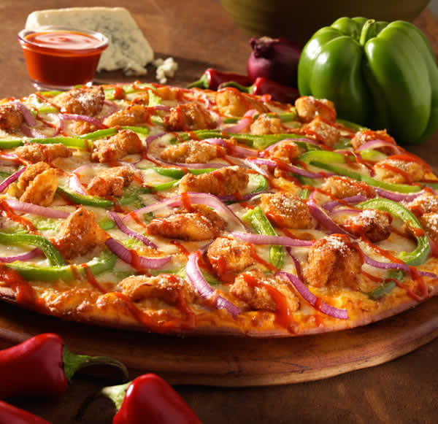
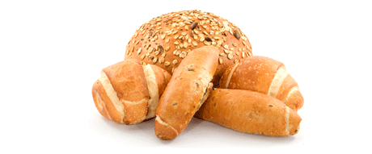
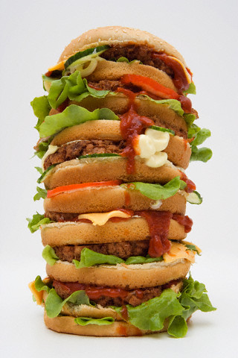
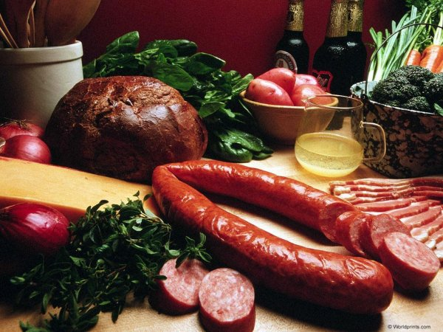
Bad products
pizza
chips
rolls
salami
hamburger

Slide 7
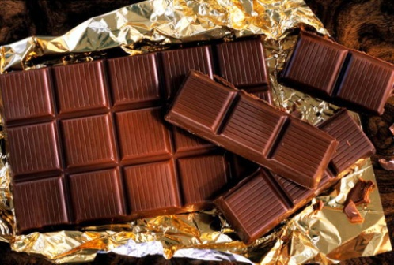
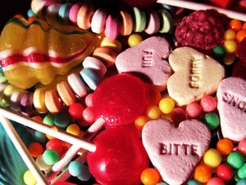
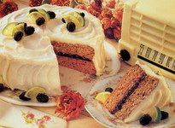
Bad products
macaronies
(pasta)
chocolate
cake
sweets

Slide 8
Bad drinks
beer
lemonade
coffee

Slide 9
A balanced food
Fruits and
vegetables
Cereals, bread,
pasta
Meat, fish,
eggs,beans
Milk
products
Fat, sweets

Slide 10
A balanced food
To look wonderful
To be healthy
What does she eat?

Slide 11
An unbalanced food
to cause health problems
to look ugly
What does he eat?

Slide 12
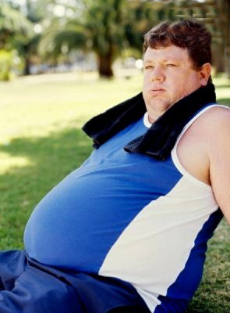
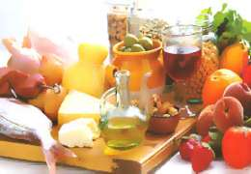
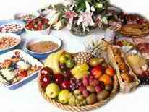
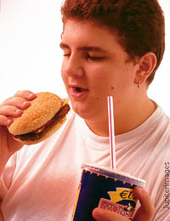
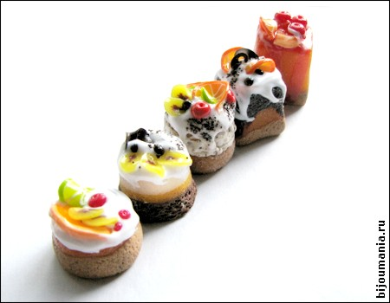
Diet: good and bad points
To keep fit to be healthy
To cut out snacks to eat less everything
To look wonderful to cause health problems
To eat more vegetables and fruits to eat a variety of food
Not to overeat to use low-calorie food
To have anaemia to cut out of sweets

Slide 13
Dictation
1
2
3
4
5

Slide 14
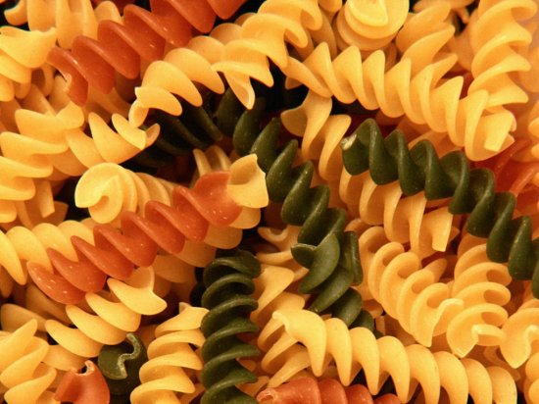
Dictation
6
7
8

