Slide 1
Merry Christmas !

Slide 2
Merry Christmas !

Slide 3
The letter from Santa Claus
Dear ….!
….. is coming!
Have you decorated your Christmas …. already?
I’ve already visited the children in …, Scotland and Wales.
stockings trees
Finland Christmas New Year
England friends guests

Slide 4
The letter from Santa Claus
Are you good children?
Are you good students?
Wait for me and I’ll come anyway!
I have prepared nice presents for you.
Bye-Bye!!!

Slide 5
Christmas is …
C _ _ _ _ _ _ _ _ T _ _ _
C _ _ _ _ _ _

Slide 6
Christmas is …
S_ _ _ _ C _ _ _ _
P _ _ _ _ _ _ _

Slide 7
Christmas is …
F _ _ _ P _ _ _ _ _
C _ _ _ _ _ _ _ _ S _ _ _ _ _ _ _ _

Slide 8
Christmas is …
C _ _ _ _ _ _ _ _ T _ _ _ _
T _ _ _ _ _

Slide 9
Christmas is …
P _ _ _ _ _ _
S _ _ _ _ _

Slide 10
Merry Christmas !

Slide 11
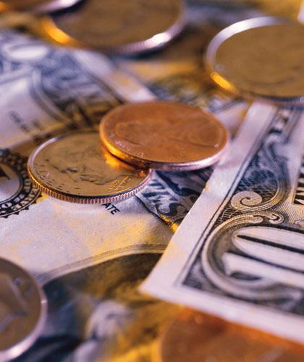
Fortune - telling

Slide 12
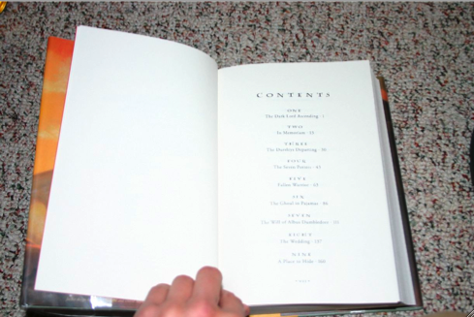
Fortune - telling

Slide 13
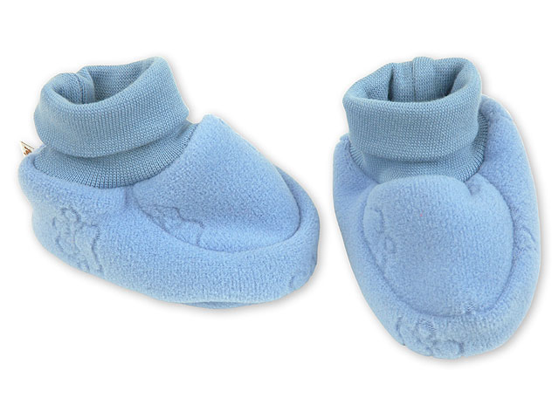
Fortune - telling

Slide 14
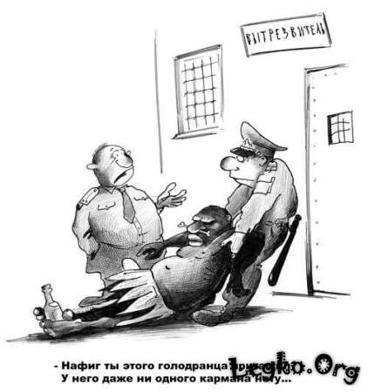
Fortune - telling

Slide 15
Fortune - telling
Справка
Дана _______________
об окончании Гончаровской средней общеобразовательной школы
Директор школы:__________ Шарин В.А.

Slide 16
Christmas is …
??????
?????

Slide 17
Merry Christmas !

