Slide 1
Учимся вести диалог - расспрос

Slide 2
th
[θ]
[ð]

Slide 3
th
[θ]

Slide 4
thank you

Slide 5
5
3
7
9
1
2
4
8
10
6

Slide 6
three
3

Slide 7
th
[θ]
thank you
three

Slide 8
th
[ð]

Slide 9
th
[ð]
this
they

Slide 10
th
[θ]
thank you
three
[ð]
this
they

Slide 11
This is Nora.

Slide 12
This is Rob.

Slide 13
This is Bob.

Slide 14
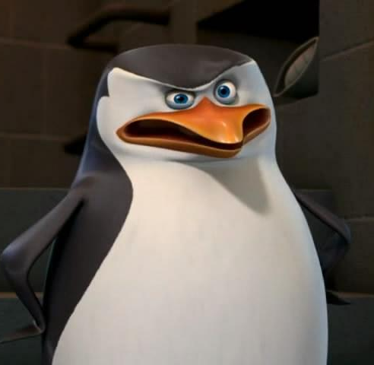
This is Skipper.

Slide 15
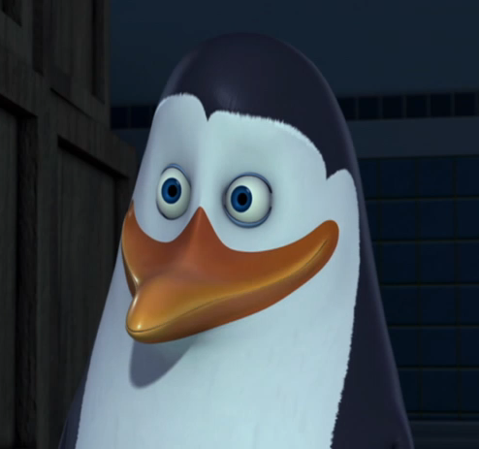
This is Skipper.
This is Kowalski.

Slide 16
a girl
a boy

Slide 17
This is Denzil, my friend.

